Slide 1
Trends in Postsecondary Data Policy & Institutional Data Use
Mamie Voight
Vice President of Policy Research
Institute for Higher Education Policy
October 25, 2018

Slide 2
IHEP is a research, policy, and advocacy organization that works to promote college access, success, and affordability, particularly for low-income students and students of color.

Slide 3
IHEP Policy Priorities: Equity First
Use high-quality data to improve student outcomes
Strengthen and protect need-based financial aid
Enhance postsecondary opportunities for individuals impacted by the criminal justice system
Foster increased college access and degree completion for all students, especially underrepresented students and students who stop out

Slide 4

The Postsecondary Data Collaborative (PostsecData) brings together organizations
committed to the use of high-quality data to promote student success and educational equity.
Image source: Maryland GovPics

Slide 5
Equity Imperative for Data: Lack of transparency masks inequities.
Policymakers, the public, students, and institutions can’t answer key questions about student access, success, outcomes, and equity, like:
How do college access, affordability, and completion vary by race, ethnicity, and income?
How many community college students transfer to four-year colleges?
After students transfer, do they go on to graduate?
Which students go on to succeed in the workforce?

Slide 6
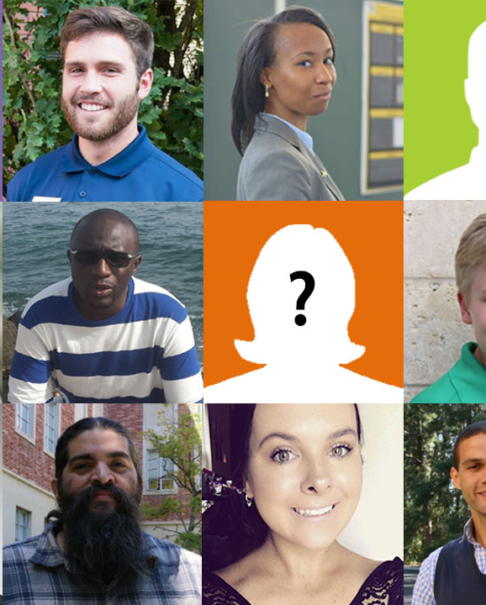
Federal metrics fall short,
Fail to count all students
Image source: Count All Students Campaign, Association of Public & Land-grant Universities

Slide 7





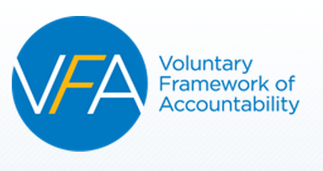


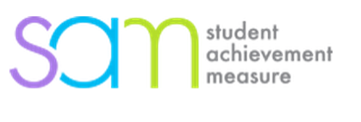

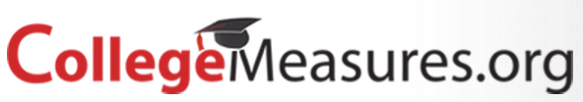
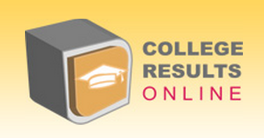
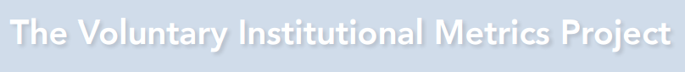
Striving for better data

Slide 8
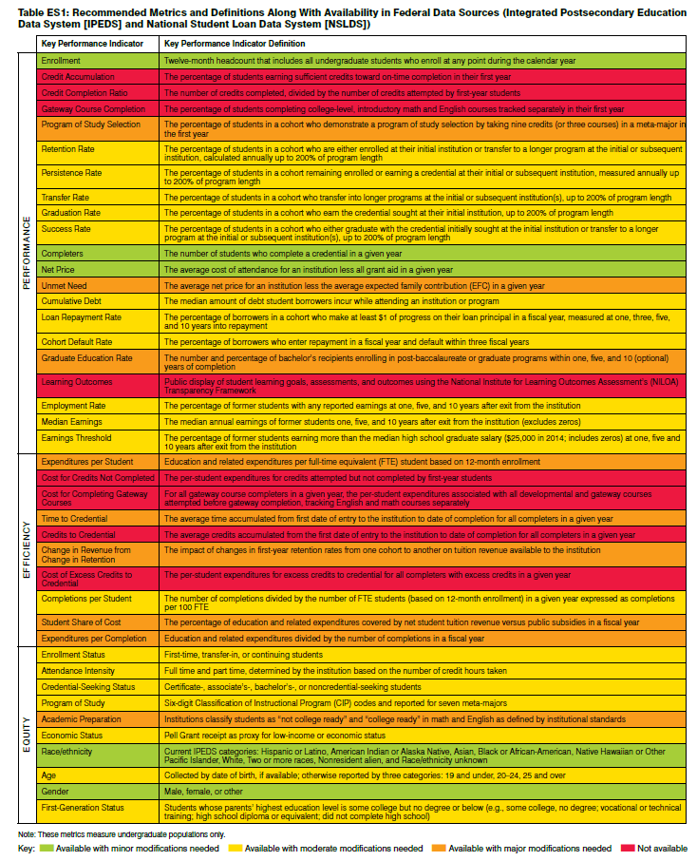
Toward Convergence: Postsecondary Metrics Framework
Toward Convergence: A Technical Guide for the Postsecondary Metrics Framework

Slide 9
Why don’t we have better data?

Slide 10
Data systems are incomplete, duplicative, inefficient, and burdensome

Slide 11
Can’t we do better?

Slide 12
Can’t we do better?
Yes.

Slide 13
Can’t we do better?
Yes.
Create a secure, privacy-protected student-level data network.

Slide 14
Why SLDN?
Promote evidence-based decision making for students, policymakers, and institutions
Students have a right to know expected outcomes before investing time and money.
Institutions need streamlined reporting to minimize burden; need to know how students fare after leaving their institution.
Policymakers require quality information to steward taxpayer investment.
All stakeholders need quality information to examine and close equity gaps.

Slide 15


Slide 16

Policy Solution: College Transparency Act (CTA)
Bipartisan, bicameral
15 Senate and 33 House co-sponsors
Hatch (R-UT), Cassidy (R-LA), Warren (D-MA), Whitehouse (D-RI)
Mitchell (R-MI) and Polis (D-CO)
130+ supporting organizations

Slide 17
What about privacy and security?
Student privacy is of the utmost importance: Limit who can access which data for what purposes
Data minimization: Limit what data are collected
Data access: Limit who can access data (house at NCES)
Data use: Limit how data can be used
Data governance: Guide system implementation

Slide 18
How are institutions using the data they do have?

Slide 19

Leading with Data
How senior institution and system leaders use postsecondary data to promote student success

Slide 20
Leading with Data
Lead by example to set a culture of data use for institutional improvement.
Distribute data responsibilities widely.
Reach beyond campus boundaries to find and use data.
Save a seat at the data policy table.

Slide 21
Set a culture of data use
Ask, ask, ask for data and only make decisions when provided with evidence
Require department heads to bring data to regular meetings
Create a data-driven, campus-wide student success committee – and meet regularly to discuss the data
Start with practice-relevant questions

Slide 22
Set a culture of data use
Help today’s students: Early alert systems
Help tomorrow’s students: Uncover and address systemic barriers

Slide 23
Distribute data responsibilities widely
Value the IR office
But involve others: registrar, financial aid, academic advising, student affairs, business services, faculty

Slide 24
Reach beyond campus boundaries to find and use data
Consider state and federal data sources
IPEDS for benchmarking
State longitudinal data systems
State UI records
Federal workforce outcomes (e.g. UT-Census partnership)
Local data on workforce needs

Slide 25
Save a seat at the data policy table
Incorporate institutional views into data policy conversations

Slide 26
Coming soon…
Metrics Framework Guidebook
Interactive Policy Summit

Slide 27
Interactive Policy Summit
Co-hosted with Association for Institutional Research (AIR) in Summer 2019
Ideal team includes executive leadership, IR, IT, government relations, other data producers and users (e.g. enrollment managers)
Primary goals:
Foster a data-informed culture on campus designed to improve student success.
Generate conversation and knowledge sharing between institution and policy experts.
Strengthen advocacy among institutional representatives to encourage engagement in state and federal policy discussions.

Slide 28
Thank you!
Mamie Voight
mvoight@ihep.org
@IHEPTweets
@PostsecData

