Slide 1

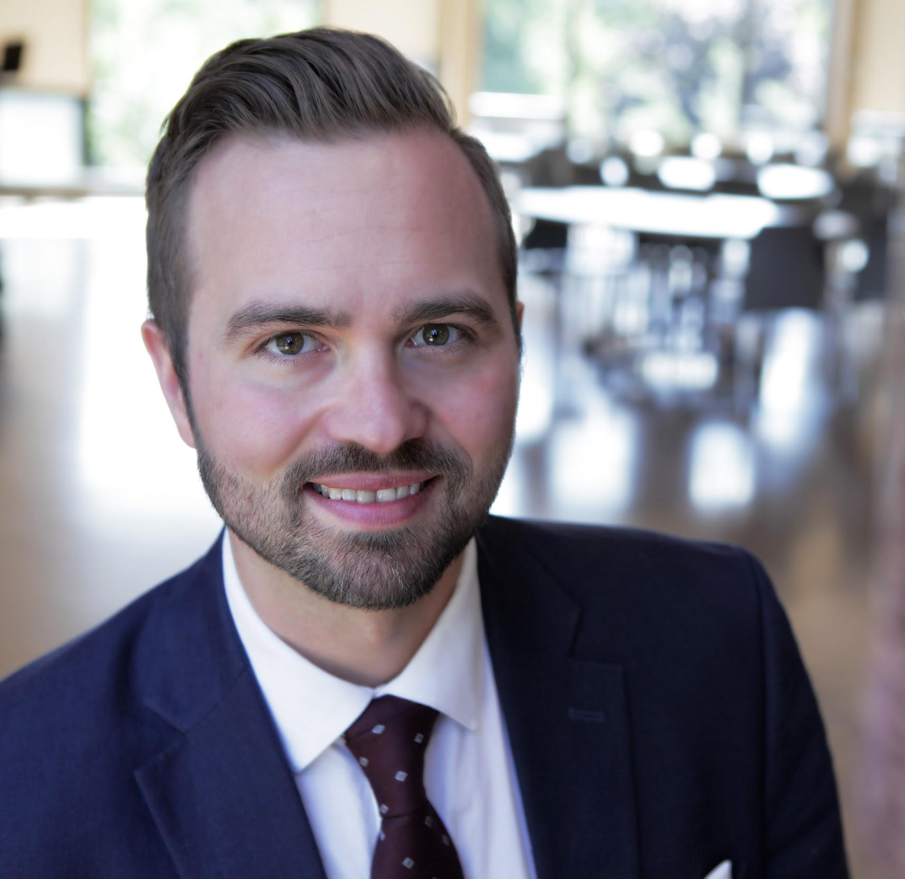


Employer Sponsored Pipeline Programs
Lee George
Executive Director, Strommen Center for Meaningful Work
LGeorge@Augsburg.edu
@LeePeterGeorge
www.LinkedIn.com/in/LeePeterGeorge

Slide 2
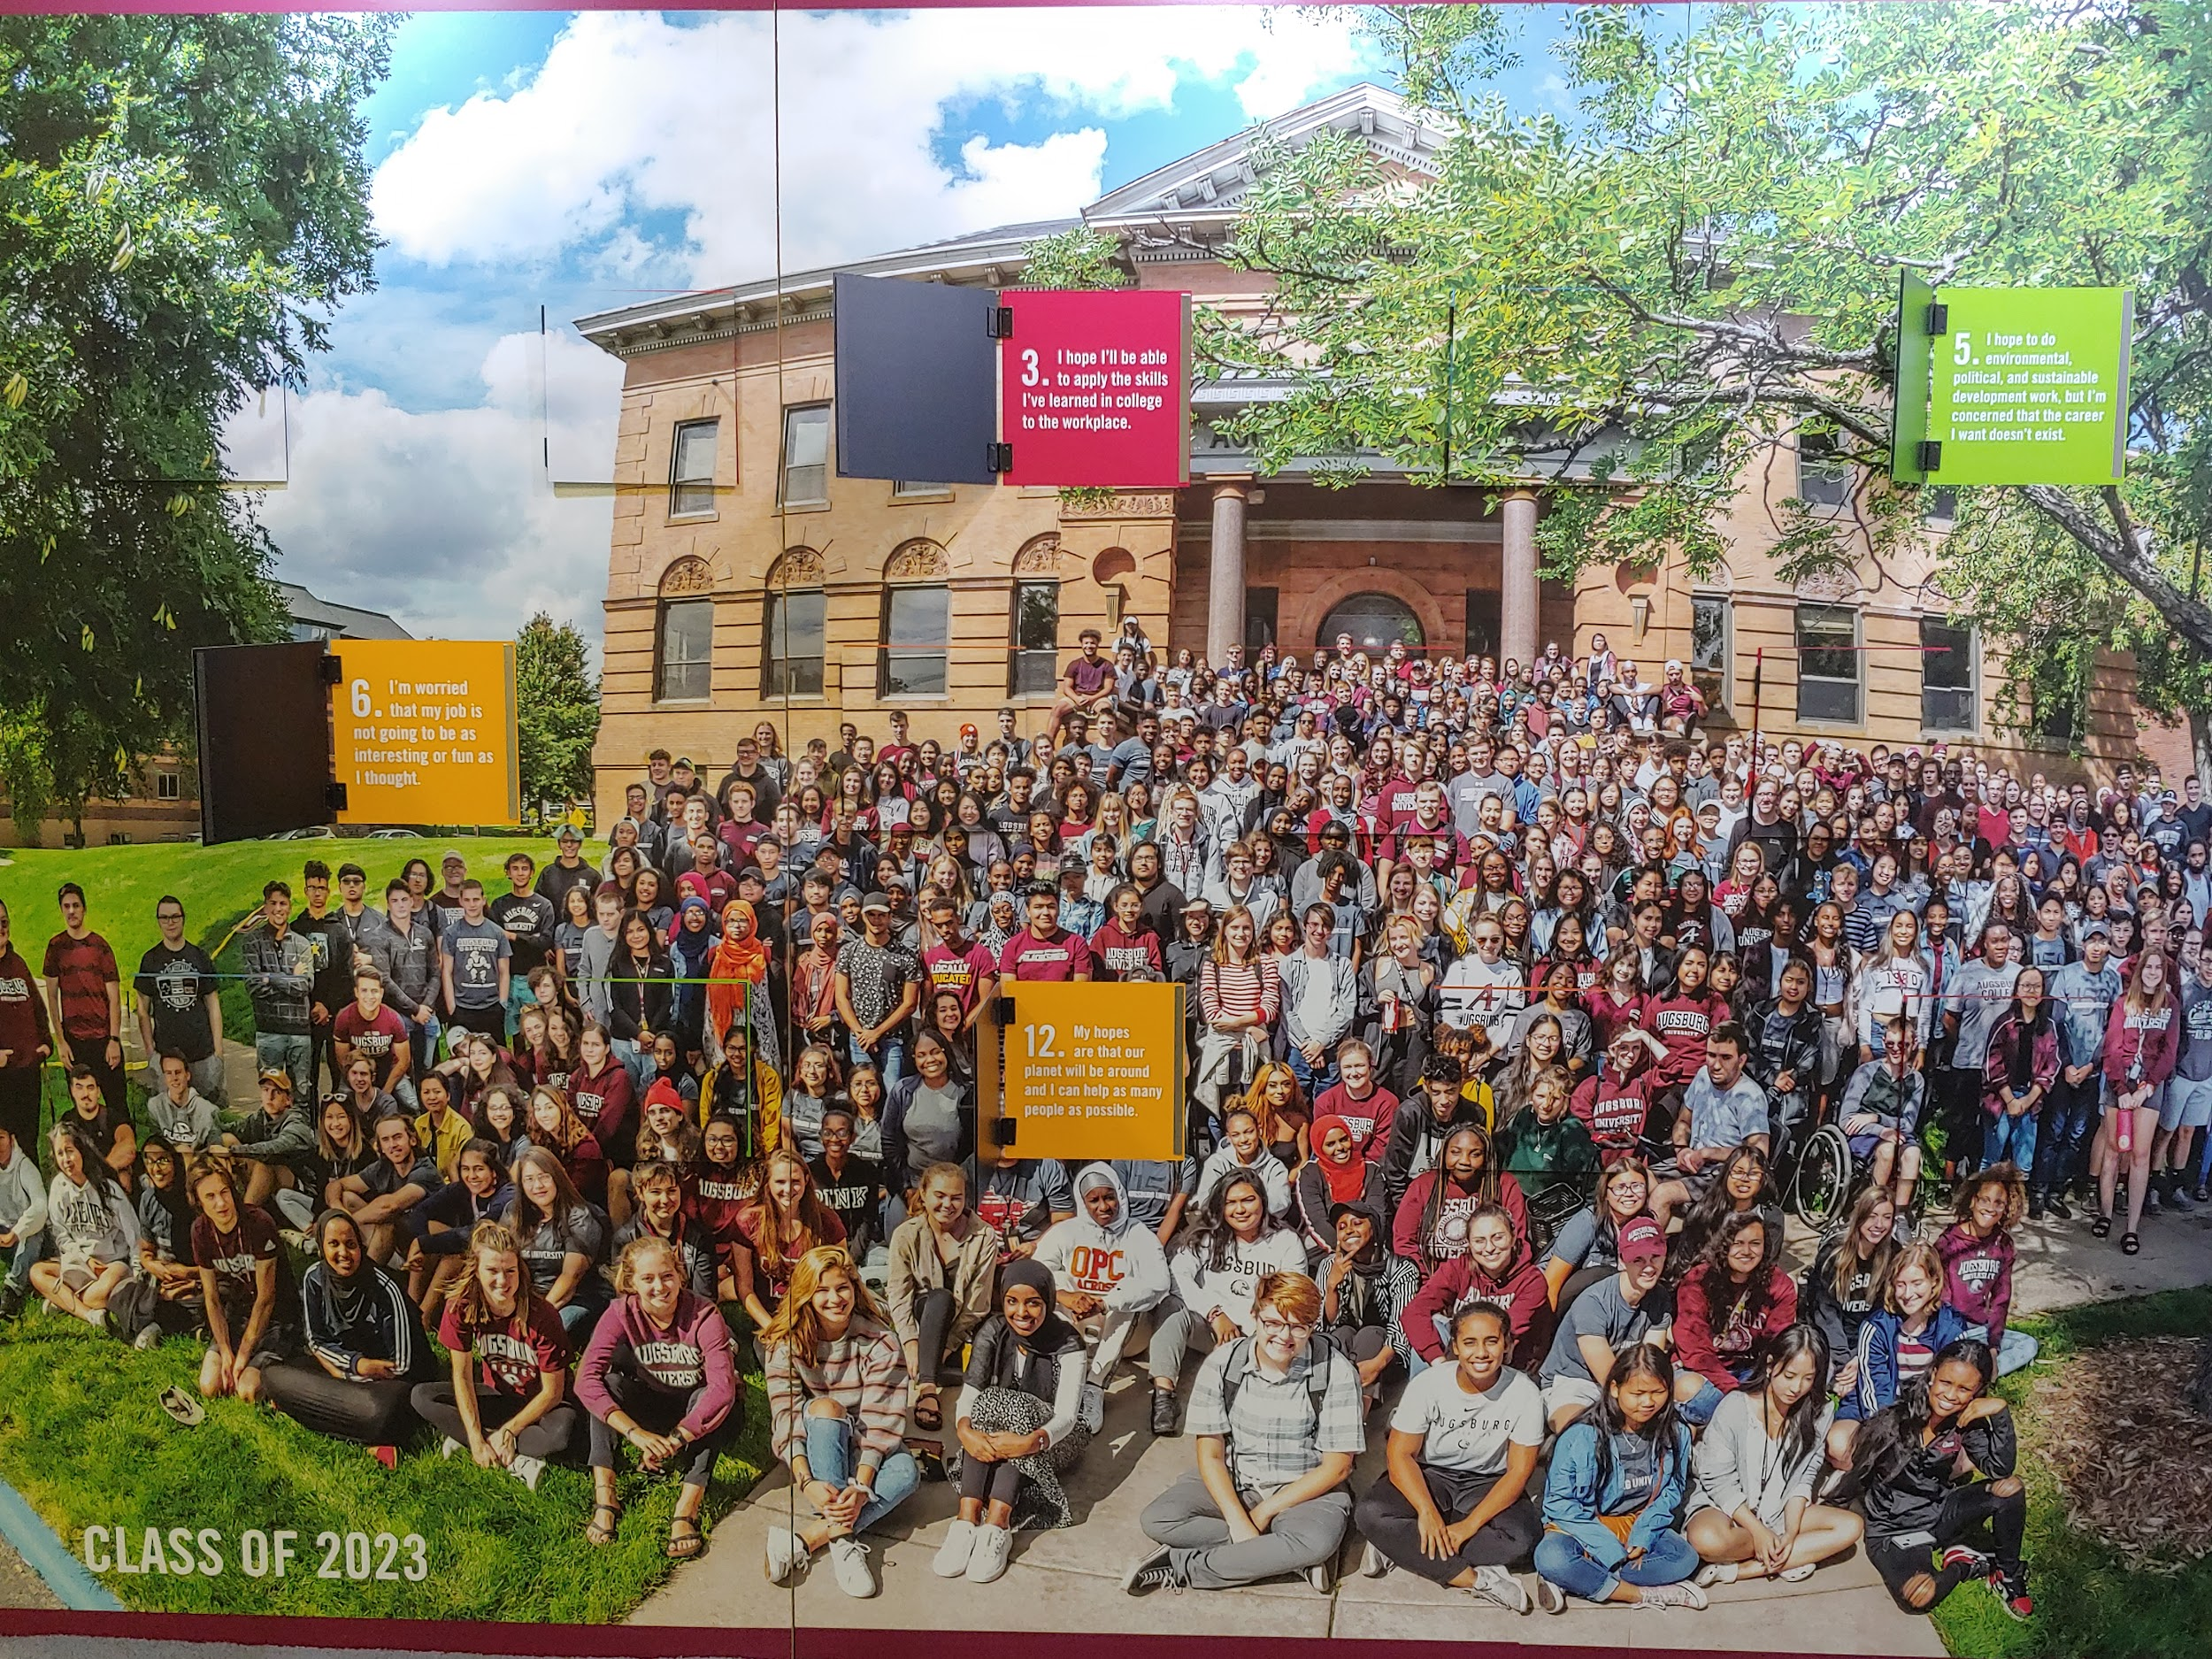
Enrollment
Undergraduate 2,391
Graduate 1,079
Student Facts
Undergraduate Day
Students of color: 53%
International: 3.2%
First-generation college students: 37.4%
Most Declared Majors
Biology, Marketing, Computer Science,
Psychology, Exercise Science, Social Work, Management, Communication Studies, Elementary Education

Slide 3
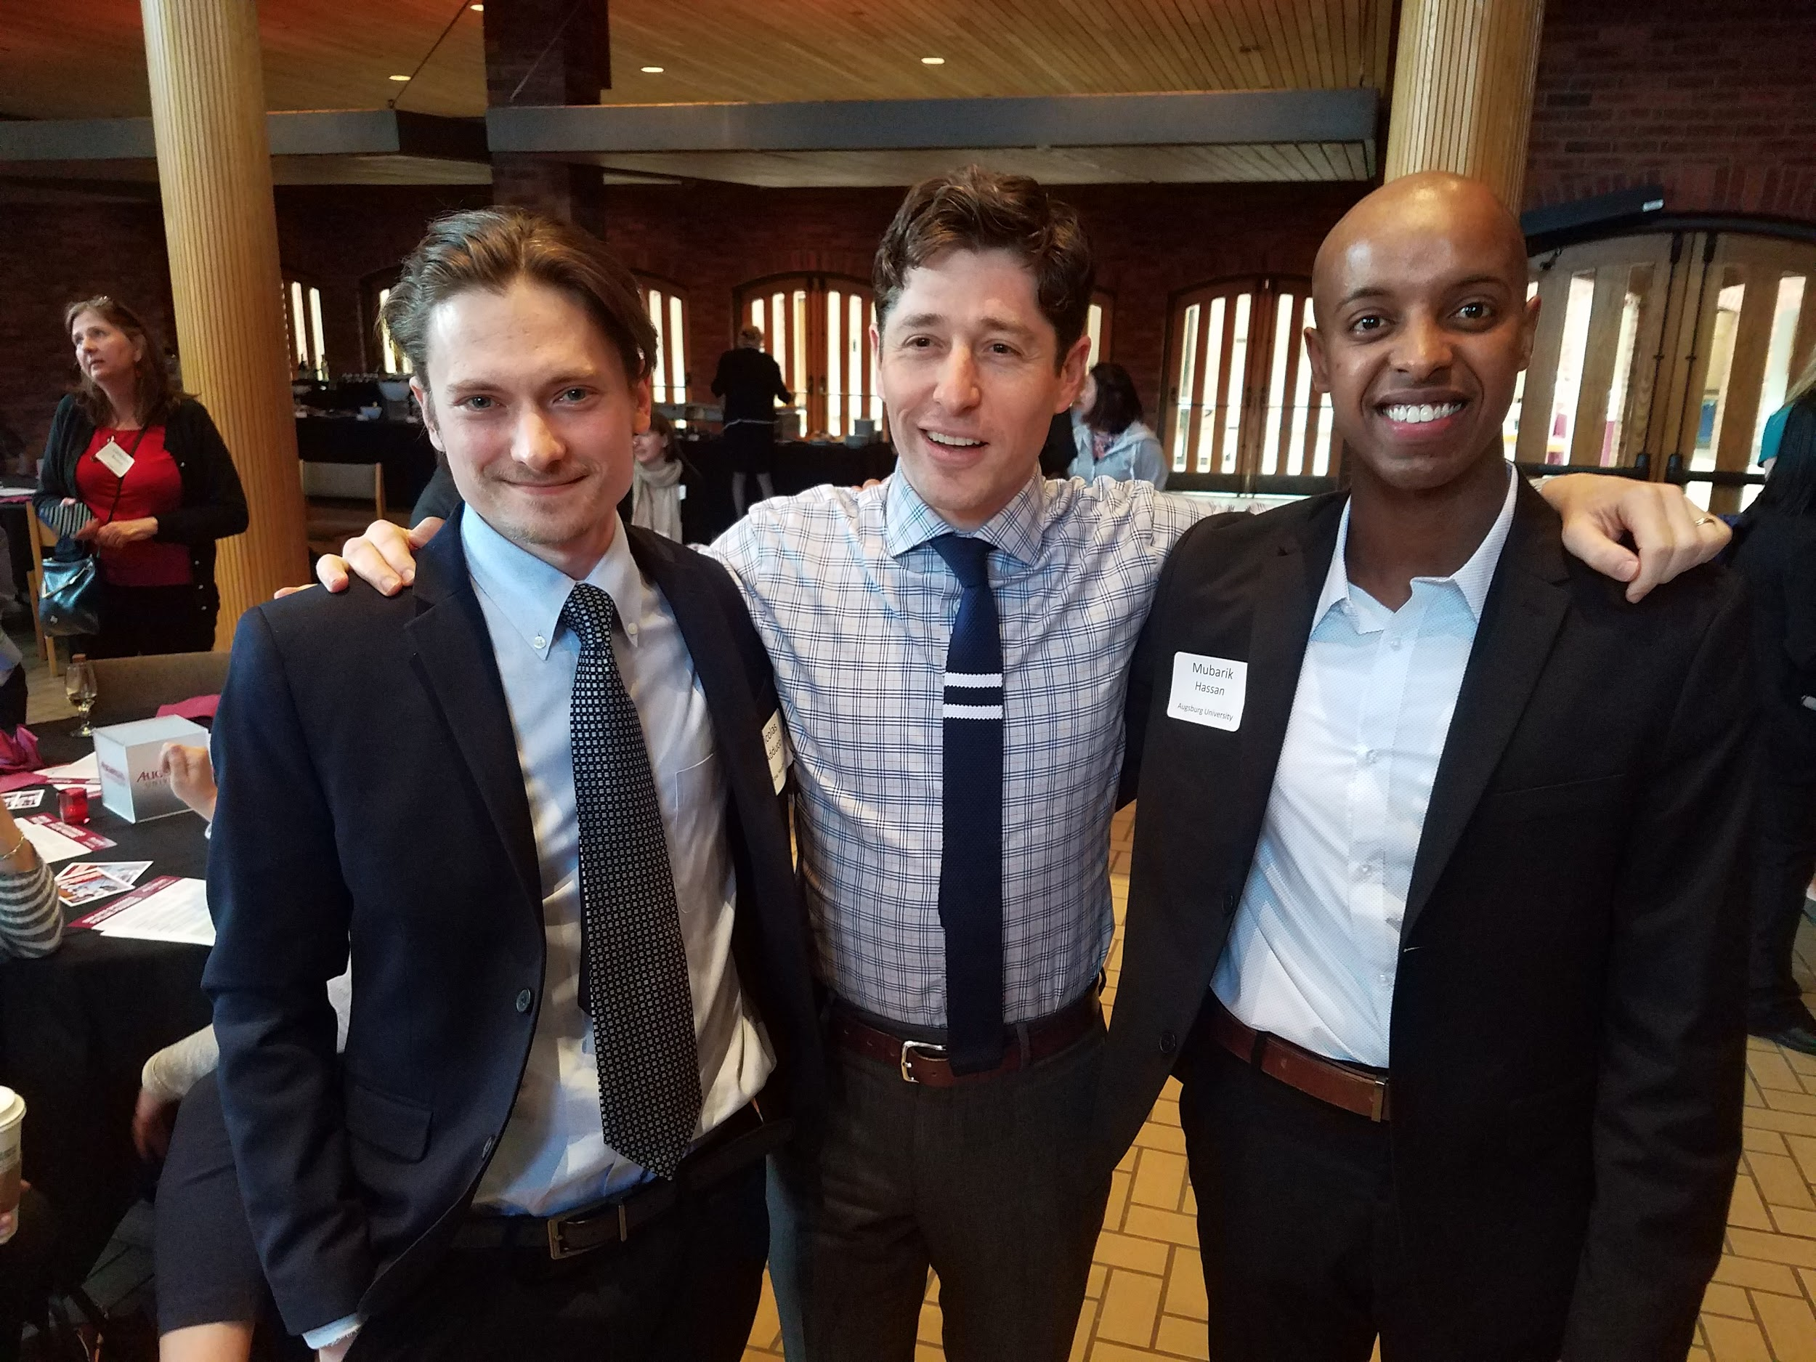
Employer Sponsored Pipeline Programs
Model of the program
Objective: Increase the number of underrepresented individuals who complete a bachelor’s degree and are prepared for careers in specific sectors
Four Components
Scholarship
Mentorship
Internship
Professional Development

Slide 4



Partners
Fairview
EDGE
(Corporate Grant)
Since 2010
12 scholars currently / 35 scholars total
$12,500 scholarship
Pipeline from partner high schools
Monthly professional development
25 Scholars have completed 1 internship
Numerous Travelers placements among scholars
TechHire Scholars
(City of Minneapolis Grant)
Since 2016
3 way partnership
IT internships are the focus (fall part-time or summer full-time)
Scholarship to cover the cost of 2 academic credits
20 scholars since 2016. Six have continued to work for Fairview
Midco Scholars
(Corporate Budget)
3 scholars in pilot year and 7 total
$2,500 scholarship and access to professional
development workshops
1 scholar completed a summer internship and accepted employment

Slide 5
What we’ve learned
There is not a one size fits all
Relationships matter
Career aspirations and goal commitment is key to retention; clear pathway and strong supportive services
Multiplier effect- family, friends and surrounding communities are impacted

Slide 6
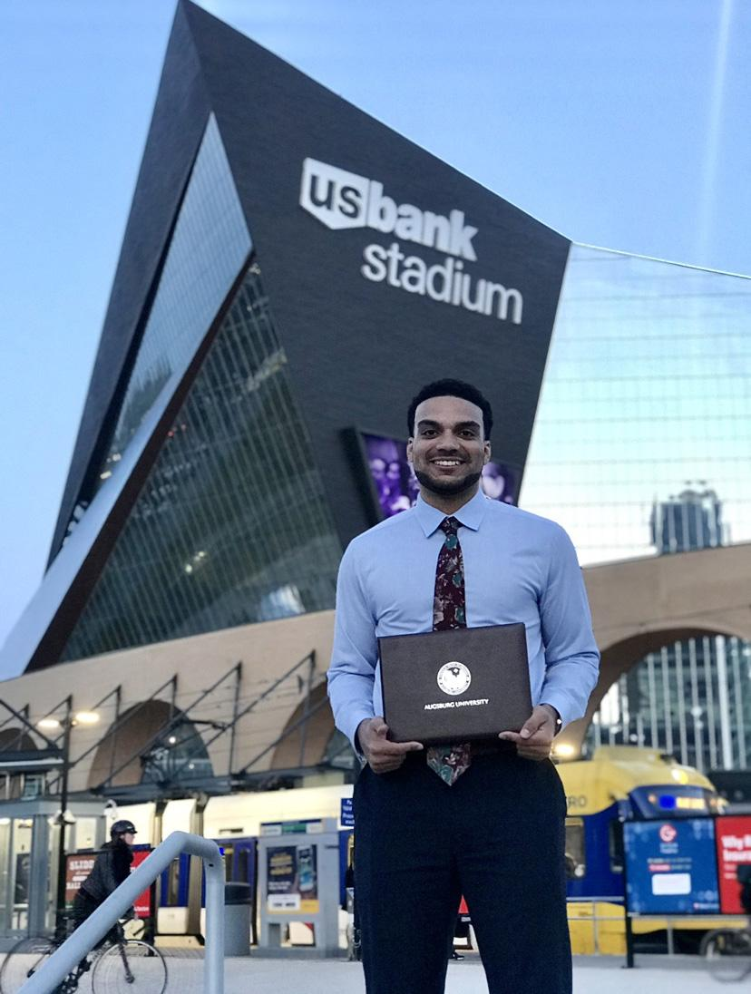
The Students
Barclay Bates ’18, Augsburg alumni and former intern (now employee) at Midco, has learned what separates leaders from managers.
Augsburg Podcast

