Slide 1

AVERETT UNIVERSITY ONLINE - EVOLUTION
WHEN GROWTH MINDSET IS ORGANIZATIONAL CULTURE
Presenters:
Dr. Carly Pearce, Assistant Vice President of Enrollment
Cpearce@averett.edu
Liz Cervantes, Assistant Director of Averett Online Student Services
Lcervantes@Averett.edu

Slide 2
“Education is the most powerful weapon that you can use to change the world.”
Nelson Mandela

Slide 3
Averett University
Averett University is a small private arts institution in Danville, Virginia
Originally a women’s college. Averett has continuously evolved over the years. Averett has a traditional campus serves undergraduate college-age students with a focus on service learning and an ever growing athletic department
Averett’s Online program is the non-traditional arm of the University offering mainly asynchronous online programs
Affordable and flexible continuing education options for adult learners for over 30 years
Undergraduate/Graduate programs in Business, Criminal Justice, Data Analytics, Education, Accounting
Premier student-centered university renowned for innovative teaching and learning
Prepare students to serve and lead as catalysts for positive change

Slide 4
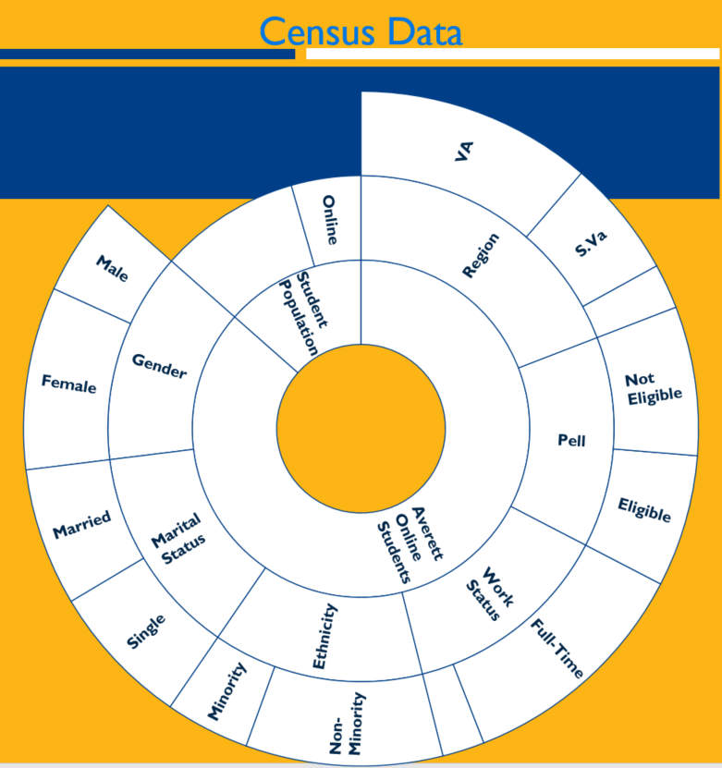
Where we are
Affordability
Almost half Pell eligible
Affordable tuition rates with robust resources
Market Driven
Market analyses on current and potential programs
Advisory Boards in Education & Criminal Justice

Slide 5
REMOVING BARRIERS
It is really important to acknowledge the unique needs of adult learners, who often face significant barriers to returning to school. Many are first-generation and lower-income learners who have historically lacked the support systems to succeed in a traditional higher ed setting.

Slide 6
Let’s review some concepts
Student Success Coaching Model
Centralized point of contact creates student connections to resources, people and information.
Free Tutoring & Mentor Services
Online 24/7 tutoring options and synchronized student services
Averett Online Anytime Anywhere
An academic calendar that allows for crossover course opportunities for students.
Data Inform Decisions
Dropout detective software used in robust early alert system allowing earlier interventions for at risk students
Life Skill Programing
Networking Programs and Career Services Workshops
Course Congruence
All course follow the same rhythm, share the same grading policy and share the same late policy

Slide 7
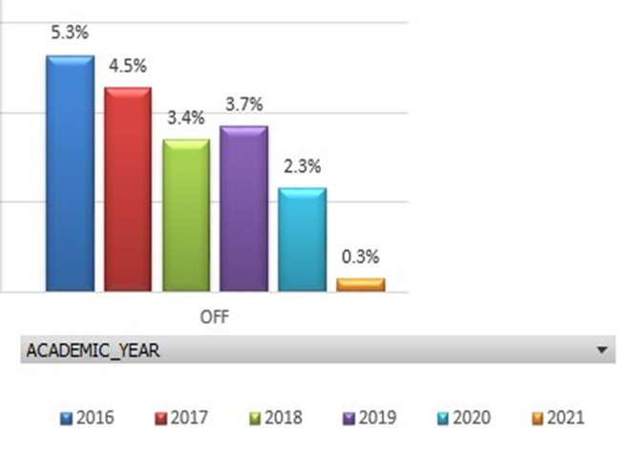
375 tutoring hours
95 student users
9 Tutors
Outcome Data
Attrition Rate by Year
Since January 2019
Yellow box denotes Term Model
75% had more than one tutoring session
Adjunct faculty, staff and alumni

Slide 8
Where are we going?
Data Informed Decisions
Analyzing student feedback surveys and course evaluations to make data informed decisions to increase student satisfaction and decrease attrition
New Market Driven Academic programs
Psychology, Entrepreneurship & Small Business Operations, Healthcare Administration, Information Systems/Security
Partnerships
Partnership driven programs and tuition agreements
ABSN
New MED C&I Concentrations

Slide 9
THANKS!
Any questions?
You can reach us at:
Cpearce@averett.edu
Lcervantes@Averett.edu

