Slide 1

Averett’s Programs for Career-Readiness for Low-Income Students
Dr. Billy Wooten
Executive Director of the Center for Community Engagement & Career Competitiveness at Averett University
Angie McAdams
Director of Career Competitiveness

Slide 2
Averett Snapshot
4-year private liberal arts institution founded in 1859 – accredited by SACSCOC
1500 students (965 traditional; 571 adult learners)
Students from 24 states and 20 countries
60% male; 40% female
52% minority traditional students
African-American, Latino, Asian-American
50% first-generation students
51% Pell eligibility; 99% receive some sort of student aid
30+ academic majors
48% student-athletes
16 NCAA Division III sports
Carnegie Classification earned 2020

Slide 3
Program Overview
Faculty Fellowship in Career Development
Averett Corps & Work College Model
1st Generation Program
Averett 101 Curriculum
Averett 2025 Stragetic Plan on Internships
Engaged Employer/Bridge-Out Program

Slide 4
Faculty Fellowship in Career Development
Summer 2020 Pilot; 8 faculty earn $1200 stipend for a 3-day intensive fellowship on:
Asset mapping what their departments/divisions are currently doing and reimagine/strengthen how career development opportunities are offered within the academic sphere
Participants also have the opportunity to network with nonprofits and for-profits in the area for potential partnership development

Slide 5
Faculty Fellowship in Career Development
Fellowship Goals
Becoming part of learning community of faculty leaders who engage with career development scholarship and best practices to reimagine how a liberal arts college can embed career-minded practices throughout the curriculum (capstones, internships, field experiences, job shadowing, federal work-study as intentional labor placement, etc.)
Mapping what career development practices are currently being done in their department/division and how those practices can be marketed, improved, or grown
Applying best practices in internship and field experience supervision
Connecting to new and/or existing community-community partners for career ventures

Slide 6
Faculty Fellowship in Career Development
Fellowship Deliverables
A curriculum map of career development experiences currently provided across each academic division at Averett;
An action plan on how to enhance our offerings;
A communication plan on how all disparate areas of offerings can be tracked through one central location (the CCECC);
A plan for how Averett’s new Averett Corps brand and program can work for your department/division
A plan for how to ensure that every Averett student has access to a workplace experience;
A plan for how our new Engaged Employers/Bridge-Out program can work for your department/division

Slide 7
Averett Corps
Capitalizing on Averett’s low-income student population, we are adopting a hybrid version of a work-college model
We have developed a partnership with Financial Aid to revamp Federal Work Study in the following ways:
More community-based positions
More intentional placements between academic majors and job sites
Academic career goals attached to each labor position
A tiered compensation scale for tiered levels of employment responsibilities
Midterm and final labor evaluations for each student
Soft-skills training for students as employees
Management training for supervisors

Slide 8
Averett 1st Generation College Student Program
Spring 2020 start-up to connect Averett’s 1st Generation students (50%) to faculty and staff mentors who identify as first-generation (57 faculty and staff)
Branding of the program to acculturate the campus
Workshops on college expectations (financial literacy, career exploration, etc.)
Workshops on college success strategies (time management, study skills, etc.)
Graduation and opening convocation recognition

Slide 9
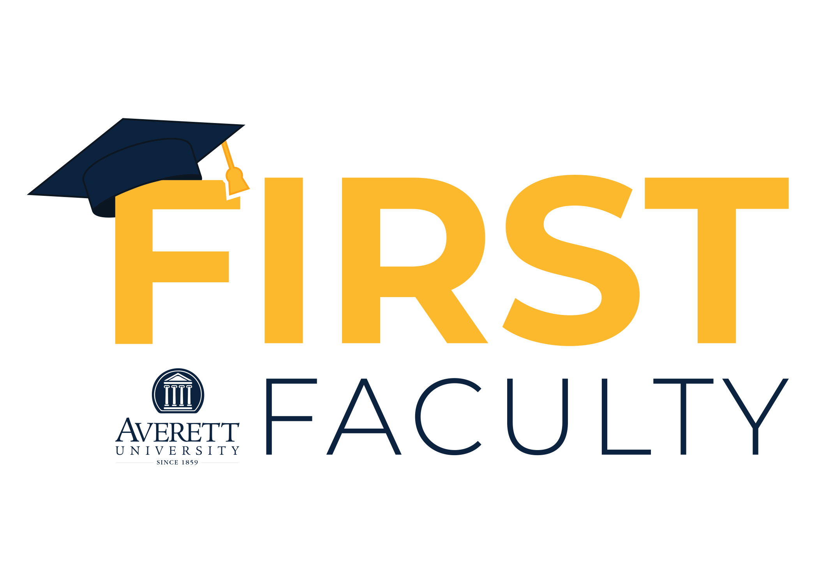

Slide 10
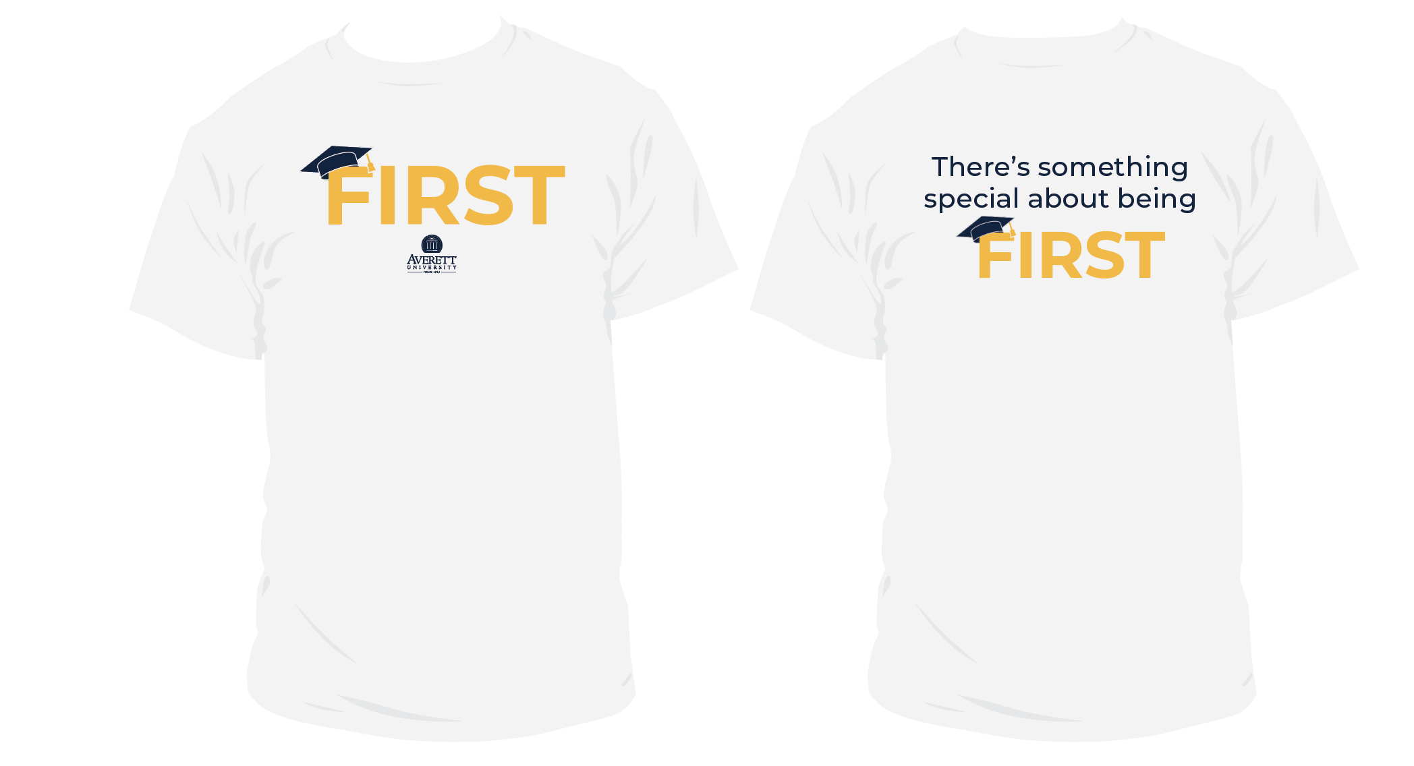

Slide 11
Averett 101
Basic FYE 1st semester course that includes career development foci as well as a service-learning project to show the correlation between experiential learning and career-readiness
NACE Career-Readiness Competencies are embedded throughout the course
Critical-Thinking/Problem Solving
Oral and Written Communications
Teamwork/Collaboration
Digital Technology
Leadership
Professionalism/Work Ethic
Career Management
Global/Intercultural Fluency
We have every student engaged in:
Resume building, cover letter formation, networking, and digital portfolio development (Handshake)

Slide 12
Averett 2025 Strategic Plan – Internships and Career-Readiness
Metrics are:
100% of traditional students must complete 4 high-impact practices (HIPSs) with 100% of all academic majors incorporating at least 1 HIP
100% of students must complete at least two workplace/marketplace experiences before graduation
Internships, field work, clinicals, student-teaching, etc.
We are using Handshake to track all career experiences that will be included on the student’s Engage Transcript

Slide 13
Engaged Employers/Bridge-Out
Currently we have a group of regional employers (for-profit and non-profit) who offer service leave to employees
We are revamping the program to develop articulation agreements with these employers to hire Averett graduates for a period of one year as a bridge-out to the workforce
Professional development through the CCECC
Stipend from the employer or via grant funding through the CCECC (non-profits for sure)
The same group will offer internships for Averett students
Replaces our Career Development Advisory Council

