Slide 1
Addressing Student Needs at Coker University
Evan Vaughn,
Director of Residence Life
& Student Conduct

Slide 2
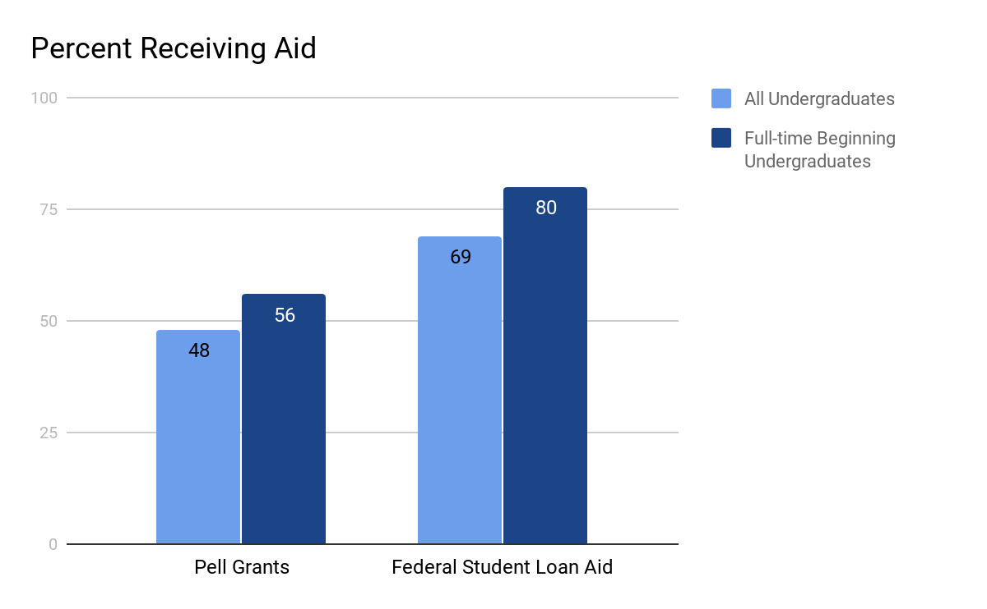

Source: U.S. Department of Education. Institute of Education Sciences, National Center for Education Statistics.

Slide 3

Cobra Cupboard
Located in Office of Residence Life
About 18 students utilizing
Donations made from community and online giving
Promoted through campus email, posters, and word-of-mouth

Slide 4
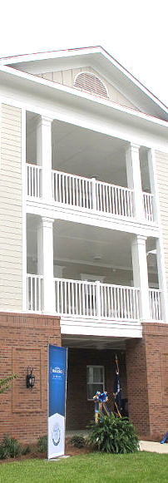
Summer Housing
Located in our residential village
24 students lived on this summer
Free to any student enrolled in 3+ credit hours
Promoted through housing draw, campus email, and partnership with Academic Affairs

Slide 5

Stock, Paper, Scissors
Located in library
More than 20 students utilizing
Entirely donation-based
Promoted through campus email, Social Media, and flyers

Slide 6
Evan Vaughn
evaughn@coker.edu

