Slide 1
Virtual Learning and
Student Engagement Survey Results
The Impact of COVID19: Perspectives from Yes We Must Students
Webinar Presentation
June 22, 2020
Maria Narvaez
Director of Institutional Planning & Research
Mount Saint Mary’s University
Notes:
Presentation:
MSMU background
Survey Methodology
Indirect and Direct Assistance based on survey results

Slide 2
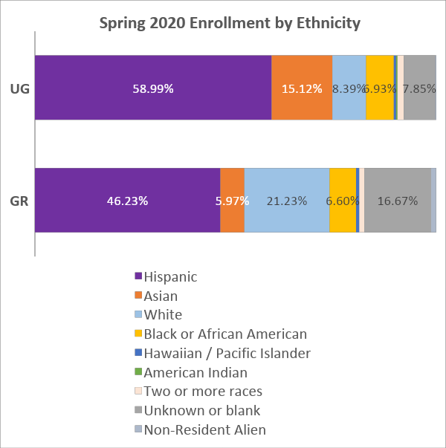
About MSMU
Private, Liberal Arts
Catholic, 90% Women
About 2,700 Students in Spring 2020
  636 Graduate
  2,063 Undergraduates
    56% Pell
    45% 1st Gen
Largest major is Nursing/Pre-Nursing (37%)
Two campuses in Los Angeles
  Downtown LA
  Brentwood (near Getty Center)
Notes:
Fire at the end of October – big challenge for campus;
for instruction, moved all classes that needed to meet in person to one campus;
a few selected to go online
Fire season in CA is starting

Slide 3
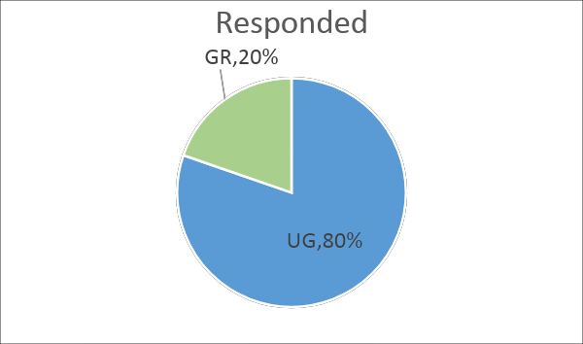
Virtual Learning and
Student Engagement Survey
Purposes of survey:
identify ways to improve the experiences of MSMU students, with both virtual learning and engagement. (long term)
provide an avenue for students to ask for help. (immediate)
Methodology:
Administered April 14 – May 8 via Qualtrics to all students
13 Likert scale or multiple-choice questions on
instructional and student support services topics
Overall Response Rate 40%
  ~ 2,500 comments
  58% Pell (UG)
  52% First Generation (UG)
Notes:
began developing the survey about a week or so after classes started online on March 16
Responses: 1085/2695
Enrollment:
56% Pell
45% 1st Gen
24% GR
76% UG

Slide 4
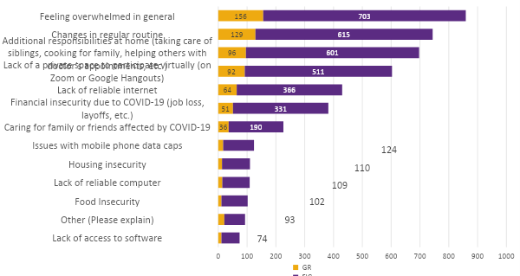
“Which of the following has limited your ability to participate in your virtual educational experience?”
Response:
Media and Technical Support Services created guides on how to access and download software
  Zoom
  Microsoft Office Suite
  Adobe
  Grammarly
Resource guides were posted to myMSMU
Notes:
By April 17 (3 days after launch), we received 526 responses (about 50% of the final total responses)
Responses: 1085/2695

Slide 5
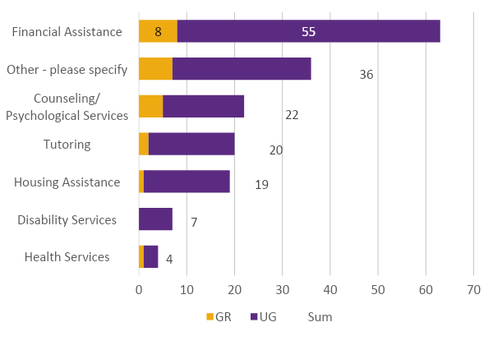
Request for Direct Contact
108 students asked to be contacted - requests were forwarded to the appropriate areas daily
Most of the students (n=63) requested to speak with someone about Financial Assistance.
Survey sent to departments to ask about their experience
  17/19 (89%) responded
  All tried to contact students on their list; a few students did not respond
  76% felt they had adequately addressed students’ concerns
  82% reported their interactions as positive (18% neutral)
Notes:
the majority were TUGS (n = 74).
Student Contact Experience Survey Results
students also asked to be contacted about
tutoring
housing assistance
wellness
WEC
MS – “…when I spoke to students in the phone, most of them were very appreciative that someone actually responded to them and listened to them.”

Slide 6
Recommendations based on
Student Responses and Comments
Provide more training for both faculty and students on how to use technology effectively for virtual learning.
Establish uniformity as to what platforms are to be used for online learning. This would aid in navigating course materials between all of their courses.
Establish university-wide standards for response time to address student inquiries. Students have pointed out inconsistencies in responses and gaps in communication.
Provide different ways for students to stay connected with each other, with their professors, and with the Mount in general.
Notes:
For long-term planning
~ 2500 comments

Slide 7
Contact
Maria Narvaez
Director of Institutional Planning and Research
mnarvaez@msmu.edu
Notes:
Introduce next speaker

