Slide 1
Getting Students to the Finish Line: Insights for Today’s 1st Gen Students
Yes We Must Coalition Webinar
September 7, 2018
Presenter: Kathleen Ross, snjm, Ph.D.
Heritage University, Toppenish, Washington

Slide 2
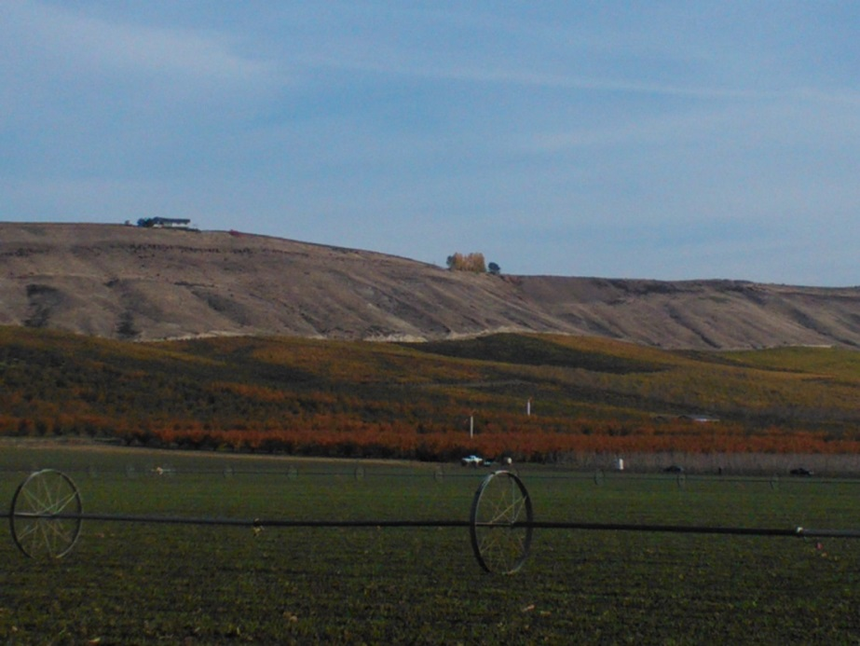


Rural Yakima Valley
Notes:
I was working in Spokane as the Provost at Fort Wright College of the Holy Names, a very small private college, when we received a request from the Yakama Indian Nation, located a 4-hour drive away in the rural Yakima Valley of central Washington State. ** They asked us to offer bachelor’s degrees in education to the teachers of their newly opened Head-Start program from native kids, and master’s degrees in Adult Education and leadership to the administrators of the tribal programs and other rural school personnel. In the Yakima Valley, the only college degrees were 2-year degrees and many who wanted more education couldn’t move away from home to other Washington state colleges or universities that offered 4-year or master’s degrees. When the Fort Wright Board approved this request, I was delegated to initiate and oversee this program, by sending faculty the 4-hour drive to Yakima once a week to offer classes. ** The program was a success, but about 7 years later, the governing board of Fort Wright College decided to close the institution due to financial pressures and the new availability in Spokane of more 4-year degree opportunities. So I had to travel to Toppenish and deliver the bad news – your programs are phasing out over the next 18 months.

Slide 3


Slide 4

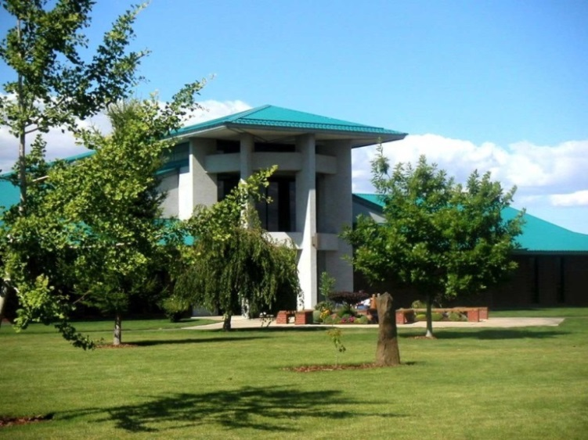
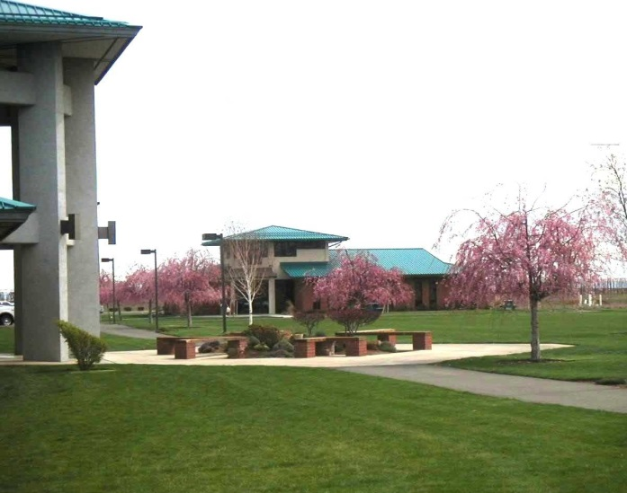
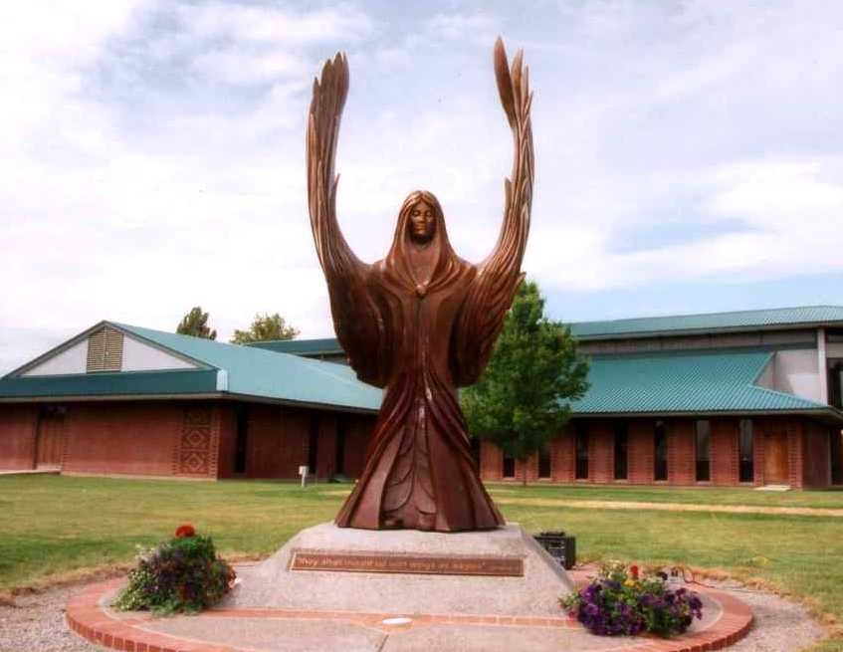
2018
Notes:
Starting from this very lowly beginning, the campus expanded through donated and purchased land, and through donor-funded “real” buildings – ** a Library and Learning Center, **a Student Services Building, ** and an Arts & Sciences Center.

Slide 5
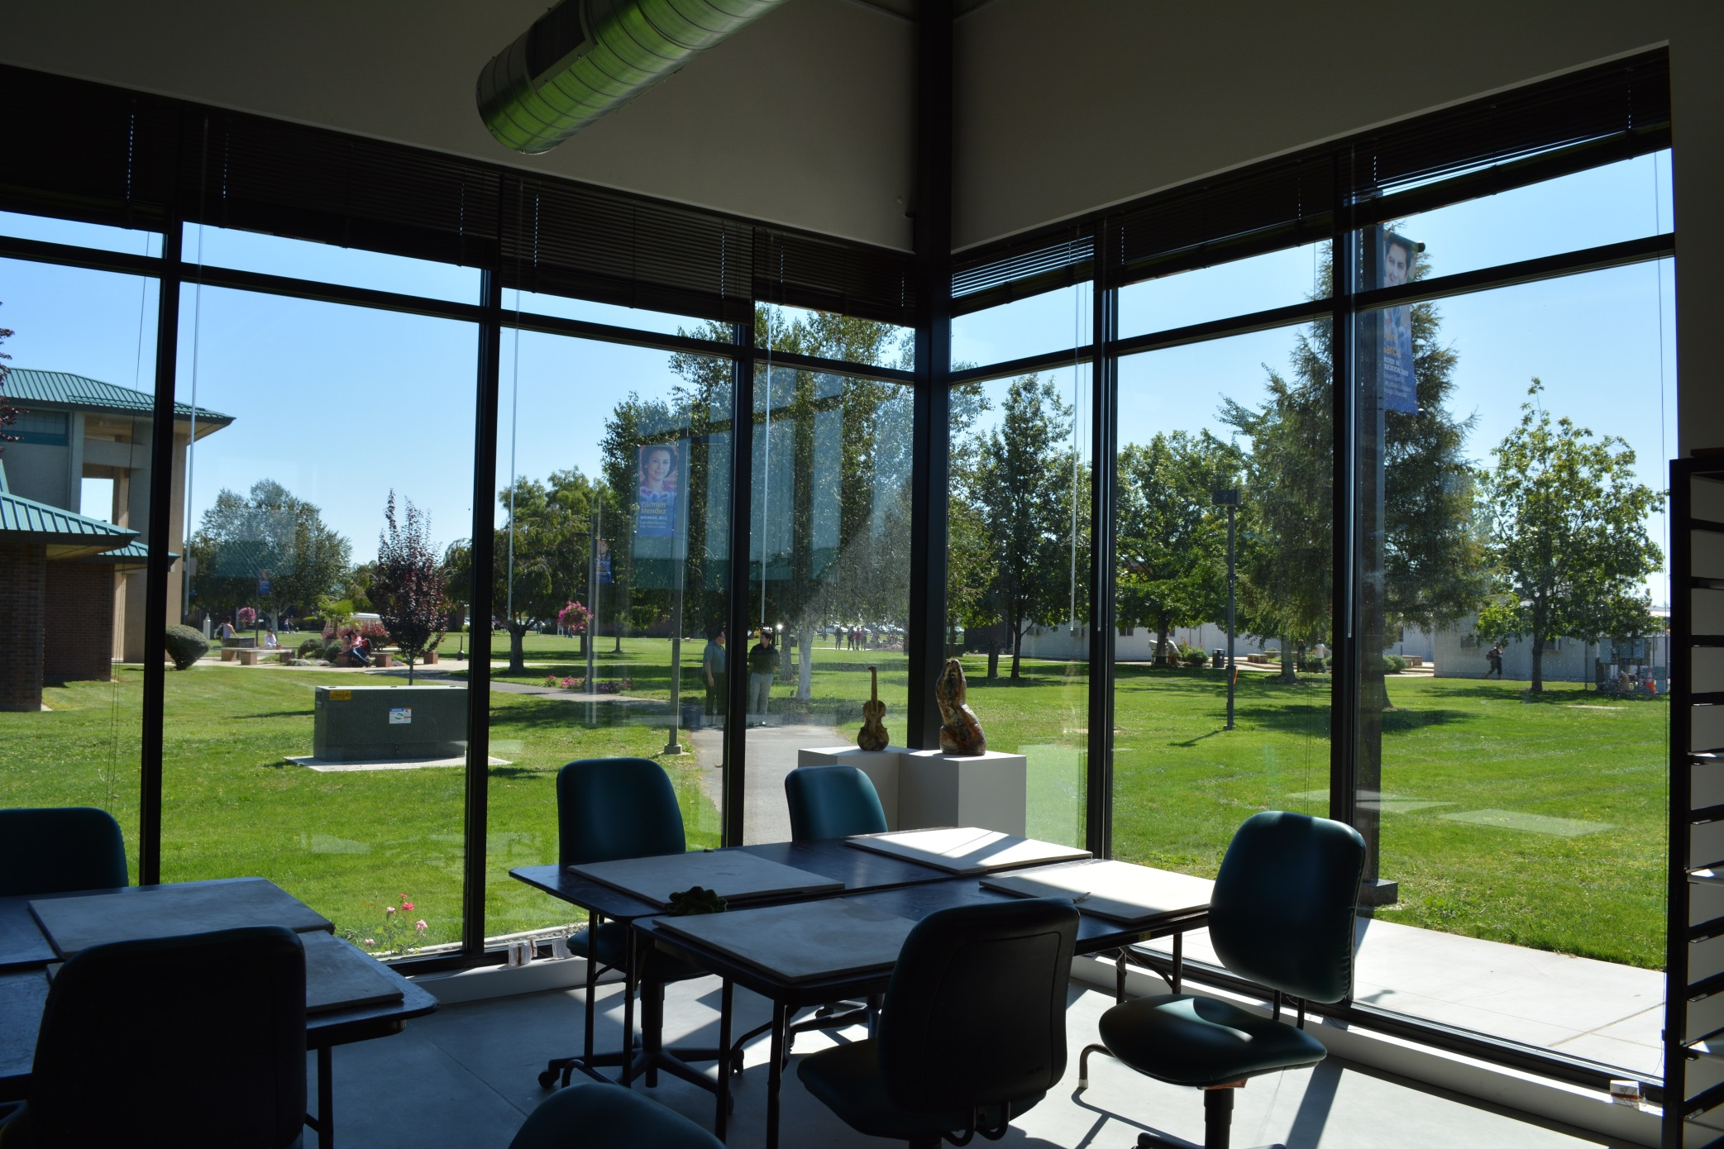

Slide 6
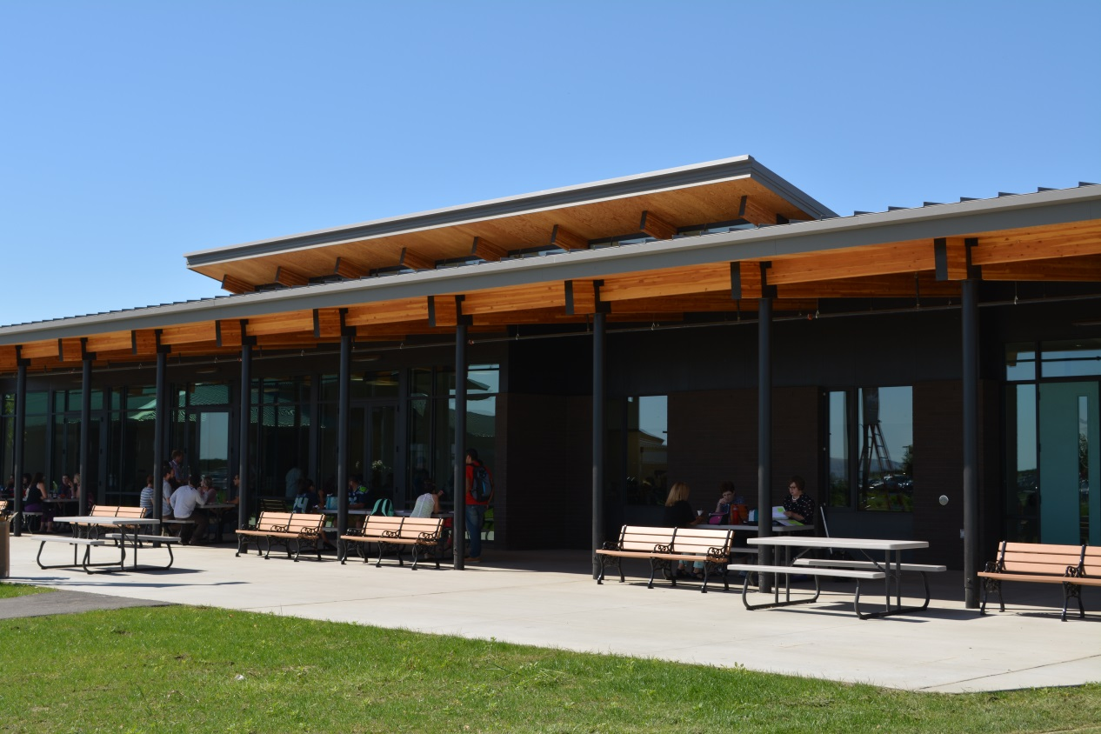
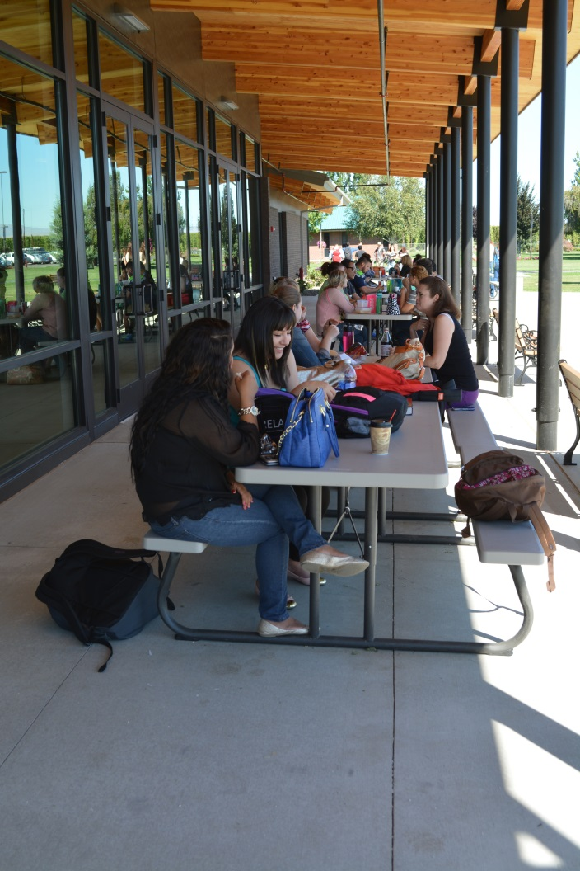
Notes:
This included a new cafeteria and student lounge, as well as an IT building and a classroom building. ** In 2004 Heritage College became Heritage University, and additional fund-raising efforts resulted in a building with administrative offices and large classroom for our new Physician Assistants program and a Health Sciences center.

Slide 7
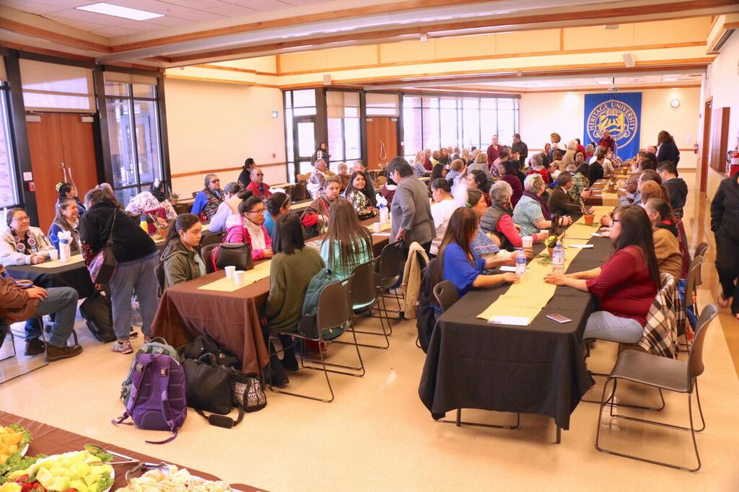

Slide 8
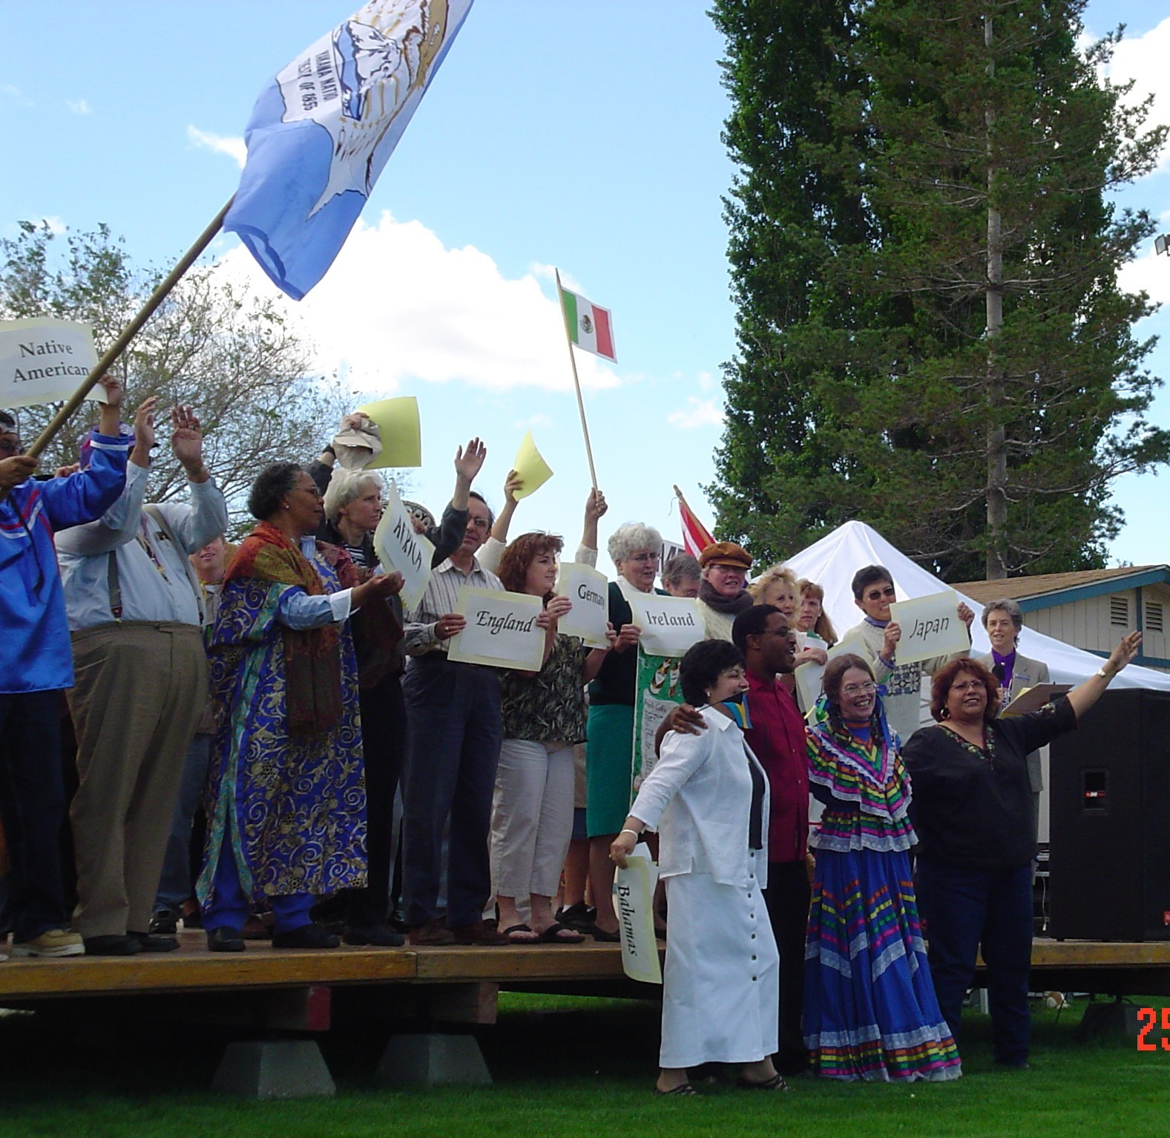

Slide 9
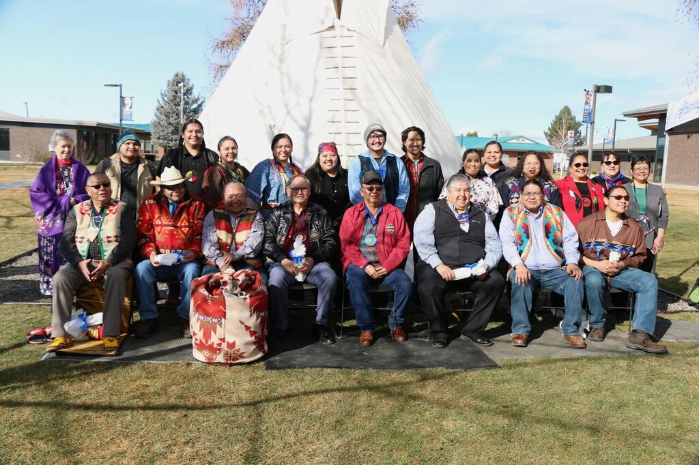

Slide 10
2018
Approximately 1100 students
85% of undergrads are 1st gen
91% of new students Pell-grant eligible / low-income
Notes:
And still serving 1st-generation, low-income, diverse background students! [Pause for audience to read data on screen.]

Slide 11
Higher Ed’s Challenge Today . . .
1st-generation-to-college students
(1st gens) are a growing percent of college students nationally;
the majority are low-income;
AND . . .
Notes:
Professional Development as a Faculty or Staff Educator in higher education today includes the challenge of staying abreast of changes in our profession. One of those changes is changes in the core of our work – our students, who they are, where they come from, what their expectations are, what talents and handicaps they bring with them. Let’s think back about 12 years ago to 2005. ** National statistics that year showed that 17% of the students in higher education that year came from families where neither parent had attended college or university. We call these “1st generation to college” students, or “1st gen” for short. That’s about 1 in 6 students.

Slide 12
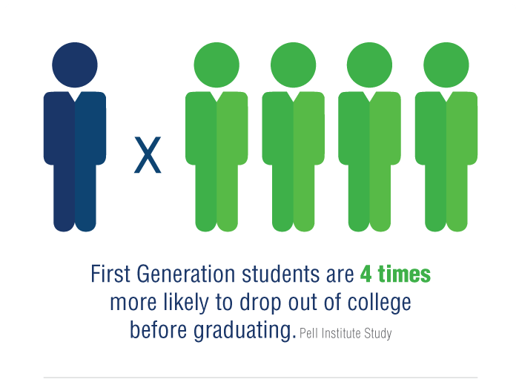
Notes:
Here’s the reason it is important for us to be aware of the 1st gen students in our institution. “First Generaiton students are 4 X more likely to drop out of college before graduating” than the students who come from families where at least one parent has attended college or university, or what we call a “continuing generation” student. As this graphic shows, the ONE person from a continuing gen family who will drop out is quadrupled for the 1st gen students. Slippery Rock University currently has a excellent 6-year graduation rate of 68%, something you should be very proud of. The national comparable average is something like 45%. But as the percentage of 1st gen students increases in your student body, which is the change happening nationally, you will be challenged to maintain that benchmark.

Slide 13
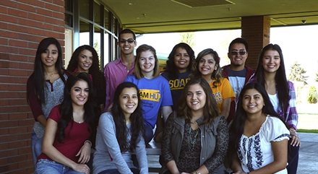
Heritage University 1st-GEN students
Notes:
No wonder we are getting a larger percentage of our students enrolling today who report that they are 1st gen students! As you are probably thinking, a good number of these students are from immigrant parents, and many are from low-income homes. With this reality in front of us, a statistic like 89% drop-out rates for 1st gen, low-income students becomes much more relevant to what our commitments are and who we want to be. We want to shepherd all our students through their studies to graduation, preparing them for being competent professionals who continue to build a thriving society with competence, creativity, and caring for the less fortunate.

Slide 14
So we undertook research looking for key success factors for 1st-Gen students:
Literature review
Student-based interview research
Notes:
With that statistical background, you understand why the Keynote talk today is focusing on what I like to call “The New Majority” students . . . 1st gen, and usually low-income. The question we need to address today is, How can we enable their academic success? A rather daunting question . . .

Slide 15
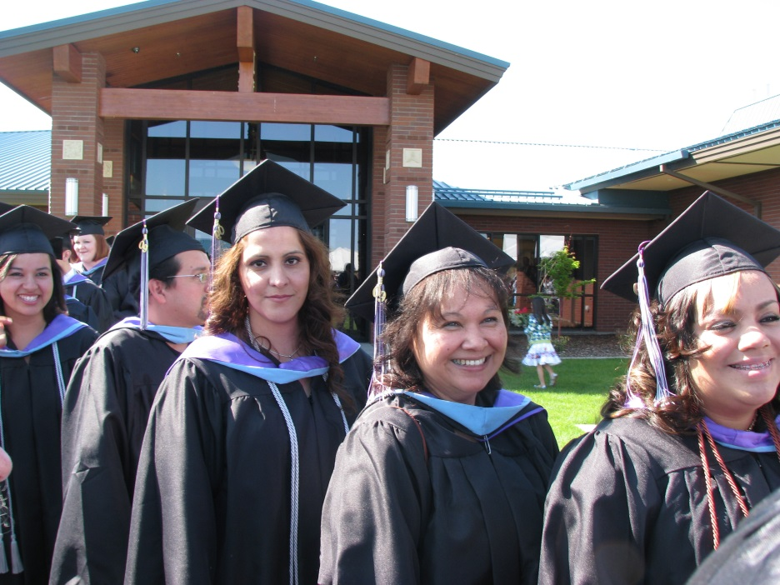
Lit Review Results: 4 Essentials Identified
Engaged Learning
Sense of Belonging
Confidence
Vision for the Future
Notes:
Extensive research on 1st-gen and low income students, conducted at various places across the country, has been reported in many journals and conferences. The results can be capsulized in four key elements: ** Engaged learning; ** Creating a Sense of Belonging in college; ** Confidence that they can succeed if they work hard enough; and ** a Vision of what the future could actually become for them. Let’s look briefly at each of these four essentials.

Slide 16

Essential #1: Engaged Learning
Notes:
The first essential for 1st-gen students, and indeed for all successful college students, is that they truly be engaged in their learning. Many of the teaching ideas that are shared today are meant to increase the engaged learning of the students, and I’m sure many of you could name some you are using. But there is a special challenge in trying to assure that “engaged learning” happens for 1st gen students.

Slide 17
Issue for 1st Gen students:
Their reference point is typical high school experience:
Read textbook assignment
Listen to teacher go over assigned text
Memorize facts
Repeat answers in class or on test

Slide 18
How can you transition 1st GENs to real collegiate learning?
One successful strategy:
Breakthrough Strategies video on . . .
Required Course Journaling
https://www.youtube.com/watch?v=MkQmdS95KYg
Notes:
So how do you get students to understand that developing their own ideas is essential for succeeding in college, especially as they advance to upper division courses. The research that led to my book, Breakthrough Strategies, also produced 3-minute videos featuring a faculty member telling about a strategy he or she uses. I’m going to share a couple of these with you as they relate to our theme this morning. This one has an idea that can be tried in any discipline as an on-going part of class assignments, in order to lead students into real engagement with learning. [Click on link to Journaling. Add 4.0 minutes.]

Slide 19
Student-led Research
Student Research Assistants:
. . . Interviewed other students
anonymously to identify
most effective professors

Slide 20
Process:
Student research assistants:
Stopped students on campus
Collected anonymous answers to this prompt:
“Name a professor who did something really effective or unusual to help you learn”
Surfaced names of 10 professors; then I held in-depth interviews clarifying strategies.

Slide 21
Statistical follow up
Identified 3-yrs of classes taught by faculty ID’ed through student research
Compared student rates of success with same classes by other faculty
Statistically significant rates of success for specially identified faculty

Slide 22
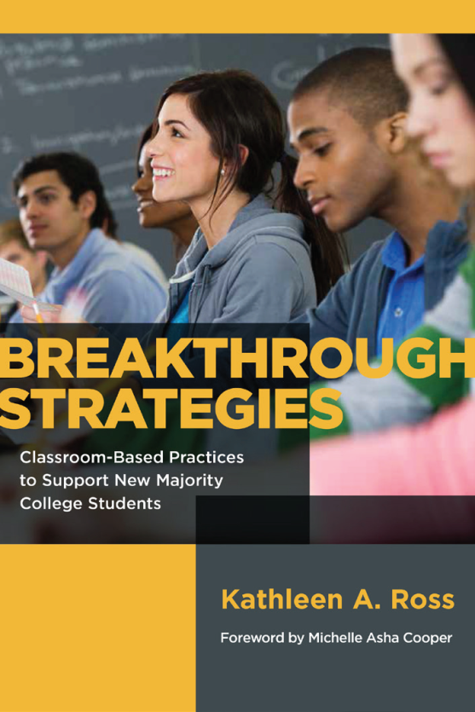
Results of Student-based Research
14 “Breakthrough Strategies” Videos
3-4 min. each
Each video focuses on one effective strategy
Available free on Heritage U website
Book published Dec. 2016

Slide 23
How can you transition 1st GENs to real collegiate learning?
One successful strategy:
Breakthrough Strategies video on . . .
Required Course Journaling
https://www.youtube.com/watch?v=MkQmdS95KYg
Notes:
So how do you get students to understand that developing their own ideas is essential for succeeding in college, especially as they advance to upper division courses. The research that led to my book, Breakthrough Strategies, also produced 3-minute videos featuring a faculty member telling about a strategy he or she uses. I’m going to share a couple of these with you as they relate to our theme this morning. This one has an idea that can be tried in any discipline as an on-going part of class assignments, in order to lead students into real engagement with learning. [Click on link to Journaling. Add 4.0 minutes.]

Slide 24
Another approach to Engaged Learning
“Bend Your Life” approach . . . To Embrace an Academic Identity
Don’t walk away from your previous self
Integrate the new with your current valuable life experience and strengths
Video: https://www.youtube.com/watch?v=3EIkMTKCs6c

Slide 25
Essential #2: Sense of Belonging Here
Breakthrough Strategies video re: first day of class ideas for faculty . . .
https://www.youtube.com/watch?v=lOGv24rCViw
Notes:
The second key factor for 1st gen students is assuring that they develop a sense of belonging in college, and in the institution they are attending. 1st gen students often look around them and see others who don’t look like them, who don’t sound like them when responding in class, and see professors as honored experts or elders who are to be respected from afar. A professor who participated in my research at Yakima Valley Community College has found a successful way to start breaking down that sense of “I don’t belong here.” He starts this approach on the first day, using his syllabus as a tool. [Click on link; add 4 minutes]

Slide 26
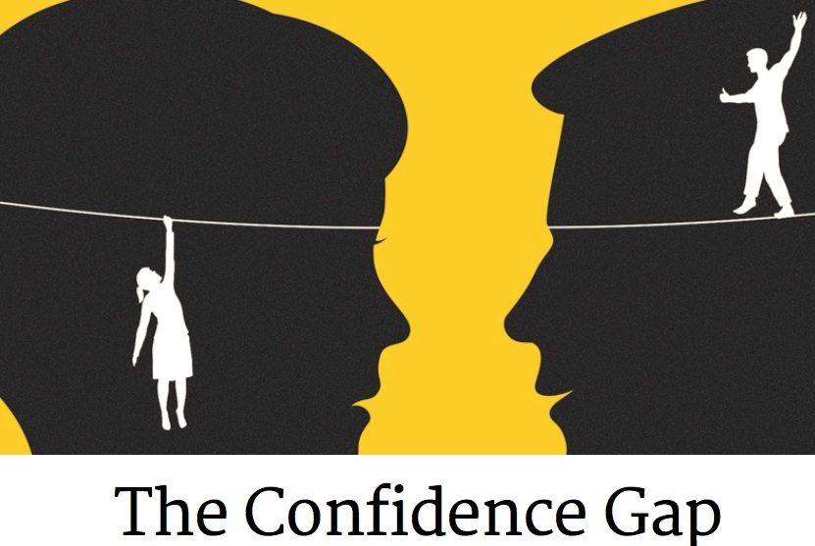
Essential #3: Building CONFIDENCE for 1st Gen
Counteracting prior “failure-is-likely” messages with – “I know you can do it”
Notes:
As students begin to feel that they DO belong in college, their confidence begins to develop. There are many ways to shore up 1st gen students’ confidence, and as we do so, it is important to remember that for many years they have received subliminal messages in our society that they probably CAN’T succeed. To counteract all those negative messages, both the overt ones and the many, many subtle ones, we will need to give a message of encouragement many, many times – counteracting each of those earlier incidents that have undermined their confidence . **I have had students tell me so many times that “Professor so-and-so just said ‘I know you can do this’” so I guess I’ll really try to finish this project!” You can never give that message too often, and you can never overestimate how important it is to re-state your message of belief in them as often as you can.

Slide 27

Building CONFIDENCE for 1st Gen
Addressing them as “future xxx’s”
Posting photos & articles, and quoting
ROLE MODELS
Notes:
Another approach developed by one of our faculty is to address them regularly in class as “Future Professionals” / “Future Nurses” / “Future Environmental Scientists” / “Future Video Producers” / “Future Managers” instead of addressing them in the usual manner as “Class” or “Students”. “Now, for your assignment tonight, future accountants, I want you to . . .” **Another well-recognized approach to build confidence is find pictures and stories about persons that look like your typical 1st gen student, and post those in your classroom, hold them up for students to see, and refer to them. **One research project had a male computer science faculty member put up pictures showing computer settings with a woman as the computer scientist or technician. By the end of the term, 20% more female students agreed to become computer science majors over the previous terms where only males with computers were pictured in the room.

Slide 28
Successful strategies for
Confidence-Building:
https://www.youtube.com/watch?v=56VVqEpWe9o

Slide 29

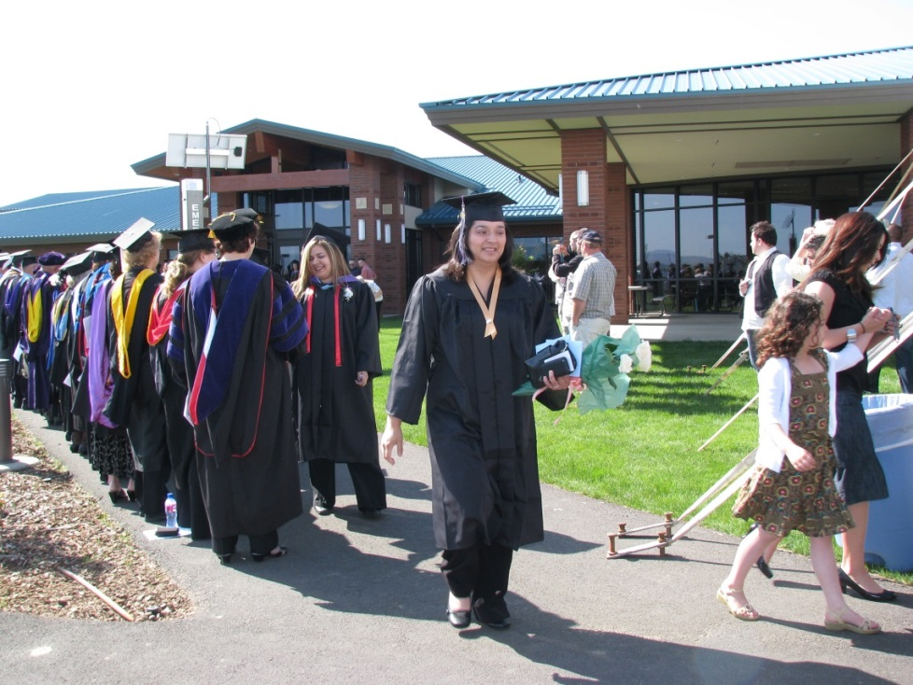
Essential #4: Vision for their Future for 1st Gen
Internships & Practicums
Bring successful Alums to campus
Notes:
The last proven element to help 1st gen students persevere to the end of their degree studies is helping them have a Vision of what could happen in their future if they complete their college program. **We’ve talked about referring to them in their future role, and being sure they see photos of people like them in the professional roles you hope they reach. Another approach receiving more attention and verification recently is having students participate in some field experiences in the general area they are preparing to enter. This could be on a volunteer basis, or as a practicum required within one of their classes, or as a paid internship. Working with local companies and non-profit organizations can help identify opportunities for students to have this key experience of working in their future profession. **Remember, continuing generation students probably have seen up close the settings where their profession of choice is practiced, thanks to their parents or other relatives. But low-income students haven’t had opportunities to see these settings up close, and so this experience is vital to keep them motivated toward graduation.

Slide 30
A Helpful Communication Theory
Empower YOU to create Breakthrough Strategies
Give you information to help you and your colleagues decode troubling events with students
“Communication Mismatch Theory”

Slide 31
“Communication Mismatch” aka “Meaning Mismatch”
when the meaning YOU give to a word, phrase, gesture, or non-verbal
≠ does not equal the meaning the OTHER understands from your word, phrase, gesture, or non-verbal
Notes:
During the remainder of our time together, I’d like to focus on two research-based INSIGHTS that can be very helpful as a platform for developing ways to provide the necessary support for your 1st gen students to succeed. **The first insight is special way to look at the communication challenge that exists when your experience is different in significant ways than the experience of the person you are trying to communicate with. It’s called “Communication Mismatch” or I like to call it “Meaning Mismatch”. This is when you say or do something with a specific meaning in mind, and you presume that it will communicate this same meaning to the other person. BUT, the other person already has another meaning for that communication and interprets incorrectly what you are trying to communicate.

Slide 32


Meaning Mismatch Example
Notes:
Let me give you a couple of examples. **One is something I discovered about handshakes shortly after I moved onto the Yakama Indian Reservation. I attended an event at the local Longhouse, and as I met people they each extended their hand for a handshake as they smiled and welcomed me. **But each time the other person’s hand was very limp and just held out to touch my hand or lightly rub past my palm. I was immediately puzzled and remembered so vividly my father teaching us how to shake hands.

Slide 33

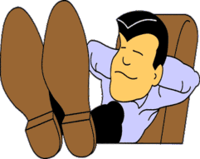

Another Meaning Mismatch
Notes:
Another example was written to me by a graduate student named Jorge Rodriguez from New York after he had read my book. He wrote: “Your book made me think of a seminar I had in college (perhaps my sophomore year). The seminar was led by a white, middle class woman . . . . During the [class] conversation I was slouching slightly in my chair and had my legs crossed—**in other words I was sitting comfortably—and I felt fully engaged in the conversation. I responded to questions, challenged and pushed my peers, wrestled with the topic—I felt like I was “in it.” **After the seminar the leader pulled me aside and asked why I was so disengaged and distant in the discussion. I was very confused by her comment and asked why she felt that way . . . She said it was because of how I was sitting, that I didn’t “look professional or interested.” ** I was confused because in my sitting comfortably I felt that I was expressing a level of comfort with the group, one which allowed me to engage fully. I felt I was communicating that “this is a conversation I would have over coffee with my colleagues, so I feel comfortable, and hope you sense my comfort with you all as a sign of respect.” She, on the other hand, felt I was communicating deep disrespect for the standards of “professional communication.”

Slide 34
Responding to a Meaning Mismatch
Friendly – self-effacing inquiry
Getting other’s interpretation first
Thank for sharing
Gently share your interpretation

Slide 35
Typical College Settings with Meaning Mismatch
Getting students to converse informally with a faculty member – key step to building relationships
Asking professors and administrators questions they need answers to
Notes:
I’m going to mention two other settings on a college campus where Meaning Mismatch is likely to occur. One is the process of establishing informal contacts between students and their professors. Many 1st Gen, low-income students have learned from their families that it is not wise to converse with anyone more experienced or higher up on the social ladder than yourself. **Yet, we know that forming a positive relationship with a faculty or administrative staff is a key pathway to belonging. When a faculty member tries to initiate a casual conversation, 1st gen students often answer in mono-syllables and don’t make eye contact. An unaware faculty member can interpret this reaction as meaning that the student does not want to relate or converse. Actually, the student may be excited that a faculty or staff member is starting to talk with him. If the faculty recognizes this meaning mismatch, she can continue pushing a conversation forward until the student begins to participate more fully. This effort, which may take several iterations, is important because it will gradually convince students that this faculty genuinely cares about their success, and that becomes a major motivation for a 1st gen student. ** Another example of a key mismatch with 1st gen students is the issue of asking questions. **Let’s listen to how one Heritage University professor developed ways to overcome this vital mismatch area.

Slide 36
A Helpful Social Psych Theory
Stereotype Threat
Relates to one or more of a person’s social identities: age or gender or ethnicity or ableness, or socio-economic class or athletic skills, etc. . . .
Happens when that identity carries stereotypes relevant in this situation
Notes:
The second Insight to share with you today is called “Stereotype Threat., a term from Social Psychology. To understand what this, you start by thinking about what social identities YOU have. For me, I would think of being a woman, being an older person with greying hair, being Caucasian, being fairly short, being middle class in terms of economics, being musical (I play the violin), but not being very athletic / don’t ask me to throw a ball any distance. Think about some of your social identities. ** Now focus on those identities that are relevant in a particular setting you might be in, where there are probably stereotypes connected to one or more of your identities. For instance, if I picture myself stepping onto a basketball court for an informal game at a Senior Center, I’m immediately aware of my identity as a SHORT person, generally stereotyped as not being a very good basketball player. Being SHORT is obviously relevant in that setting.

Slide 37
Stereotype Threat Effects
(Heightened awareness of an identity area that has negative associations)
Feeling at risk of confirming a negative stereotype about one’s group
Creates a feeling of anxiety
Automatic interferes with my highest mental abilities.
Notes:
Or take my current setting of being a university’s keynote speaker, coming to you as a former president. Here, being a woman has relevant stereotypes, because only about 1 in 5 university presidents are women and there are stereotypes we’ve all heard, portraying women as often not being very effective as CEOs of big, complex entities, especially when most of the organization’s professionals are male, like a typical university. So when I go to a meeting where the primary invitees are college and university presidents, most of whom will be men, I can’t help being aware that I’m not the norm, and that there are stereotypes about women as CEOs. Are you starting to see why “Threat” is connected to “Stereotype” here? ** At that meeting of university presidents, I want to be sure that I don’t confirm the stereotype that is out there about ineffective women CEOs! **And that creates some anxiety inside me, like walking on eggshells. And brain science has shown us in recent years that ** anxiety / fearfulness / worry / nervousness interferes with the smooth operation of my highest thinking abilities. I am distracted by this gnawing fear that I won’t look as bright or as competent as I believe women really are, that I will accidentally say or do something that will confirm that stereotype.

Slide 38

Stereotype Threat Effects
Under-performance
Lower confidence
May lead to giving up or failure
Notes:
So, in this setting, and suffering from this stereotype threat, I will not perform at my best. **The best thoughts and insights I usually have in more relaxed settings won’t be coming to mind, and I won’t have the courage to share them if they do. **It is easy to see how this phenomenon of Stereotype Threat can be operative with a 1st gen student especially those from ethnic minorities. They are very aware that they don’t look like the majority of other students in a class, maybe they don’t have the same quality or current style of clothes as others due to their tight economic circumstances; maybe they realize they can’t contribute any stories of family members’ college experiences when other students are sharing; maybe they know their English is not as fluent as most of the other students. And with each of those identity differences, students are aware of the stereotypes of failure or incompetence attached to people “like them”.

Slide 39

Lessening Stereotype Threat
Be watching for its presence
Refer to role models who have similar identities
Encourage and
confirm self-affirmation
De-emphasize the threatened identity(ies) / refer to other aspects of their identity
Notes:
Being aware that stereotype threat exists is the first step in helping to lessen it. ** If you are watching for signs that students might be experiencing stereotype threat, you can be proactive about changing how they are thinking. **We’ve already discussed using role models of people who are successful in the relevant field, and who look like the students themselves. **We’ve also talked about the importance of constant encouragement and affirmation that the student CAN succeed. **Another approach is to de-emphasize the threatened social identity. For instance, someone who was trying to lessen my stereotype threat as a woman university president could focus the conversation on where we all got our graduate degrees. Talking about the various Ph.D. programs we were in immediately de-emphasizes the GENDER of the university president. So look for other aspects of the student’s identity that are not subject to stereotype threat.

Slide 40
More info on Stereotype Threat:
Whistling Vivaldi by Claude Steele
and great practical ideas:
http://www.reducingstereotypethreat.org
Notes:
A book by Claude Steele, who is currently a Professor of Psychology at UC, Berkeley, is the best resource on Stereotype Threat. It has a fascinating title: Whistling Vivaldi, and explaining where he got that title is a great story that captures the meaning of Stereotype Threat. One of his graduate students in Chicago, was an African-American kid who daily walked from his home through an all-white residential neighborhood to his restaurant job. The kid noticed that whenever he walked down the street, groups who were chatting would move off the sidewalk, get out of his way as he walked by. His family often played classical music, and one day as he was walking through that same neighborhood, he starting whistling tunes from Vivaldi’s The Four Seasons. Immediately he noticed that as he approached a group of ladies, they looked up at him and smiled. They didn’t try to move off the sidewalk, and one of them smiled at him. The stereotype they usually saw of him – a young black kid who might be dangerous – was transformed into a young man who obviously heard the same kind of music they played in their homes. Must be a smart kid to whistle it! Amazing story, isn’t it? It leads us to ask, what can we do in our university to lessen the experience of stereotype threat that keeps students from having confidence, becoming really engaged, and feeling they belong?

Slide 41
Thank You! Check out the other Breakthrough Strategies Videos at www.heritage.edu/institute
Notes:
Thank you for walking with me today through some of the challenges and opportunities we have as the number of 1st gen, low-income students increase in our entering classes! I wish you the very best in inventing your own creative solutions to the barriers these students experience. May God bless each one of you!

