Slide 1

First-Year Athlete Student Success and Retention
Notes:
Liz will lead introduction.

Slide 2
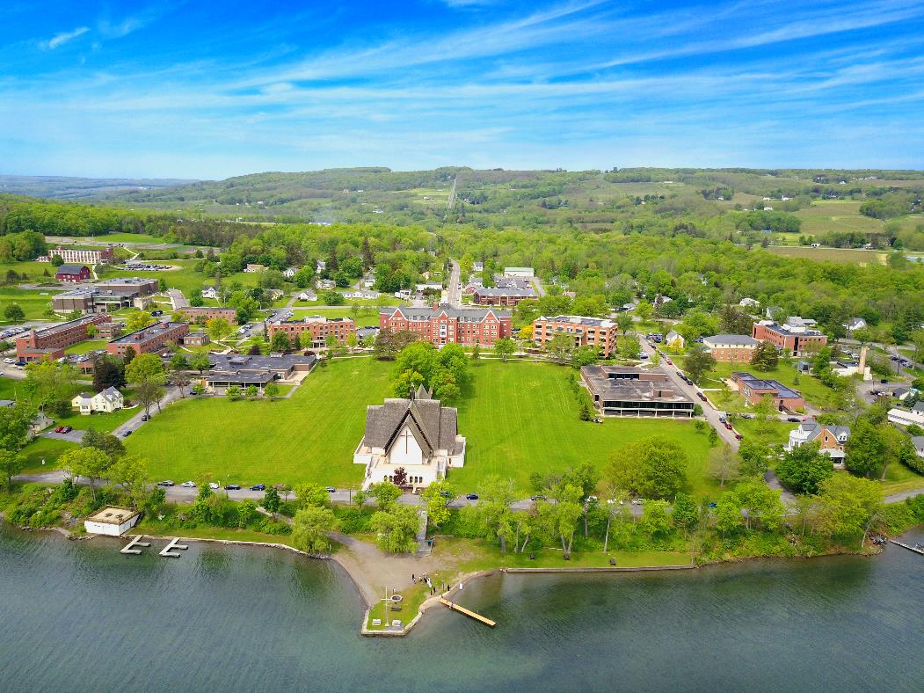
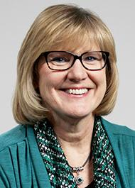
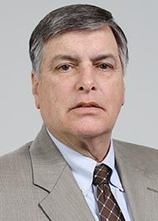
Dr. Elizabeth Lambert
David
Sweet
Dean of Student Success and Chief Retention Officer
Director of Athletics
Keuka College
A small, private college in Keuka Park, NY
Notes:
Liz will introduce herself and then Dave will introduce himself. Liz will point out the location of our beautiful, rural campus on Keuka Lake.

Slide 3



Overview
Keuka College Background
Founded in 1890 and evolved to an all women’s college in 1921. In 1984, went co-ed and in addition to 4 women’s athletic teams, implemented men’s basketball team in 1985
NCAA Division III, currently a member of the NEAC conference and moving to the Empire 8 in Fall 2020
Small, private college that emphasizes experiential learning and preparing students for postgraduate success
Intercollegiate Athletics offer 8 men’s, 9 women’s, and 5 co-ed teams
In the Fall of 2016, started an Office of Student Success and joined the EAB Student Success Collaborative
Located in the Finger Lakes region of New York State
Just over 1,000 on-campus undergraduate students and another 700 undergraduates in the adult professional studies program off campus
312 student athletes
60% six-year graduation rate and 83% overall retention rate
Notes:
Liz will go over green box, and Dave will cover bullet points under background up until last bullet on EAB, Liz will cover that point.

Slide 4
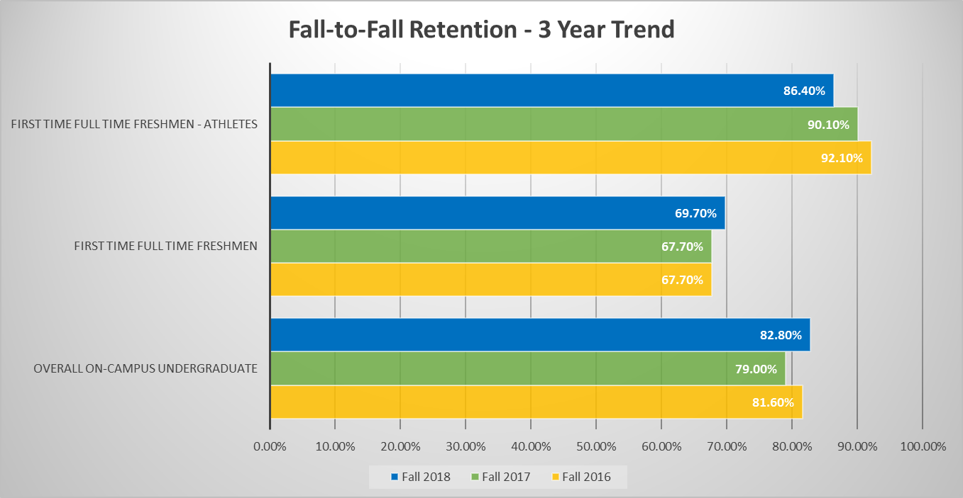
Retention Outcomes
Notes:
Liz will start by discussing FR and overall retention rates, then pass to Dave to talk about Athlete retention rates.

Slide 5
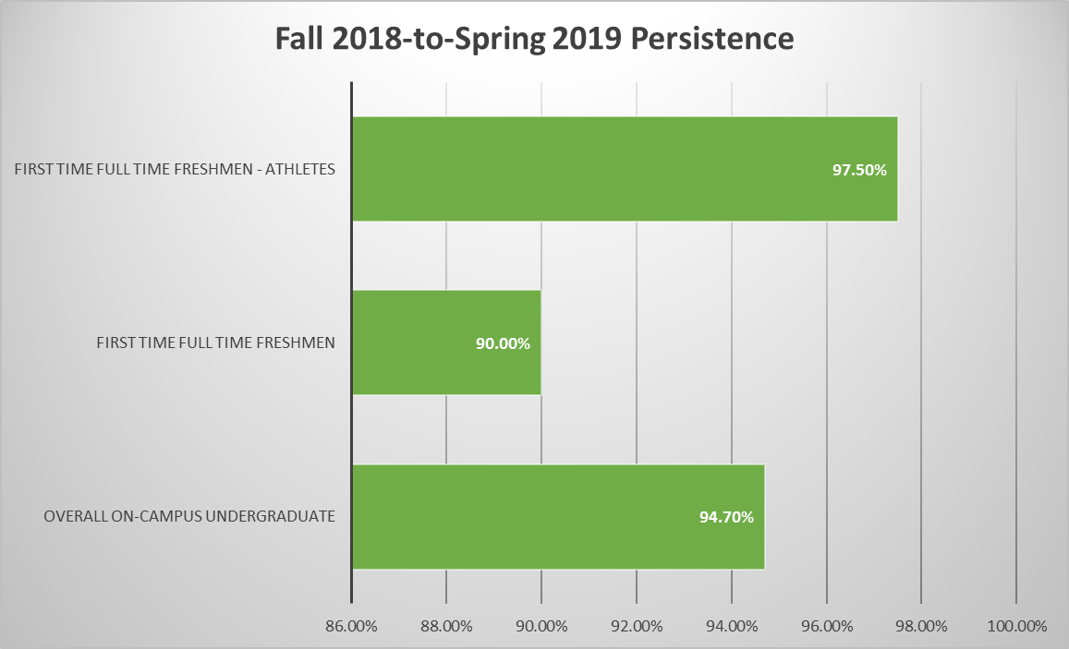
Persistence Outcomes
Notes:
Liz will cover this slide.

Slide 6
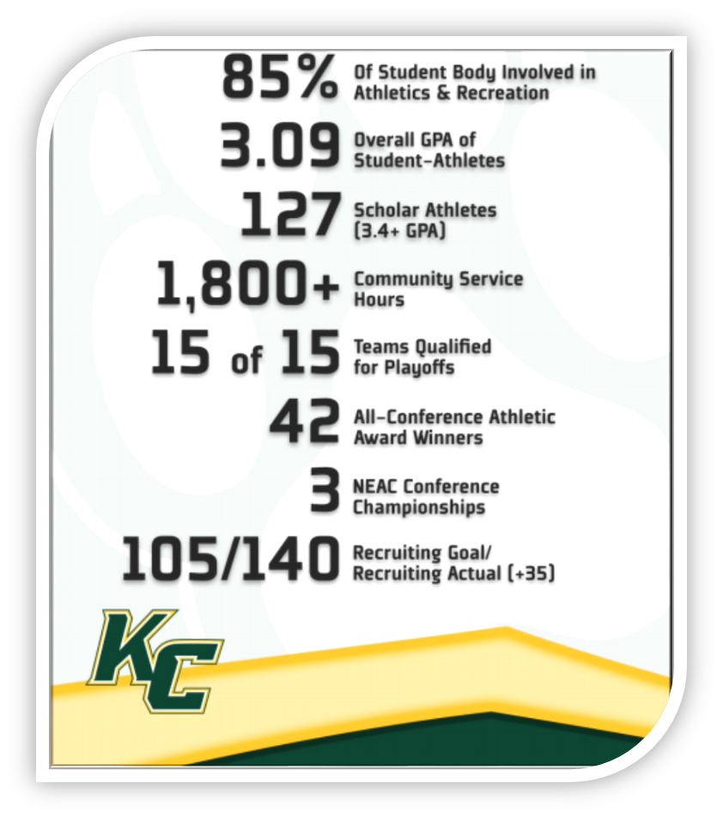
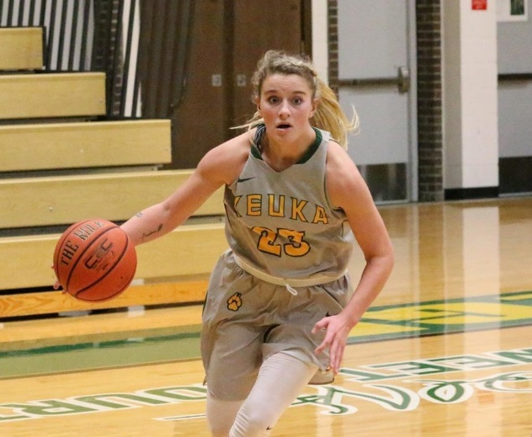
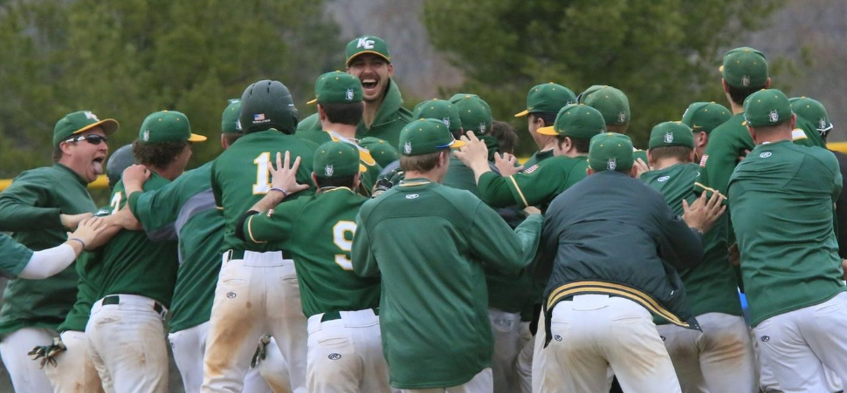
Other Outcomes for Athletes
Notes:
Dave will cover this slide.

Slide 7

Student Success Initiatives
Focus on relationships (building community)
Goals for coaches emphasize recruiting,
retention, and student success
Coaches promote tutoring and
academic support
Coach’s access to student data
Team of support for each student
Parent engagement
Student Athlete
Coach
Student Success Advisor
Academic Advisor
Teaching Faculty
Residence Life Staff
Co-curricular Support
Notes:
Dave will take first three bullets, Liz will take last three bullets.

Slide 8

Questions?
Elizabeth Lambert Dave Sweet
elambert@keuka.edu dsweet@keuka.edu
(315) 279-5412 (315) 279-5682
More information available at www.Keuka.edu
Notes:
Liz will close.

