Slide 1

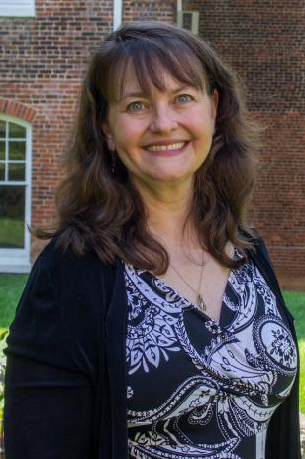
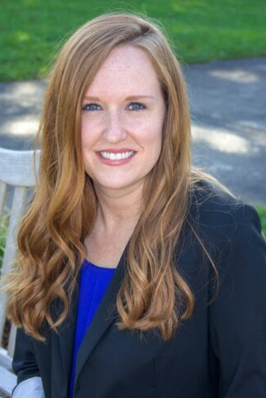
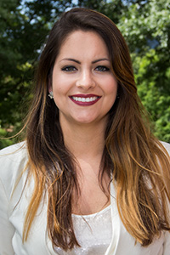
Removing Barriers for Adult Students at Mars Hill University
Donna Parsons
Dean of Professional Studies & Social Sciences; Adult & Graduate Studies
Kristie Vance
Director of Admissions; Traditional, Adult, Graduate
Carolyn Kuzell
Associate Director of Admissions; Adult & Graduate Studies Counselor

Slide 2
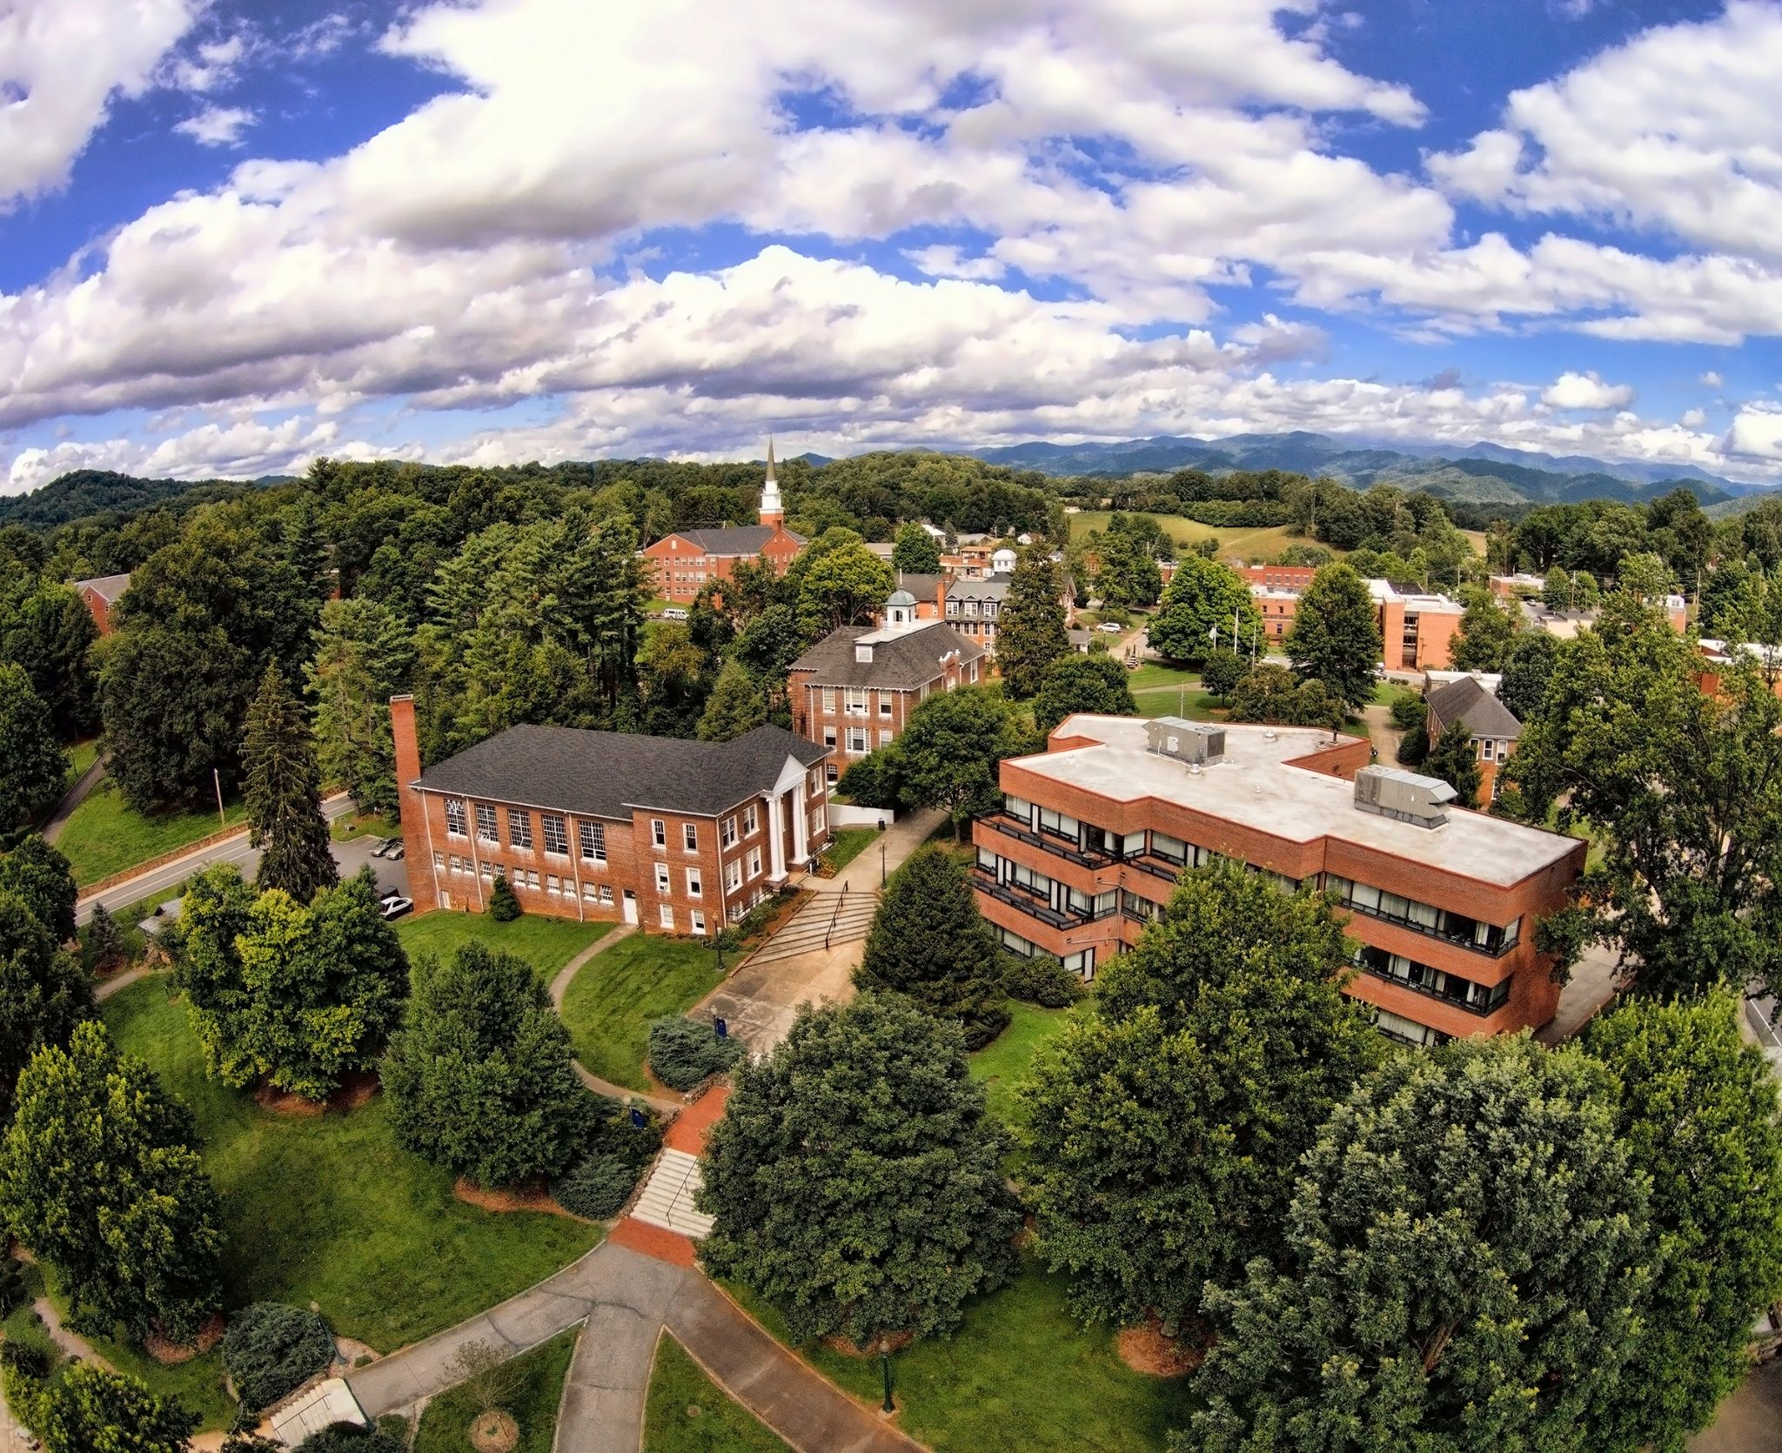
About MHU
Overall enrollment just over 1000 students
Adult Population
4 programs offered
  Business Management
  Social Work
  Psychology
  Education (Elementary, Special, Integrated)
Over 50% Pell eligible
Over 20% First generation
Graduate Population
4 programs offered
  Master of Management
  Master of Arts in Teaching
  Master of Education
  Master of Arts in Criminal Justice

Slide 3
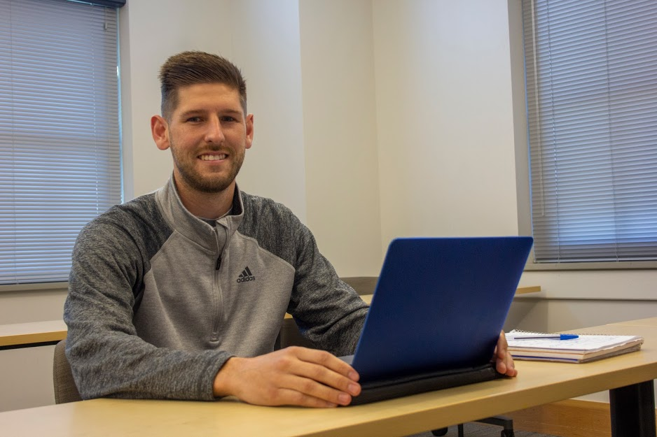
Reimagining Adult and Graduate Studies at MHU
Structural Changes
  Dean’s position
  Common Admissions Office/Financial Aid
  Advising in academic programs with dedicated advisor
  Scheduling in academic programs
  Full-time faculty
Program Changes
  New online programs
  Hybrid seated programs
  Minors

Slide 4
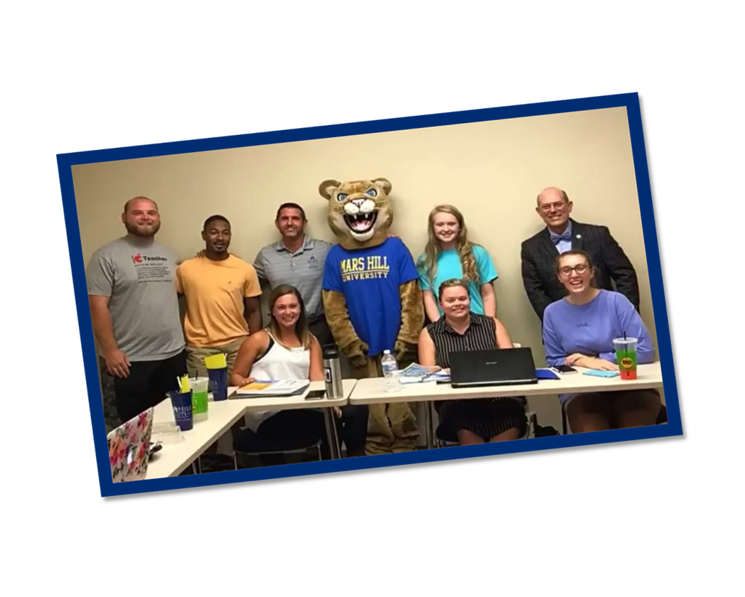
Resources & Support
Scholarships & Financial Aid
  Creating institutional dollars
  Incentivizing cohorts of new online programs
Building a clear path to graduation
  Articulation agreements
  Transfer Promise
Community & corporate partnerships
Dedicated staff
Academic, Health & Safety resources

Slide 5
Place
Potential
Purpose

Slide 6
Donna Parsons
dparsons@mhu.edu
Kristie Vance
kvance@mhu.edu
Carolyn Kuzell
ckuzell@mhu.edu

