Slide 1



OERs at MHU
Presented By:
Kevin Mulhall
& Chris Cain

Slide 2
Who are We?
Total of 955 Students Undergraduate
  At least 27% of our students are minority
  39% are first generation students
  55% are low income
  115 students have some form of disability.

Slide 3
Why we may be different
Students do not pay for textbooks at MHU
We spend approximately $500,000 per year
We work with a vender – however, high use books are purchased.

Slide 4
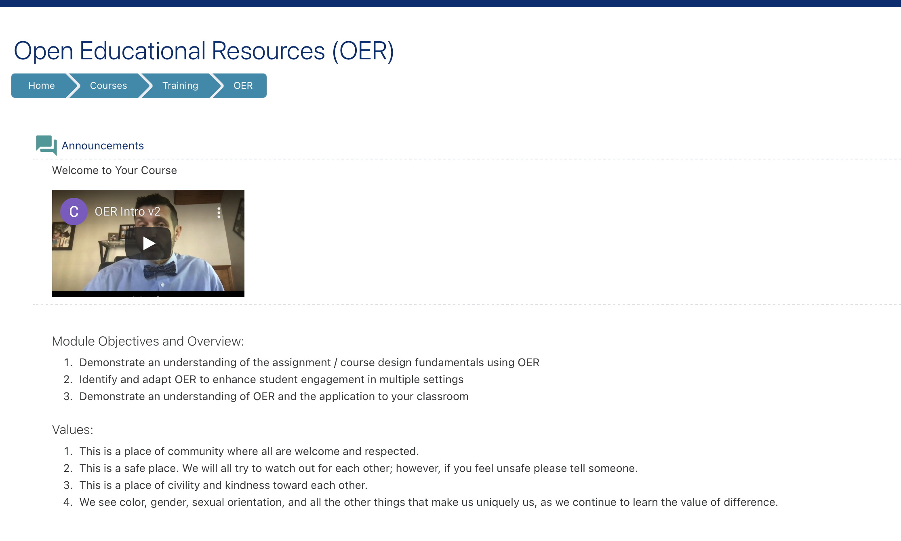
OER Training
High-cost courses were identified
Stipends offered / faculty volunteered
Easy to link directly to institutional savings
This was our Pilot Program

Slide 5

Evaluation / Shifts in Pedagogy

Slide 6
Contacts
Kevin Mulhall kevin_mulhall@mhu.edu
Chris Cain ccain@mhu.edu

