Slide 1
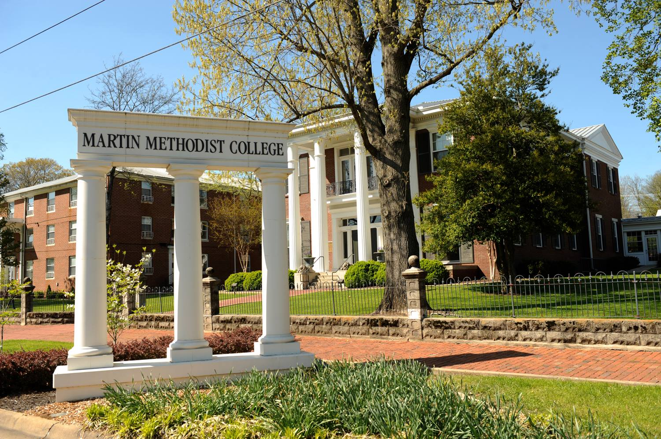
Martin
Methodist
College
Judy B. Cheatham, Ph.D.
Provost & Vice President of Academic Affairs
June 20, 2019
PICTURE HERE!

Slide 2
Martin Methodist College: An Overview
Typical Service Area: 18 county region along Tennessee-Alabama line
- 17 of 18 characterized as “poor” or “rural”
- Only four-year institution in this region
SACSCOC Accredited
25 majors, Business Management is the most popular
33 minors, emphasis areas
40% male, 60% female
37% six-year graduation rate; 61% overall retention (FA17 to FA 18)
97% of degree-seeking students are full-time
Mission is commitment to teaching, student learning, public service
- Historically committed to education in the liberal arts and sciences AND spiritual and social message of the United Methodist Church
- Especially committed to economic development in the geographic region
* Tennessee, 44th in the nation for post secondary attainment
* Fewer than one-third low income students in Tennessee enroll in post secondary

Slide 3
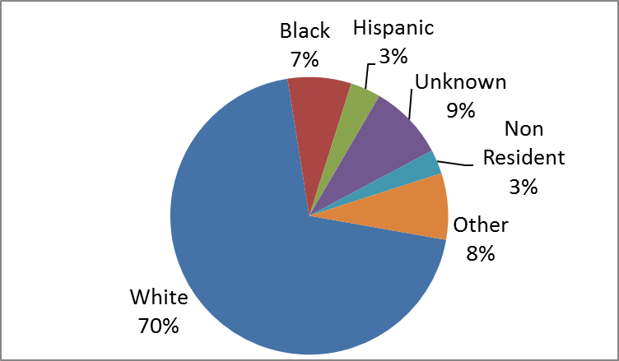
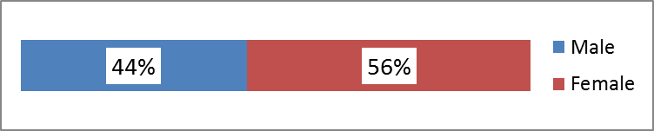
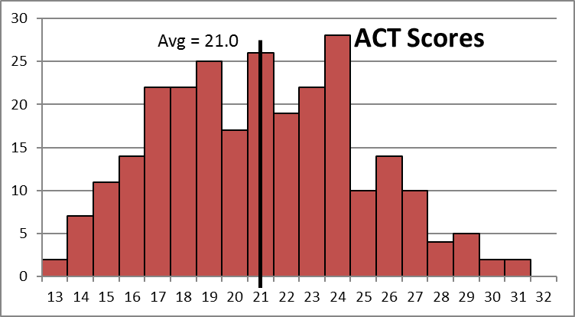
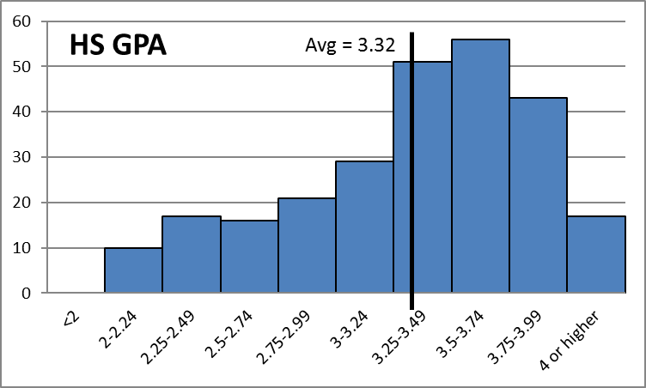
Martin Methodist College: An Overview
52% FTFT Retention (FA 17 to FA 18)
277 Incoming Freshmen (FA 2018)

Slide 4
Examples of the Ways in which MMC
Uses Data
Modifications based on data
Evidence-based decision making
Grant Applications
Comparative examples of “apples to apples” when talking with external constituents, including Board of Trustees
SACS-COC self-study
- QEP

Slide 5
Sometimes, it’s about attitude…
YWM sample- 17, 863 students
Findings influencing several changes to MMC
- Athletes outperform non-athletes ➔ change in perspective
- Students who have earned credits before college outperform students who have not earned credits before college; strongest prediction of persistence
➔ change in Dual Enrollment and in
First Year Experience

Slide 6
Data-driven Results?
Quality Enhancement Plan (QEP): High Impact Practices
- not necessarily new and improved
- more like systematic, evidence-based, enhanced, … and funded
* written and oral language intensive
* internships across all majors
* capstone experiences
* service learning
* student-faculty research
* travel away
* First Year Experience

Slide 7
As an Example…
Transformation of First Year Experience
  - less focused on academic content
  - more pragmatic and learner-centered
  - more “How to College”
  * Common Reader – college catalogue
  * First Year Advising – FYE professors
  * Conferencing – FYE professors within first 2-3 weeks of class
  * Learning Communities – 3 common meeting times
  * Community Service – Into the Streets, Boo-Out, Visit Santa
  * Project-based Learning – perceived “problem” either
  on-campus or in larger community: identify, explore, research,
  interview, analyze, present findings and possible solutions

