Slide 1

Yes, We Must:
Affordable Learning at MSMU
October 28, 2021

Slide 2
About Mount Saint Mary’s University
Located in Los Angeles, California
  Tongva/Gabrieleno land
  2 campuses: Downtown LA and Brentwood
CSJ founded
Historically a women’s college/university
  90% identifying female
3,028 students
  58% Hispanic
  14% Asian / Pacific Islander
  11% Other/Multi
Student retention is 75%
Pell Grant recipients for 4 year graduates = 51% (higher for 6-8 year graduates)
Notes:
Two campuses located in Los Angeles, California. Hstorically a women’s college/university with 90% identifying female. Our 3,028 students are 58% Hispanic, 14% Asian/Pacific Islander, 6% Black, 11% White and 11% Other/Multi-Racial. Designated HIS and AANAPISI. Student retention is 75% and 51% of traditional 4 year undergraduates are Pell Grant eligible. Many students are the first in their families to attend – and finish – college. Also, as a CSJ founded institution, equity and social justice work is a major part of the institution, so this provides an incentive for our affordable learning initiatives.

Slide 3
Affordable Learning at MSMU
Goal: Increase student success by reducing textbook costs
  Improve academic performance
  Reduce time-to-degree
Strategies:
  1) Create incentive program for faculty to use OERs and/or library-licensed materials
  2) Promote the libraries’ ebook collection
  3) Expand print reserves
Notes:
Improve academic performance = from having all course materials on Day 1. (1/3 of students report not purchasing all their textbooks). Sometimes it takes several weeks before students have their books and their grades suffer.
Reduce time-to-degree = able to take a full load of classes without breaking the bank
Re: Ebook Collections – the Libraries own and license annually ebook packages from Springer, Gale, etc. Many of the books, though inherently discoverable, are not always found due to search strategy or where the books are listed on the results screen. We have over 300K ebooks and want to make sure that the relevant ones stand out.

Slide 4
About the Affordable Learning Materials Initiative (ALMI)
Launched in Spring 2019 (January!)
Collaborated with the Instructional Design team
$1,000 stipend offered (used Library gift funds)
Three Summer Term classes
  Biology 2 (Lab course)
  Microeconomics & Macroeconomics (One instructor!)
Both instructors selected Open Textbooks from OpenStax
Course materials were delivered via LMS (Canvas)
Notes:
Mount Libraries and ID Team launched ALMI in Spring of 2019 in response to concerns shared by the AA Dean about students delaying their educational progress because the required textbooks were too expensive. They were concerned that for the wont of a textbook, students would not take a core course – like a math class.
The Instructional Design team had been trying to encourage use of OERs in introductory or core classes with little success.
Voluntary program – offering a stipend incentivized Faculty to choose to switch course materials.
Used Library Gift funds to offer a $500 stipend for 2 Faculty members a semester to revise a course based on an open textbook or library-licensed material. No one applied for the grant until we doubled the stipend amount. We know that Federal/State taxes are taken out of the total stipend amount so $500 isn’t a lot when it has been so reduced. We recently reduced the stipend to $750 and the interest is still there so maybe timing is everything.
We accepted two applications: a business professor teaching Macroeconomics and Microeconomics (a two-fer), who proposed using OpenStax textbooks for both classes, and a biology professor who wanted to teach a lab course without students needing to buy a $200+ textbook. OpenStax – along with some additional you-tube videos – worked for this professor, too. The Instructional Design team assisted in embedding the textbook modules into Canvas.
During the Spring 2019 term, we met with each professor twice and were in contact via email throughout the process. Each course is different, but we expect the instructors and librarians to collaborate equally in the process.
Students were asked to respond to a short survey partway through the term. Responses were mostly positive and any issues students had were addressed quickly.
Unfortunately, the Bio instructor left the University after that Summer so the new Bio students still need buy the pricy books.

Slide 5
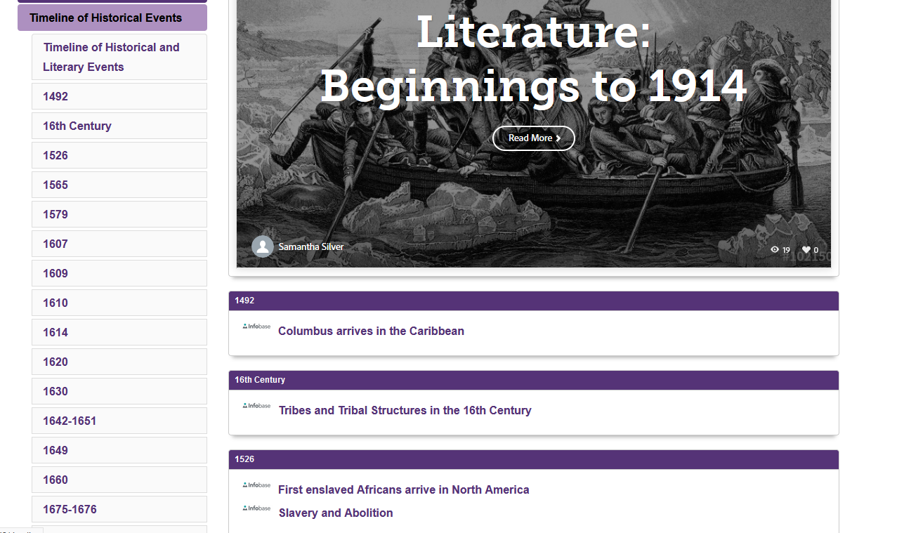
Using LibGuides
Notes:
Fall 2019 - fewer applications led to choosing an English class that was using mostly out of copyright works. We also built a libguide timeline so that students could understand literature’s historical context, linking important historical events to library-licensed encyclopedia and primary source articles.
One benefit of the libguides is that they can be embedded in Canvas so students may access their course information in more than one place.
We also added a “Faculty Report” to the ALMI requirements for better assessment of our efforts and more accurate enrollment data so that we could determine the cost savings of taking a course with affordable materials. And, faculty felt free to share their impressions of students’ work.
We’ve used libguides for a couple of other courses and the format seems to work well. And other English professors allow students to use any edition of the novels they read.

Slide 6
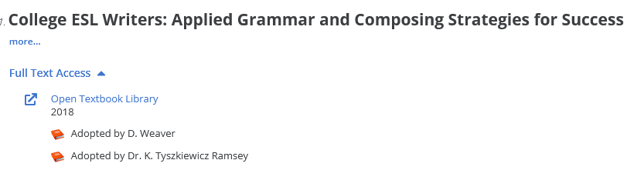
COVID-19: Moving Forward (Spring 2020)
Launched Adopt-an-Ebook Program
Course Reserves
  Licensed electronic books & Films by request (from Faculty as well as students)
  Course Reserves and Adopted ebooks contributedto a 39% rise in usage!
Notes:
When instruction moved online, the Nursing class were planning to develop fell through as the professor was no longer scheduled to teach that class and her other classes were not textbook heavy.
In order to keep ALMI’s momentum going, we started the Adopt-an-Ebook Program, in which we offered Faculty the opportunity to see their names in our catalog as champions of specific ebooks or open education textbooks. We hoped that this would increase ROI on our already owned books and did not offer a stipend to participate.
All we asked was that Faculty tell us which books they wanted to adopt. This works pretty well, though sometimes we discover the use of e-books during other conversations with instructors so the adoption process starts a little late.
We also continued building our Course Reserves collection by purchasing ebooks and print books at Faculty and Student request. Some publishers don’t offer ebooks of specific titles, the preferred edition is not available or the license is inhospitable, but our print book budget allows for multiple copies and we’ve been able to scan selected chapters of key texts as long as we remain copyright compliant.
With these programs, usage on licensed ebooks rose by 31% in 2019-20 and 39% in 2020-21.

Slide 7
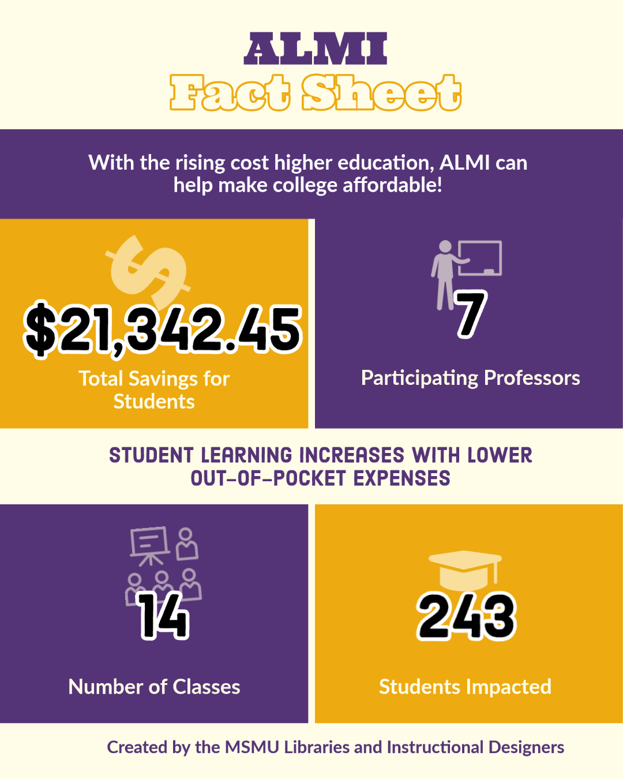
Affordable Learning by the Numbers
Notes:
While we do not have exact numbers of student beneficiaries and costs saved for Adopted ebooks or course reserves books, we estimate about $70,000 in student savings based on the number of students enrolled and the cost of the books we purchased. Some students still choose to purchase their course texts.
During the COVID closures, though we did not add new ALMI courses, the instructors using OpenStax books (Business, Sociology) continued using them so we were able to add to our number of student beneficiaries. Some courses have been offered more than 3 times since we started tracking them. We are especially grateful to the Sociology professor who recently switched to the 3rd edition of the Intro to Sociology book for the current term. This class is one of our larger ones, with over 50 students per term.
This Fall, we launched our first Nursing course. Our Health Sciences Librarian worked with a truly motivated and enthusiastic instructor to locate materials in the library’s electronic book and article collections as well as videos, podcasts and open access articles that met the learning objectives. In the professor’s Faculty Report, she said that
"I do not intend to go back to using textbooks again! Utilizing current content, evidence, and research is a best practice for the 21st-century educator.“
When we recently reduced the stipend to $750, faculty members still applied for Spring courses. Involvement in ALMI is still the instructor’s choice and we hope that monetary incentives will, one day, no longer be necessary. Collections of OERs grow monthly so there are more viable choices for textbook alternatives.
Looking ahead, we plan to initiate an OER creation program in which Faculty can re-mix and design their own textbooks that meet their learning objectives. We hope to collaborate with a Spanish professor with OER publishing experience. We are looking at LibreTexts as a platform for this project. And it would be great to connect our professors with professors at other institutions who are interested in creating OERs on the same subject.
This is a good time to launch and expand equitable learning programs as Faculty and Administration awareness is growing every day.
.

Slide 8
Links & Thanks
ALMI Guide: https://msmu.libguides.com/affordable (public)
Course Guide (NUR184T): https://msmu.libguides.com/c.php?g=1154893 (public)
Course Guide (ENG145): https://msmu.libguides.com/eng145 (public)
Course Guide (ENG195): https://msmu.libguides.com/english/austen-bronte (public)
BIO2 Supplementary material: https://msmu.libguides.com/c.php?g=932118&p=6718433 (private)
Samantha Silver, Electronic Resources Librarian, ssilver@msmu.edu
Notes:
We are grateful for our Faculty supporters who share information about the Library’s electronic collections with their colleagues. This is, in no small part, due to our dynamic Library Director, Danielle Salomon, whose vision catapults our ideas into action. With ALMI, in two years, we have saved students over $21,000!
Thank you for giving me the opportunity to speak to you today about the Mount’s affordable learning efforts!

