Slide 1



Slide 2
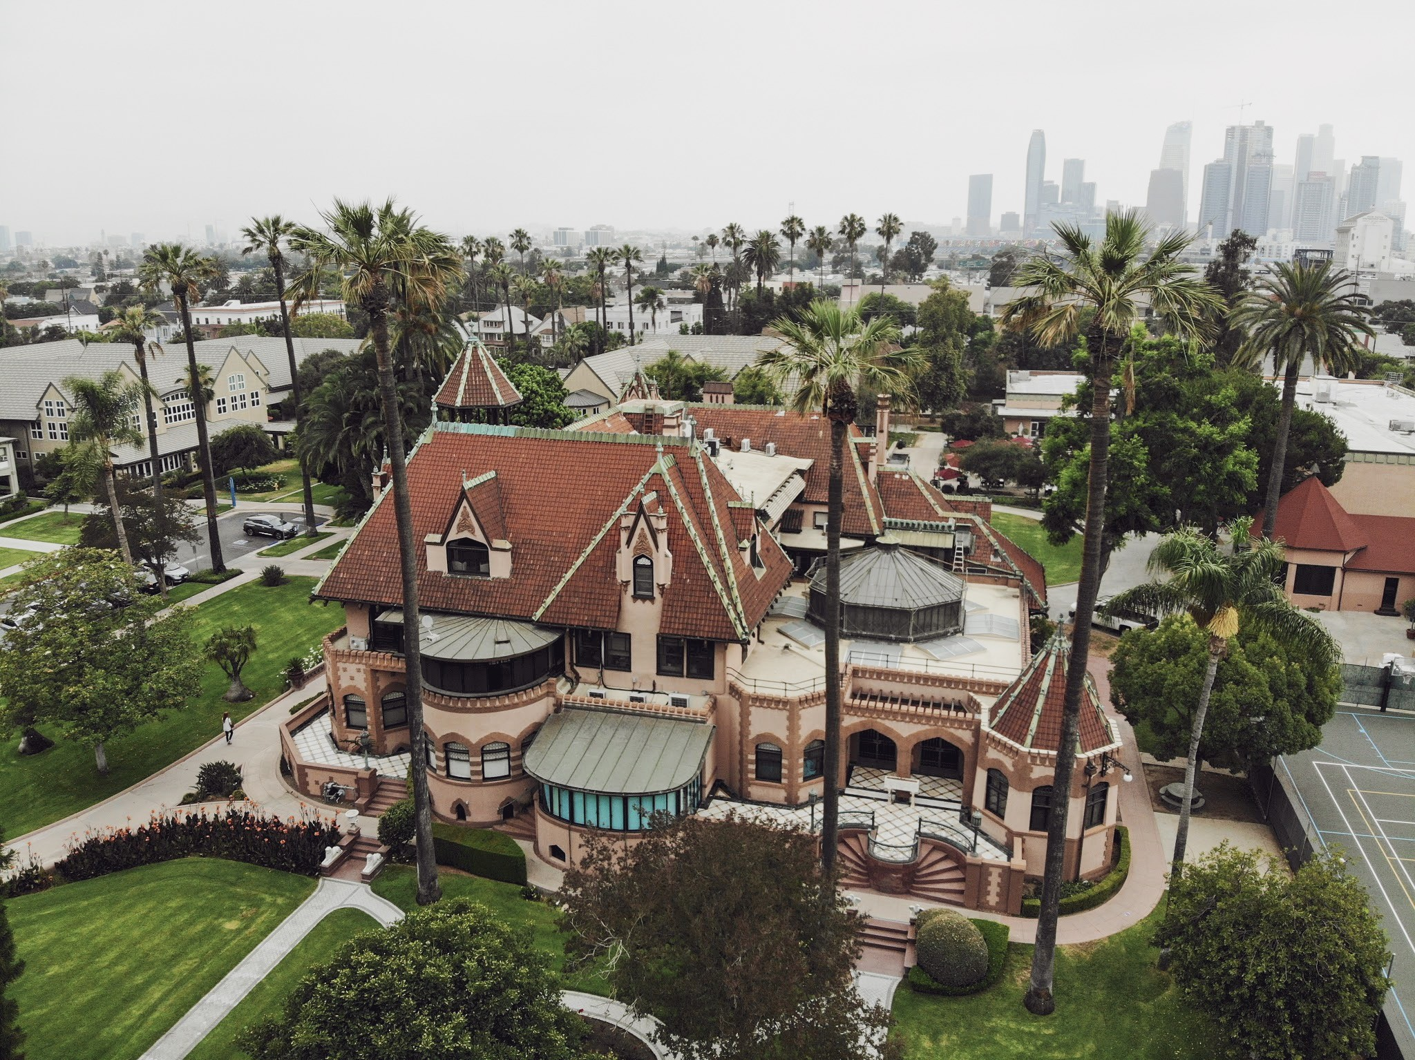
Suzanne Williams, LCSW, LMFT
Dean of the Weekend/Evening & Online College
swilliams@msmu.edu
Araceli Aguilar-Sigaran, M.S.
Director of Admissions
asigaran@msmu.edu

Slide 3
History
Founded in 1925, Mount Saint Mary’s University, LA is an independent Catholic, liberal arts university which provides a values-based undergraduate education, with innovative programs for professional men and women
The Weekend College began in 1991 with 91 students and was located on the Chalon Campus. In 2006 we moved to Doheny Campus in historic West Adams area of Downtown LA. Evolved into Weekend/Evening and then Weekend/Evening & Online College.

Slide 4
Rankings
Forbes ranked MSMU 23rd (out of 95) in Regional Universities in the West
MSMU ranked No. 2 Most Transformative Colleges in 2019 (Nationwide)
MSMU ranked No. 14 Best Colleges in America (Regional Universities in the West)
MSMU ranked No. 1 in Top Performers in Social Mobility (Regional Universities in the West)
MSMU ranked No. 4 Best Online Colleges Offering Accounting Degrees in (OnlineU.com, 2021)
Recognized as one of the Top Adult Undergraduate Programs in Los Angeles, and the State of California since 2017 (Abound Finish College)

Slide 5
Student Population Overview
78% work 40 hours+ per week
73% are first generation college students
51% of WEOC pursue graduate coursework
Average age: 37
Average Transfer Units: 43
Average CUM GPA: 3.2
Average Transfer GPA: 2.4

Slide 6
Majority female – about 3-4 % male
Race & Ethnicity – 62.8 % Latinx, 3.6% Asian, 13.8% Black/African American, 10.2% White
70-73% Pell-eligible
Top majors – Business, Applied Psychology, Social Work
89% Satisfied / very satisfied with academic advising
94% Likely/very likely to recommend to friends/family
Graduate approximately ¼ of our student population each year (80-100 graduates each spring)

Slide 7
Adult Friendly Admissions Process
1:1 Appointments
Virtual Events
Qualify prospects
Motivation
Potential Challenges
Affordability

Slide 8
Application Items
Online Application
Essay – 2 page
Letter of Recommendation
Transcripts
FAFSA
Admission Interview

Slide 9
Fast-track Application
Fast-track Application
Supplemental Items (Essay, LOR, and Transcripts)
Transcript Request Authorization Form
Admission Interview
Application Fee Waived

Slide 10
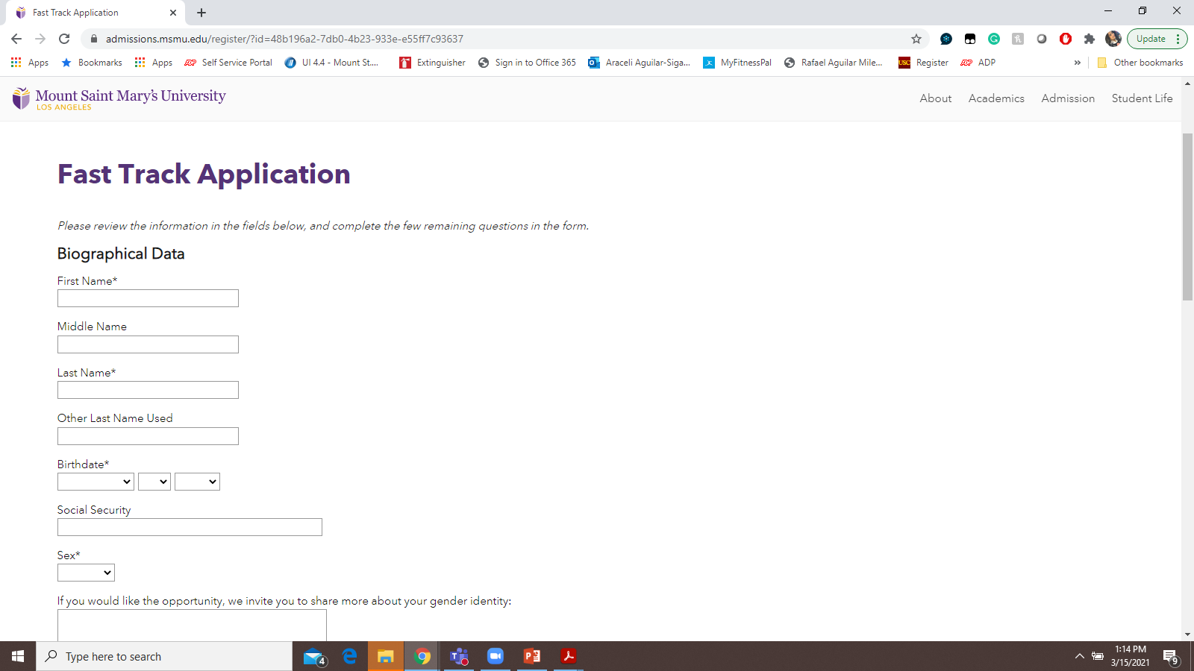

Slide 11
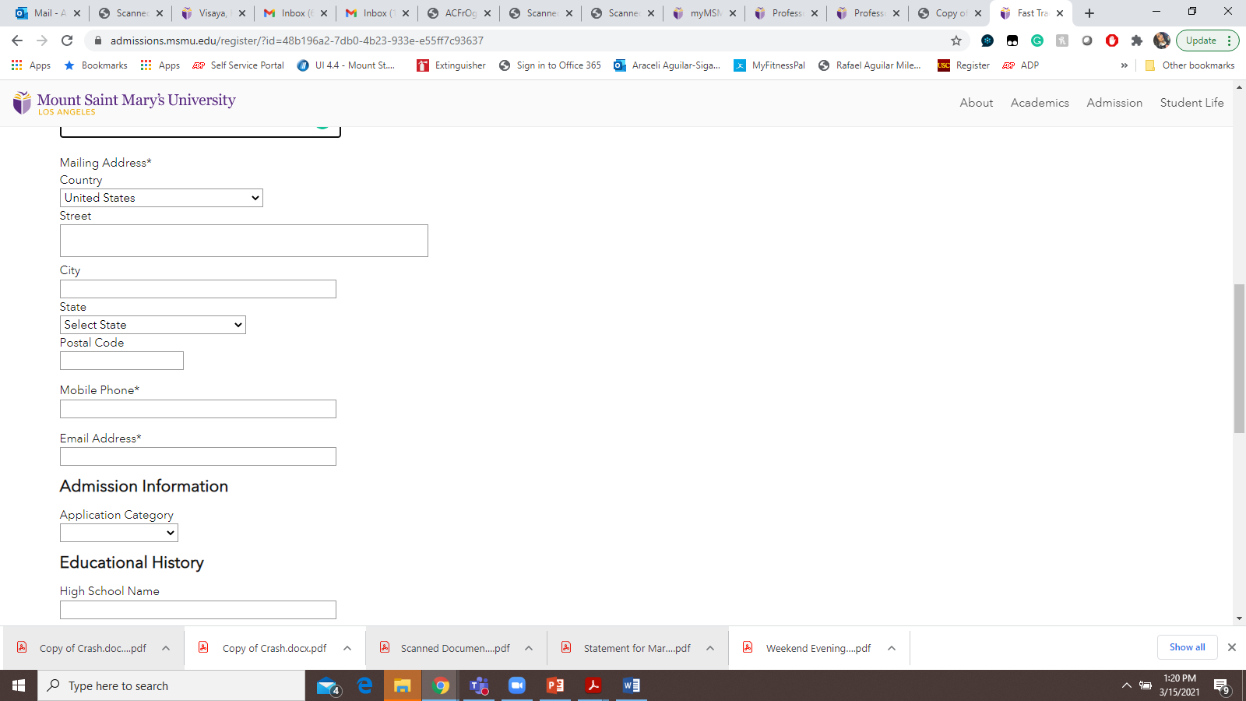
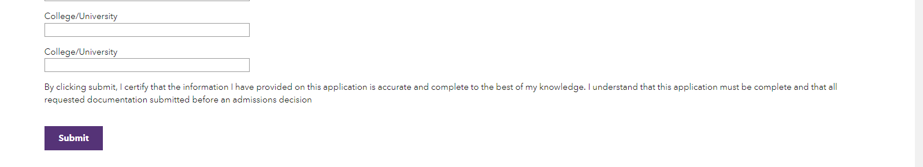

Slide 12
Transfer Process
70 lower division units may be transferred
Additional upper division units may be transferred from 4-year institutions
AP Test Credit
Credit for Prior Learning (12 units)
Portfolio
Lower or Upper Division Electives
Joint Services Transcript (Military Transcripts) (15 units)

Slide 13
A Major Decision
BA Applied Psychology
BA Liberal Arts
BA English
BA Business & English
BA Religious Studies
BS Sociology
BS Business Administration
BS Criminology
BS Social Work
BA Film & Media
BFA Professional Photography

Slide 14
Flexibility Matters
Weekends:
Evenings:
Online:
classes meet on 6 non-consecutive weekends (BOTH SATURDAY & SUNDAY)
Approximately 1 to 2 weekends a month
classes meet once a week, per class (for example: Every Monday of the semester from 6:00pm-9:00pm)
classes take place in an virtual format
Low Residency Pathways: Meet for classes once a week, supplemented with online coursework

Slide 15
Weekend Format
Saturday
Class 1 | 8:00am-10:00am
Break | 10 minutes
Class 2 | 10:10am-12pm
Lunch | 40 minutes
Class 1 | 12:40-2:40
Break | 10 minutes
Class 3 | 2:50pm-4:20pm
Break | 10 minutes
Class 1 | 4:30pm-6:30pm
Sunday
Class 3 | 8:00am-10:00am
Break | 10 minutes
Class 2 | 10:10am-12pm
Lunch | 40 minutes
Class 3 | 12:40pm-3:10pm
Break | 10 minutes
Class 2 | 3:20pm-5:20pm

Slide 16
Weekend Format Schedule: Fall 2021
Weekend Format | Saturday | Sunday
Weekend #1 | 8/28 | 8/29
Weekend #2 | 9/18 | 9/19
Weekend #3 | 10/2 | 10/3
Weekend #4 | 10/16 | 10/17
Weekend #5 | 11/6 | 11/7
Weekend #6 | 11/20 | 11/21

Slide 17
Scholarships & Grants
$1,500 Adult Incentive Grant: All Students Qualify (Step-outs/ New Students)
Presidential Transfer Scholarship: $2,000- $6,000 per year: Students with a 3.0 Transfer GPA (New Students)
Merit Awards: (Continuing Students)
Ahmanson’s Scholarship (Veteran Students)
Phi Theta Kappa: $2,000 Grant

Slide 18
“You gain strength, courage and confidence by every experience in which you really stop to look fear in the face. You must do the thing you think you cannot do.” Eleanor Roosevelt

Slide 19
Removing Barriers
Mission – To partner in the growth and success of post-traditional students on-campus and online by fusing education and life experience in order to increase global awareness and prepare for lives of service, innovation and continual learning.
Mandatory New Student Orientation each semester
Dedicated professional Academic Advisor – from first advising to graduation and beyond
Retention Manager – focused on student success initiatives and reengaging step-out students

Slide 20
PARC ( Professional Academic Resource Center) –free academic and professional development support offered at hours convenient for adult students
Peer Mentor program
Student Orientation Leaders
Dedicated Financial Aid and Student Accounts associates

Slide 21
Supporting Student Success
Weekly e-newsletter “Weekend Update”
Veteran Coordinator
Weekend/Evening Online Advisory Council – cultivating openness and communication, gaining faculty input
First Year Seminar

Slide 22
Telehealth for medical and counseling needs
Campus Ministry ( Tranquil Tuesdays)
President’s chat, Dean’s Tea, Virtual Study Groups

Slide 23
Honors & Accolades
Honors and accolades - Omicron Pi Chapter of Alpha Sigma Lambda est. 2015, Honor Societies within majors, Dean’s List, Honorable Mention, Latin Honors, Mother Margaret Mary Brady Award, Commencement Speaker, student led organizations ( Owl Assembly and APSO Applied Psychology Student Organization)
Graduation Dinner and Awards Ceremony

Slide 24
Admissions 2017
Graduation Dinner

