Slide 1
Greetings from Muskingum University

Slide 2
Location of Campus:
Southeastern region of Ohio
Village of New Concord (population 2,500)
along Interstate 70
1 hour east of Columbus (population 880,000)
2 hours south of Cleveland (population 385,000)
2 hours southwest of Pittsburgh (population 300,000)
On 245 scenic rolling acres with 21 major buildings

Slide 3
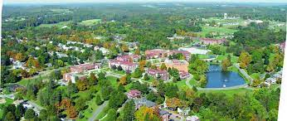
Muskingum University in 1988

Slide 4
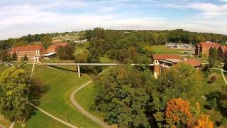

Slide 5
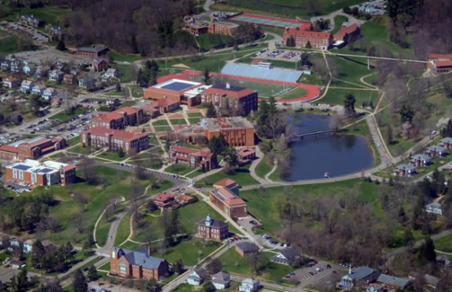

Slide 6
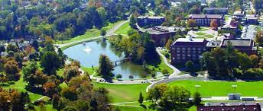

Slide 7
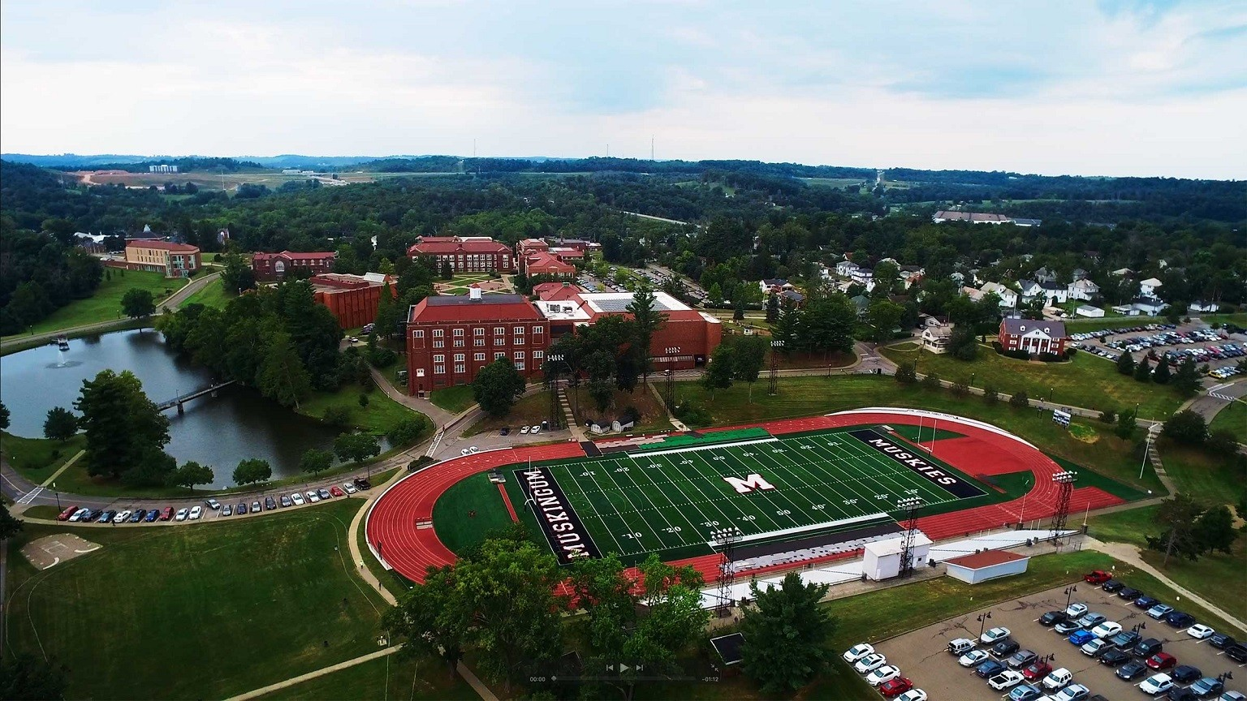

Slide 8
History of Muskingum University
Established since 1837 (was called Muskingum College before 2009)
1,300 + Traditional Undergraduate Students
1,400 + Graduate Students
500 + Continuing Education Students
300 + Muskingum Adult Program (MAP) Students

Slide 9
Affiliation / Accreditation
Affiliated with the Presbyterian Church, USA
Accredited/Approved by:
Higher Learning Commission on Colleges and Schools (HLC)
Ohio Board of Regents (OBR)
Council for the Accreditation of Educator Preparation (CAEP)
Commission on Collegiate Nursing Education (CCNE)
Ohio Board of Nursing (OBN)
National Association of Schools of Music (NASM)
American Chemical Society (ACS)
Accreditation Board of Engineering and Technology (ABET)
Commission on Accreditation of Athletic Training Education (CAATE).

Slide 10
Fun Facts:
Named #8 Best Value in midwestern regional universities by U.S. News & World Report in its 2019 Best College’s Guide
In our area, a very robust Teacher Education Program especially Special Education-Intervention Specialist Major
Outstanding Nursing Program – recent news:
Ranked #1 in the State of Ohio from registerednursing.org
Ranked tied #1 in country out of 932 BSN programs from RNCareers.org

Slide 11
Muskingum Alumni who have changed the world:
Agnes Moorehead, Class of 1923 Emmy-winning actress from TV show Bewitched
Philip Caldwell, Class of 1940 Former CEO of and Chairman of the Board of Ford Motor Company
Annie Castor Glenn, Class of 1942 Wife of John Glenn, advocate for children, elderly and persons with disabilities
John H. Glenn, Class of 1943 Astronaut, U.S. Senator
Jack Hanna, Class of 1969 Well-known naturalist/adventurer, TV personality, Director (emeritus) of Columbus Zoo and Aquarium
Jacqueline Dudek Woods, Class of 1969 First woman president of a major public utility company, Ameritech Ohio
Nikhil Deogun, Class of 1991 Senior Vice President and Editor-in-Chief, Business News, CNBC

Slide 12
Approximately 67 Academic Majors including Teacher Licensure in 21 areas
Muskingum Adult Program (MAP) offers 18 Academic Majors; & also Certificates
Accounting, Accounting (Public), Accounting Certificates
Business Management, Human Resource Management, Marketing, Information Systems
Criminal Justice, Child & Family Studies, Communication
Early Childhood Education, Special Education: Intervention Specialist
Community Health & Wellness, Health Science, Healthcare Management, Medical Laboratory Studies, Occupational Science, Sport and Fitness Science
Nursing (RN to BSN)

Slide 13
Routes to Complete Bachelor’s Degree:
Traditional Undergraduate Program
Coursework offered on campus where students attend classes Monday through Friday during the daytime hours
Muskingum Adult Program (MAP)
Housed in the Graduate & Continuing Studies Department
Developed to meet regional workforce needs.
The adults are non-traditional students
Created to support adults returning to college to complete bachelor’s degrees
Majority of coursework offered Online except for some EDUC education courses that meet one evening a week during a ten week term from 5:30-9:15 p.m.
Few courses offered in Blending Learning Format (meeting on campus and online)
Even if only one student registers for a course, we will still make it run as we won’t cancel a course with an enrollment
Provides flexibility – start in any term and choose the pace (part-time or full-time) that you want to complete bachelor’s degree
The online format was a key element in the design of MAP, as it enables non-traditional adult students to continue to gain valuable experience working in their chosen profession while also pursuing opportunities and advancement in their career through completion of a four-year degree.

Slide 14
Challenges Muskingum University faces:
Serving the region in east central and southeastern Ohio composed largely of Appalachian counties, this population has a low level of educational attainment and is economically disadvantaged
Lower income families
Many first-generation students
Access to technology and internet capabilities
Financial matters
Childcare issues – single parenting
Impact of COVID-19 and the uncertainty of the pandemic

Slide 15
Covid-19 and Spring 2020….
Senior administration, faculty and staff cultivated openness within our campus community and acted quickly on implementing new models of teaching formats and scheduling to meet the needs of students as well as the needs of our campus community as a whole.
Traditional UG looked at MAP as an example of how we already were offering online courses
Faculty cooperated and connected with campus resources including our CNS computer department (which provided quick tutoring and training sessions) with the logistics of setting up their classroom online and quickly moving into an online teaching format
For the last two months (mid March – mid May) of Spring Semester 2020 (mid March through mid May), the daytime on campus courses moved fully online
All MAP courses went online including EDUC education courses.

Slide 16
Spring 2020 -Data Analysis completed on Muskingum Univ.
Funded by the Bill & Melinda Gates Foundation that we received through the C2C Grant in the state of Ohio
Identified that since Fall 2012 to Spring 2019, there were 1,100 students between the ages of 19-45 who were identified as stopped-out students who never completed a bachelor’s degree. (This includes both the traditional UG and MAP students.)
Furthermore, it was identified that 167 of these stopped-out students are “near completers” who have completed 90 semester hours or more of college credits (Senior student status) towards a bachelor’s degree.

Slide 17
Covid-19 and Summer 2020
Senior administration, faculty and staff continue to
form committees (including both traditional UG and MAP faculty and staff)
work feverishly and cooperatively
brainstorm with creative scheduling and prepare for whatever Fall 2020 would bring our way

Slide 18
2020-2021 Creative Scheduling
Summer offerings – May Term and More Session, and MAP Summer Term
Traditional UG Program offers accelerated courses in one month, online format during the month of May; as well as offers a 10 Week “and More” Session (which the courses are actually cross listed with the MAP’s Summer Term online courses.
MAP Summer Term – offering online courses in a 10 Week format, and accelerated courses offered in an Early 5 Week Session, a Late 5 Week Session, and One-Week Summer Seminar format.
Fall Semester -
Omitted Fall break – Traditional UG & MAP students finished the semester/term before Thanksgiving, knowing that those students could go home and stay home after the Thanksgiving holiday instead of returning to campus for a couple weeks to typically finish around the second week of December.
Instead of a break – provided students with a couple “Reading Days” where they are basically given “days off” from attending on campus classes but can use this time according to their educational needs.
Spring Semester –
Omitted Spring break – started a week later in January on the 17th to still finish first week of May
Instead of a break – provided students with a couple “Reading Days”

Slide 19
Covid-19 and since Fall 2020
Traditional UG classes returned to campus
Practice social distancing and wearing masks
Students along with all of the campus community completed daily Self-Health Assessment on their Muskie Safe App on smart phones or computers
Very low cases of Covid-19 on campus
Created hybrid class formats offering on campus and online (recorded lectures) to those students in need or in quarantined
Allowing traditional UG students greater flexibility of being permitted to take online MAP courses, for example those choosing to live or be quarantined at home; as well as for our foreign exchange students living abroad at home such as in China
All MAP courses remained online except for a couple EDUC courses

Slide 20
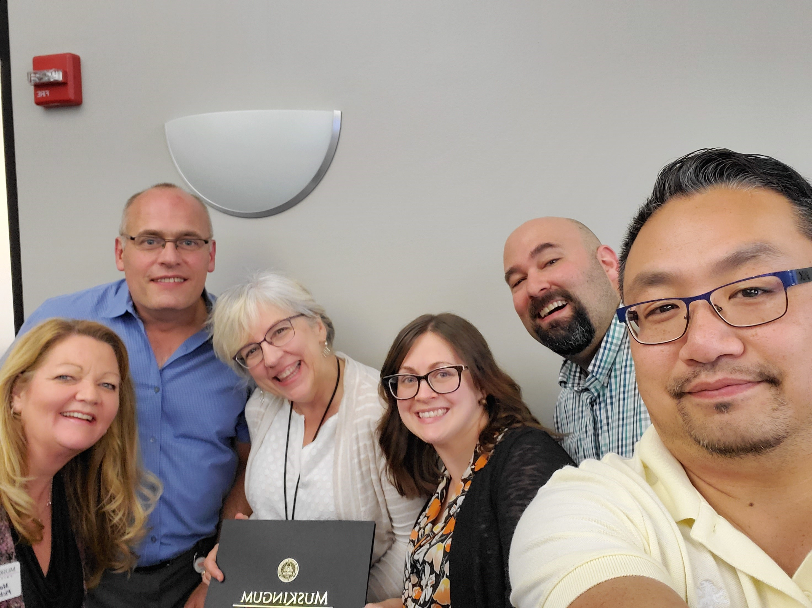
Focusing on the Muskingum Adult Program (MAP) – helping non-traditional adults complete their degree and/or certificate

Slide 21
Strategies to Recruit and Retain MAP Students - Advising:
Provide personal customer service on advising adults from start to finish/completion
Designed a “One-Stop Shop” for advising
There is an individual advisor for nursing, allied health majors, and all other MAP majors
The advisor works with a student from recruitment, admissions, advising, and completion of bachelor’s degree
Advisor supports the student from the beginning of their time at Muskingum and all the way through to graduation

Slide 22
Strategies to Recruit and Retain MAP Students (Cont.):
Credit Transfer from other regionally accredited institutions
Generous
Use Transfer Module (based off of Ohio Board of Regents Transfer Module)
Experiential Learning Credits
Create a portfolio through the Experiential Learning Workshop to earn credit from life experiences such as through work, trainings, and volunteering
Credits from BSN Nursing Program
Create a portfolio to earn up to 18 semester hours based on experience, certifications, and being active in nursing organizations
Military Credits
Transfer military credits through submission of Joint Services Transcript

Slide 23
Strategies – Resources for New MAP Students
“Helpful Information Guide” for New Students
Student ID #, UserName, and Temporary Password
Webmail
MuskieLink
Blackboard & Blackboard Tutorial
Purchasing Textbooks
MAP Guidebook

Slide 24
Strategies – Additional Resources for MAP Students:
For each office/services below, provide students with a faculty/staff’s contact Information such as name & email, and provide a link to website
Bookstore – purchasing text books
Computer and Network Services – assigns username, assists in changing passwords, and with other computer/internet related issues
Disability Education Office – helps students with any disability matters
Career Services – assist w/ resume preparation, job searching, interviewing, and etc. to help prepare students for their future
Library – set up a Zoom training meeting to assist in utilizing and researching library materials
Virtual Writing Center – meeting through Teams with a tutor & tutoring hours
Business Office – arranging payment plans, and military benefits
Financial Aid Office – setting up financial aid and inquiring about scholarship opportunities

Slide 25
Strategies - Affordability:
Financial assistance and scholarship opportunities for students
70% of our adult students completing a bachelor’s degree are receiving some kind of aid in 2020-2021 (200 + students); for example:
131 students received Federal Student Loans – FAFSA
74 - Pell Grant
2 - Federal TEACH Grant
45 - Ohio College Opportunity Grant (OCOG)
25 - Choose Ohio First Scholarship (COFS) – STEMM majors such as sciences, technology, and math
(TBD) - Career to Cradle Grant (C2C) - Debt relief assistance
Financial Aid for MAP Students
Part-time student status
Full-time student status

Slide 26
Strategies through Marketing:
Created a name and a website called “Finish Now!”
https://www.muskingum.edu/gcs/FinishNow
Developed Postcards, Flyers, and Brochures (hard and electronic copies)
Made YouTube Videos –clips (stopped out students, alumni, and advisors)
Stopped Out Students – “Life Got in the Way” - https://youtu.be/n3PqH5kook0
Students (alumni) – “College Navigation Help” - https://youtu.be/-LcCwQliLiQ
Advisors – “It’s Easy to Come Back” - https://youtu.be/u8K9T_a-r58
Post on social media: Instagram, Facebook, LinkedIn

Slide 27
Strategies through Communicating and Outreach to Students:
Mass email messages (for example - sent to targeted groups of students such as to the 1,100 stopped out students)
Personalized/Tailored email messages (for example - sent to specific groups of students such as to the 167 near completers from the stopped out group of students)
Text messages (created Google Voice account)
Phone calls
Zoom Meetings
Face-to-Face Meetings (practicing social distancing and wearing masks)

Slide 28
Additional Strategies to Recruit and Retain Students:
Reach out to 2-Yr. Colleges, for example to our nearby Zane State College
Developed institutional and program specific Articulation Agreements
Build relationships with program directors
Speak in classrooms (to both first year and second year students)
Participate in college transfer fairs
Arrange group visitations – intro/welcome time discussing transfer credits into MU; meet faculty member, meet transfer student, Q & A time, and tour MU
Host virtual meetings and events such as a virtual transfer fair through Zoom
Reach out to Businesses
Work through the Chamber of Commerce
Local areas of Cambridge and Zanesville
Connect with Human Resource Management Directors
Establish partnerships with businesses:
VSP Vision Care in Columbus, Ohio
Nationwide Insurance in Columbus, Ohio
Worthington School District in Worthington, Ohio (Columbus Area)

Slide 29
Newest Initative in Strategies to Recruit and Retain Students:
Debt Relief Assistance (C2C Grant Funded)
Focusing on the 167 near completers of the 1,100 stopped-out students since Fall 2012, it was identified that 52 students had debt.
Currently reaching out to 23 students, who meet the set criteria, to provide the opportunity to receive debt relief assistance.
Criteria: Good academic standing min. GPA of 2.0; 15 sem. hrs. or less to graduate; didn’t withdraw from MU; owe less than $10,000; stopped out for min. 1 year
Application Process: submit Application for Admission Form, submit FAFSA form, and submit brief statement of previous MU experience and explain how they plan to reach their goal to obtain a bachelor’s degree
Distribution of Funds: Conference with counselors- academic, financial aid, and business office to arrange curriculum plan and arrange a payment plan; register for course(s) and grade and complete with grade of C or higher
If debt is above $700, then the student receives $700 plus 7% of their remaining balance; if debt is $700 or less, then student receives up to $700
The money from grant fund to be used towards tuition; late fees that are non-tuition cost related would be forgiven by the Business Office
Student recipients who are successful with grade of C or higher and re-register for following semester may be eligible for additional % of debt relief funding contingent upon available funds

Slide 30
Success in Helping Adults Complete Degrees:
Increase collaboration and cooperation among Senior administration, faculty, staff, and students
Increase creativity with course offering formats and scheduling to help with busy adult lifestyles
Increase resources and usage of technology/social media through Zoom/Teams Meetings and Events; Blackboard format for online courses; Instagram, Facebook, and LinkedIn
Increase building relationships and articulation agreements with other colleges and program directors
Increase in developing connections with local and regional businesses to aid in the work force needs of the employers to upskill employees through certificates and/or degrees
Increase in making connections on State and National levels
#1 Success Story – Non-Traditional Adult Students Graduating with Bachelor’s Degree
Almost 600 MAP students completed a bachelor’s degree since Fall 2012, with approximately 350 MAP students graduating within the past 5 years (not including 2020-2021 academic year).

Slide 31
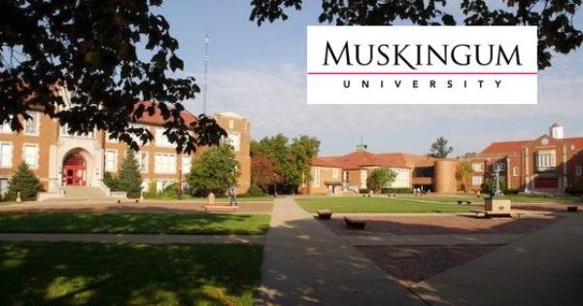
Thank you for your time! Presentation by Marjorie Pickworth Director of Muskingum Adult Program (MAP) mpickwor@muskingum.edu

