Slide 1
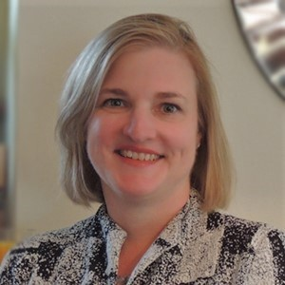
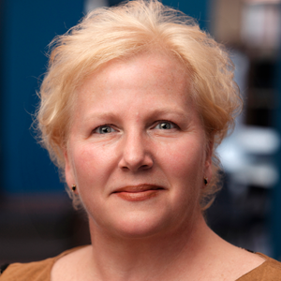
Bachelor’s In Professional Studies Concept
Allyson Lowe, Ph.D., Vice President for Academic Affairs Email: lowea@trocaire.edu Phone: 716-827-2471
Linda Kerwin, Ed.D., Dean of Allied Health and Professions Email: kerwinl@trocaire.edu Phone: 716-827-2454

Slide 2
Fast Facts about Trocaire College
Private, career-oriented, opportunity-driven, Catholic college founded in the Mercy tradition.
We strive to meet the community’s “next great need”
Offers 12 associate degrees, 3 (soon to be 6) bachelor's degrees, and 8 certificate programs in healthcare, business and technology
Programs prepare graduates for high-demand fields using flexible transfer pathways to meet student need for cost-competitive, convenient, and clear completion plan
Current enrollment is approximately 1,300 students

Slide 3
What is the BPS concept?
Bachelor’s in Professional Studies is one of the approved bachelor’s degree types in NYS and different from the BA/BS in that it features:
30 credits of professional competency
30 credits of general education
30-60 credits of electives focused around the major link career focus with professional competency and skills (a good place to use transfer and prior learning credit!)

Slide 4
Audiences and Areas
Who takes the BPS?
How does it work?
Working professions, including alumni returning, seeking career advancement and up-credential to bachelor’s
Military veterans
Transfer students seeking degree completion and use of existing credits
Designed for working adults: 7 week online format
Flexible course load
Skills and Experience Focus: Content focus + Leadership, Teamwork, Problem Solving, Communication, Externship

Slide 5
BPS Examples
BPS Healthcare Management
What’s Next? BPS degrees in . . .
Regional need for healthcare managers and more bachelor’s prepared employees
Captures certificate and associate’s graduates ready to “up credential” for promotions at work or new career paths. (e.g., allied health professions and nursing career changers)
BLS: +18% job growth with a median annual salary of $99,730
Management (shares a core with HCM; appeals to AAS community college credit holders)
Medical Imaging (radiologic technology core and specialization in one of three categories)
RT Generalist
Diagnostic Medical Sonography
Echocardiography
Biology (capture science interest and nursing off-ramp)

Slide 6
Questions?

