Slide 1
Guilford College
Wiser Justice Program
Since 2014

Slide 2
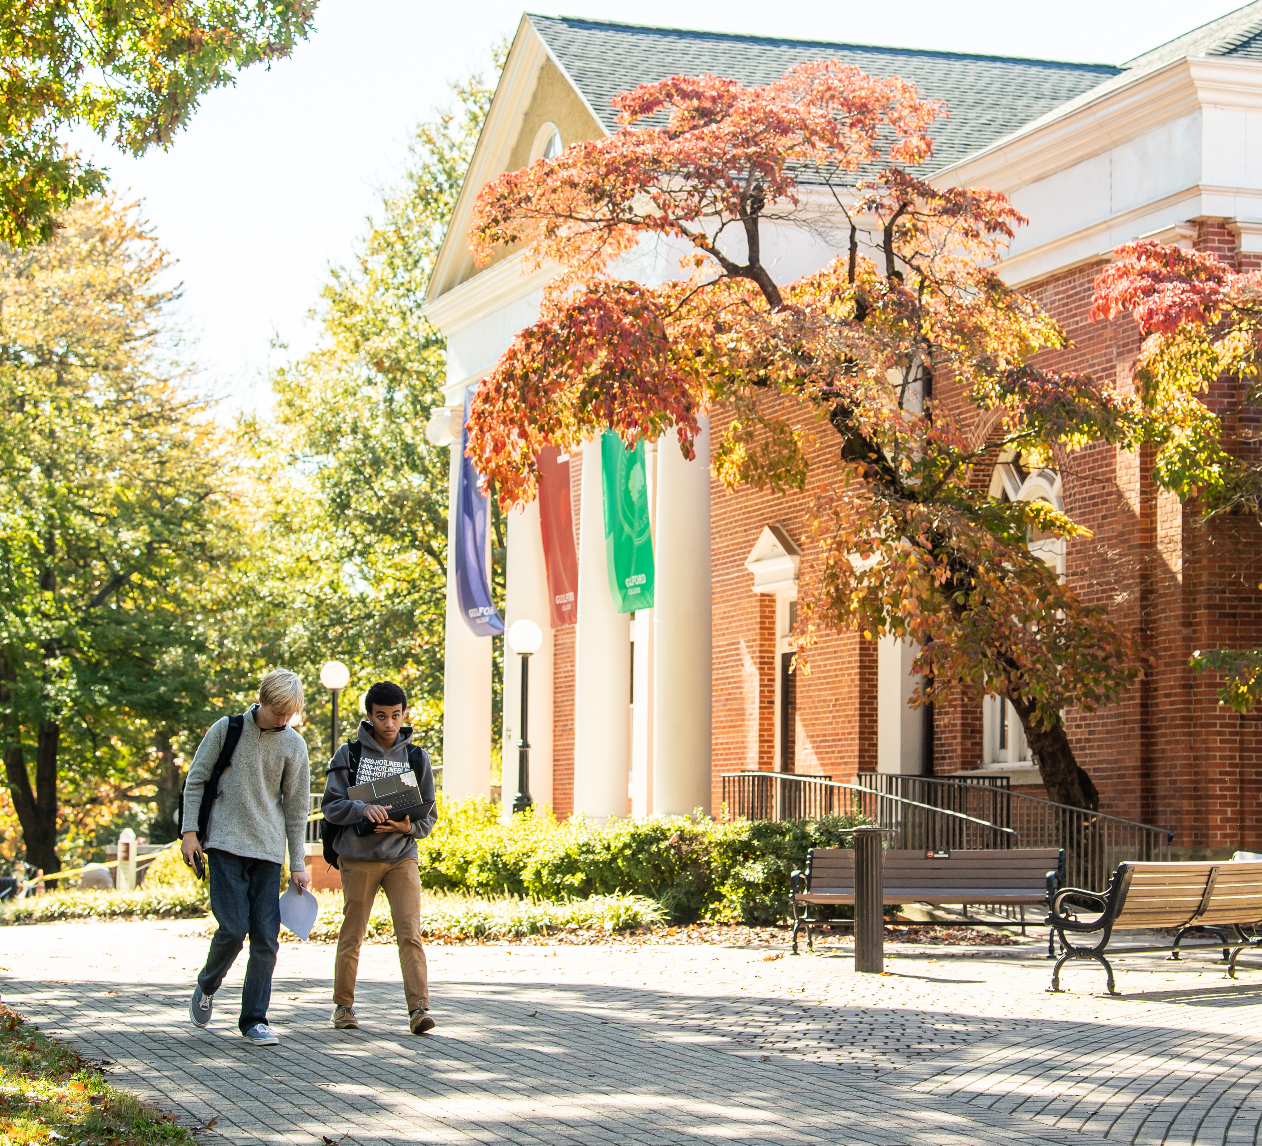
About Guilford College
Guilford College is a private liberal arts college in Greensboro, NC
1776 Students – diverse student body that includes adult and Early College and Wiser Justice Program students, which gives individuals a chance to earn college credit while incarcerated
40% students of color
Students from 38 states and 16 countries
41 Majors, 52 Minors, 1 Graduate Program
Included in Colleges that Change Lives for more than 20 years

Slide 3

Wiser Justice

Slide 4
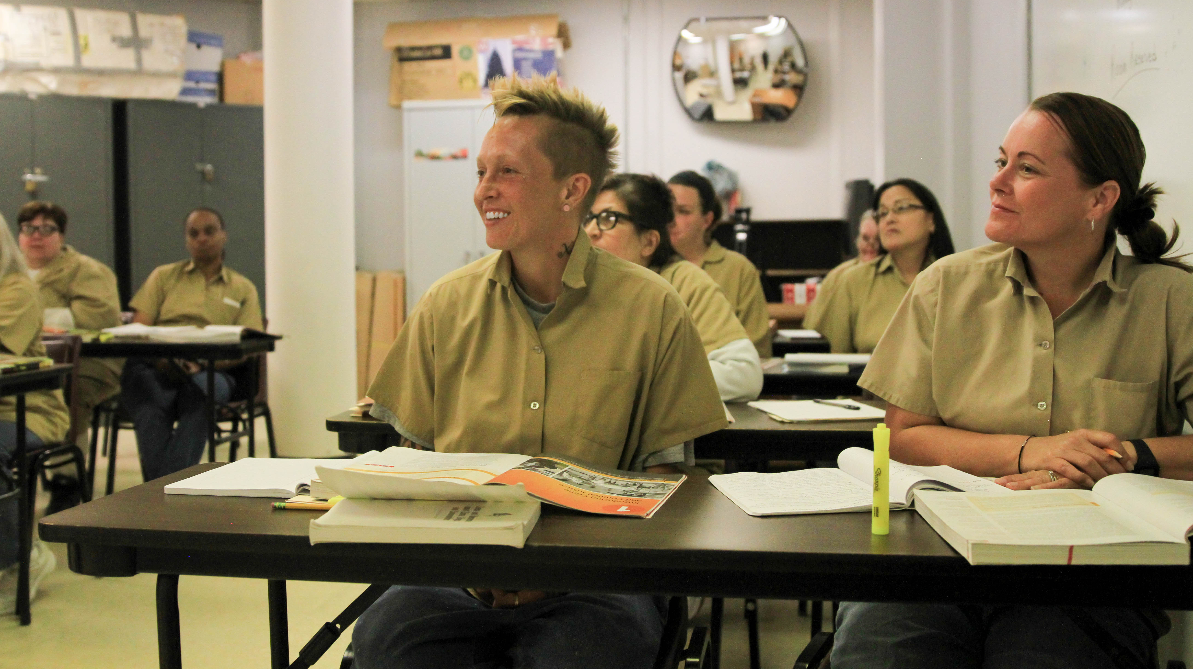
Wiser Justice Program
Formerly known as the Higher Education in Prison Program
Guilford offers liberal arts courses in three correctional facilities in NC
Piedmont – Medium Custody (Men)
Anson – Medium Custody (Women)
Dan River – Minimum Custody (Men)

Slide 5
Smarter Justice
How it’s done
Our best instructors
5 semester program
30 college credits - Transferable
LEED and PSSP Certifications!!
Popular disciplines
Current information

Slide 6
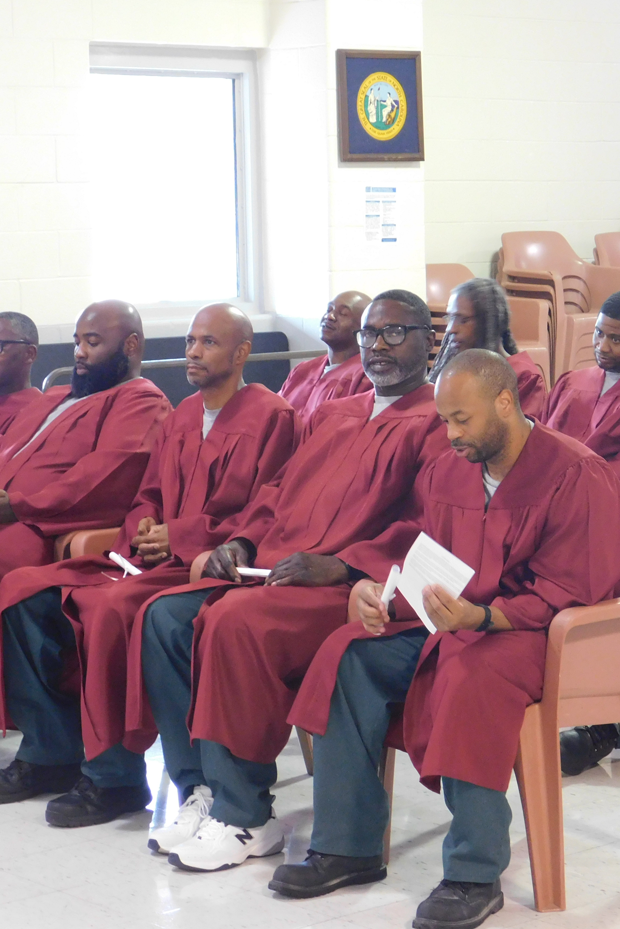
Fulfilling Our Mission of Justice one day at a time
Tools necessary to successfully re-enter society
We believe all individuals deserve the chance to restore their lives and discover new possibilities
Currently 60 students
Served 100+ students
60+ graduates
Vision – Signature AAS

Slide 7

Thank You!
Questions

