Slide 1


Degrees When Due
Helping Students with Some College,
No Degree Across the Finish Line
Leanne Davis
Associate Director of Research and Policy, IHEP

Slide 2
Degrees When Due is a national initiative to increase degree attainment among the “some college, no degree” population.

Slide 3
DWD: Participating Campuses
23
States and
Systems
190+
COHORT 1
Participating
Campuses
COHORT 1 & 2
59
COHORT 2
COHORT 1 , 2, & 3
Minority Serving Institutions (MSIs)
COHORT 3
COHORT 2 & 3

Slide 4
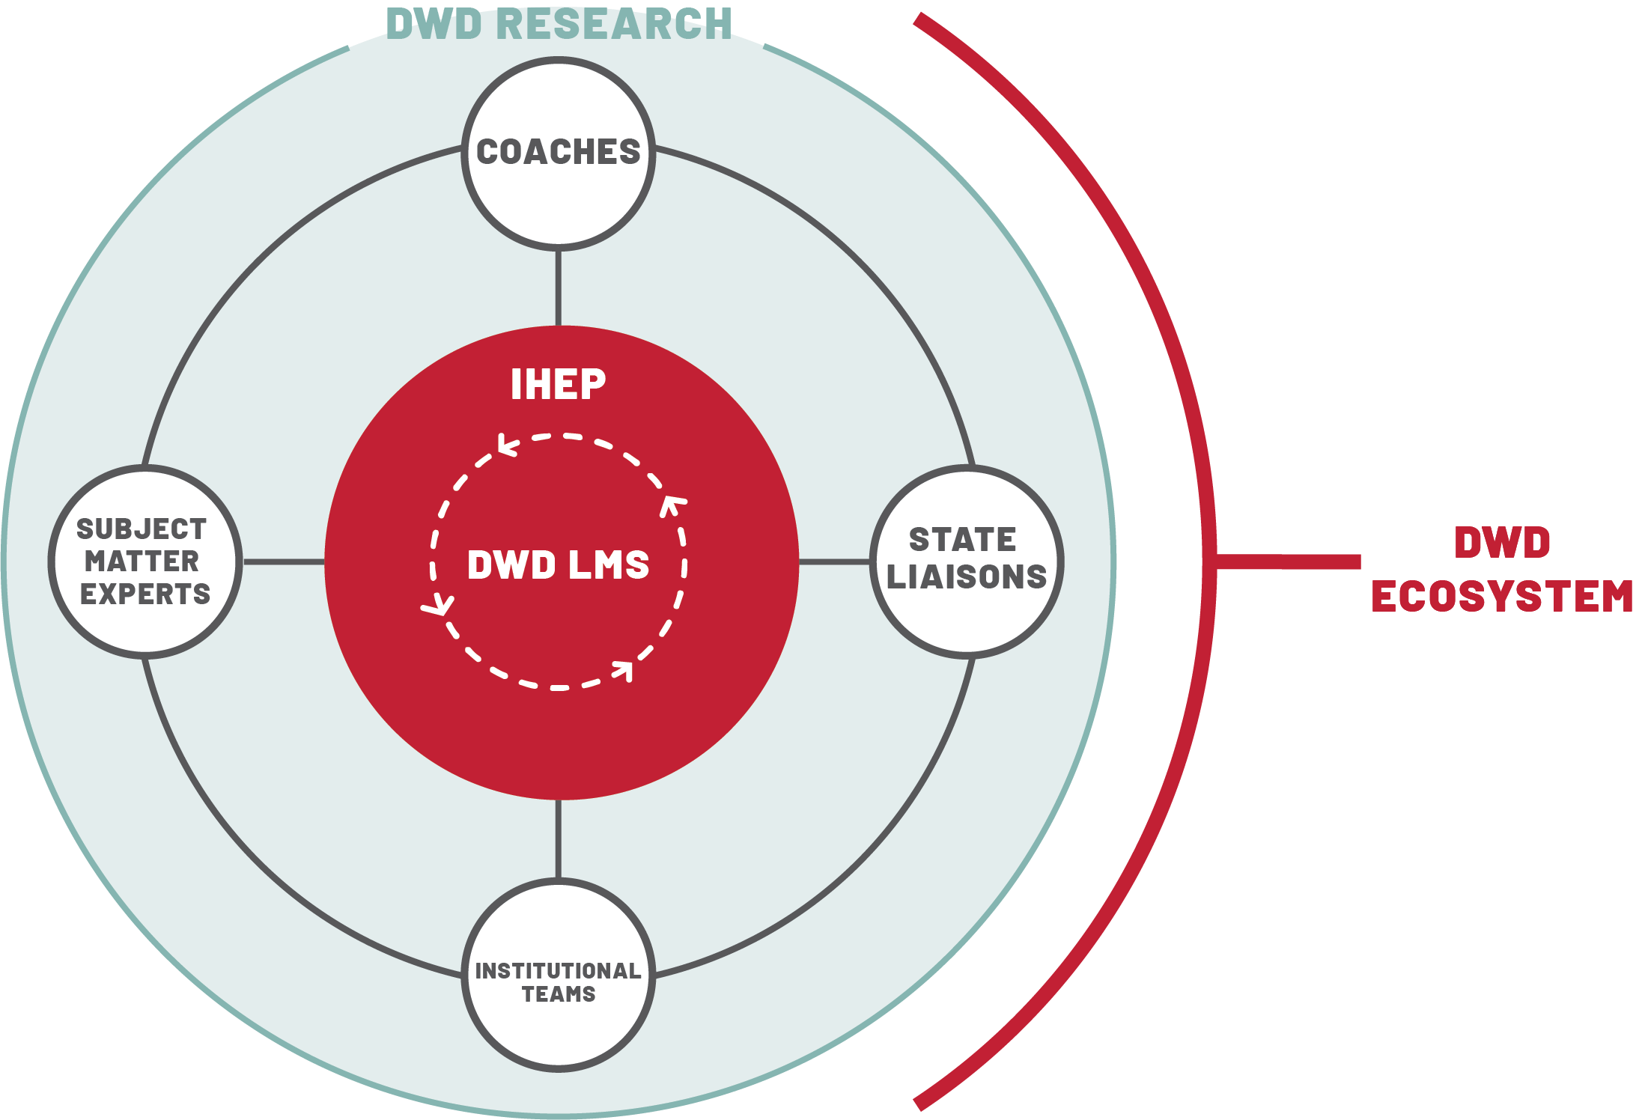

Slide 5


Slide 6
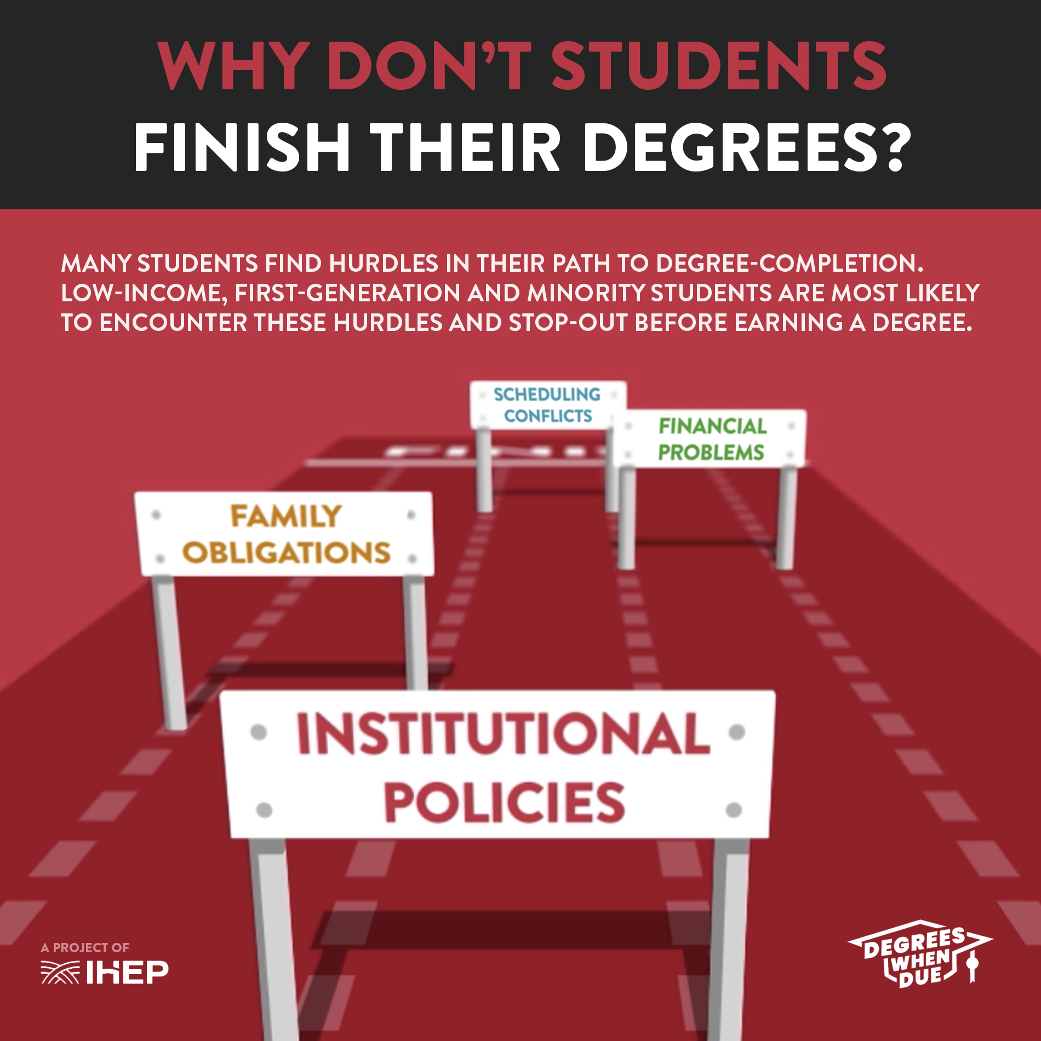
Barriers to Completion

Slide 7
Communication – What Works?
Be persistent
Use multiple channels
Personalize the message (use your data!)
Provide clear steps or a call to action

Slide 8
Thank you!
Leanne Davis
ldavis@ihep.org
@leannemdavis

