Slide 1

Finishing Strong: Online Teaching Tips for Supporting Low-Income Students' Success Friday, April 3, 2020 at 12:00 pm Eastern

Slide 2
Bluefield College - Dr. Pat Neely, Dean of Online & Distance Ed
Expect Computer & Internet Access Issues
Free internet may be available through local internet providers
Students can download phone apps to complete assignments
Assignments
Keep instructions simple and avoid academic speak
Offer options, i.e. paper or presentation, annotated bibliography or infographic, etc.
Avoid email submissions of work
Avoid shorter time limits
Flexible due dates
Consistency is important
Assignment due dates on the same day of the week
Face-to-face meetings on regular schedule
Communicate often
Weekly emails
Post weekly emails in announcements in LMS
Set up a discussion thread where students can discuss how they are doing
Make no assumptions about students’ technology skills
Contact Information: pneely@bluefield.edu or 276.971.1282

Slide 3
Mount Saint Mary’s University Los Angeles
Dr. Michele Starkey Associate Provost & Accreditation Liaison Officer
· Catholic university in Los Angeles, CA
· Liberal Arts institution
· Primarily for women (coed graduate and adult programs)
· 62% Pell Eligible
· 56% Latina, 13% Asian, 11% White, 7% African-American
· Founded in 1925 by the Sisters of Saint Joseph of Carondelet
· Two campuses
· Around 3,000 total students
· 8 associate degree programs, 32 bachelor degree programs, 16 graduate degree programs
Edgar Chabolla Director, Instructional Design
Tips for supporting students in virtual/online education
Establish an instruction plan and set goals and objectives
Get to know your audience and set clear expectations
Understanding virtual nods and smiles (don’t worry, it will make sense later)

Slide 4
Mount Saint Mary’s University Los Angeles
Establish an instruction plan and set goals and objectives
Start with what you know (rely on your experience)
Start with your syllabus
Learning goals and objectives
Reading materials
Assignments
Schedule
Backwards design
Getting current content to fit different delivery models
Instructional Plan
Single contained units
Promote engagement (Faculty - student, content - student, and student -student)
Sample Learning Unit
Introduction Guide (Agenda)
Goals and Objectives
Lecture material (PPT, Videos, Articles)
Activities (Think, pair, share)
Discussion (group work)
Assessment (presentations, reflections, quizzes)

Slide 5
Mount Saint Mary’s University Los Angeles
Getting to know your audience
Rely on experience - How do you currently engage with your students? Do you establish clear guidelines for communication? How often do you provide feedback?
Unknowns
Students access to technology
At home learning environment
Experience in learning remote/online
Tips for success
Continue your communication guidelines or integrate guidelines that are frequent and consistent.
Classroom guidelines are often familiar to instructors and students. In a remote and online format, they need to be written. Set etiquette guidelines for participation and communication
Do not wait for class time to engage. Mitigate the unknowns by communicating early and often. Make guidelines and expectations clear so that students can identify and share any potential issues.

Slide 6
Mount Saint Mary’s University Los Angeles
Understanding virtual nods and smiles
In face to face instruction we often assess our audience with visual cues. Nods and smiles indicate understanding while confused looks or lack of engagement may indicate cognitive overload.
Common strategies, stop and ask questions to understand what is confusing students. We can also have planned activities for students to apply what they learned, for example, think, pair, share.
In a virtual environment
Being proactive is key.
Develop low stakes activities such as learning checks, case scenarios, matching questions, short answers, and fill in the blanks.
Based on experience, integrate these activities as part of your virtual or online lecture.
Best if not graded but provide as participation points.
Use and reference the information collected with your students. It reinforces a sense of community among the classroom.

Slide 7
Ferrum College--Dr. Sandra Via
Converting Assignments from F2F to Online Instruction:
Keep it simple for now
Don’t try to learn an entirely new application or software
Examples
Providing Feedback
Students need quick and frequent feedback
Time management when grading
Resources (next slides)
Contact information: svia@ferrum.edu or 276-952-5379

Slide 8
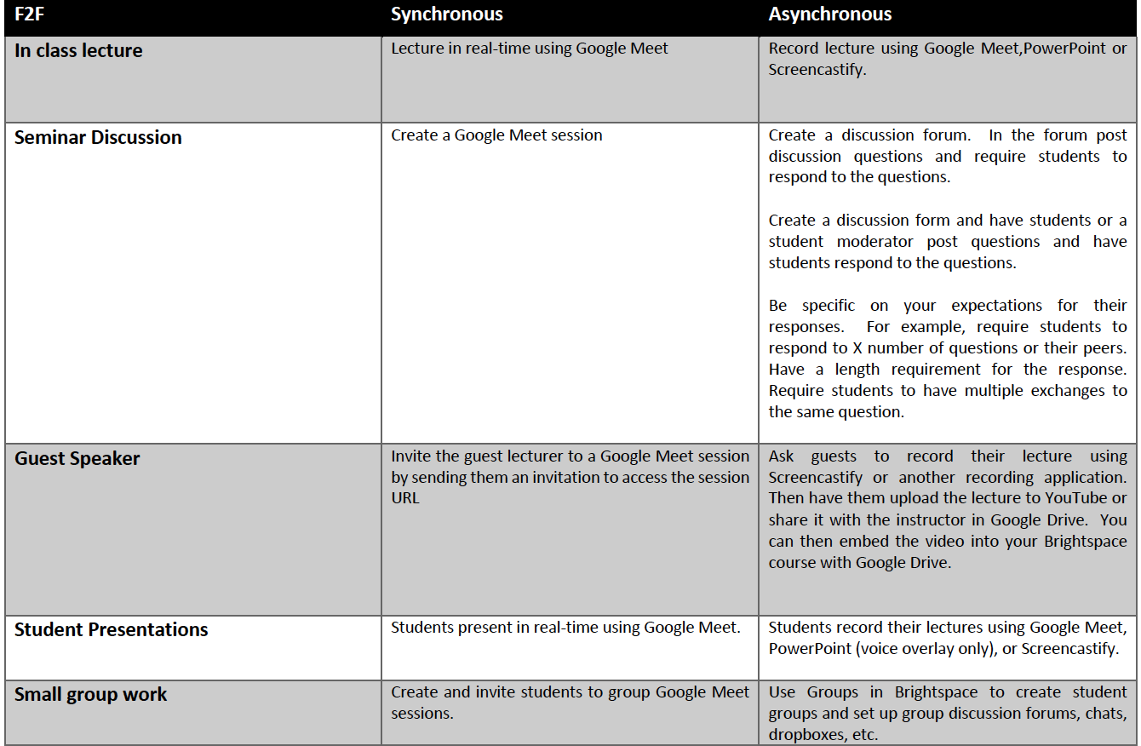
Converting F2F Assignments for Online Delivery

Slide 9
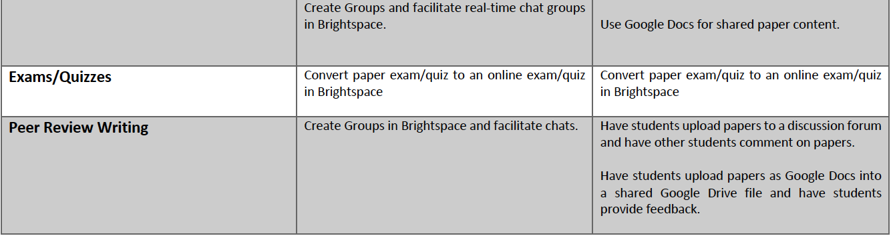

Slide 10
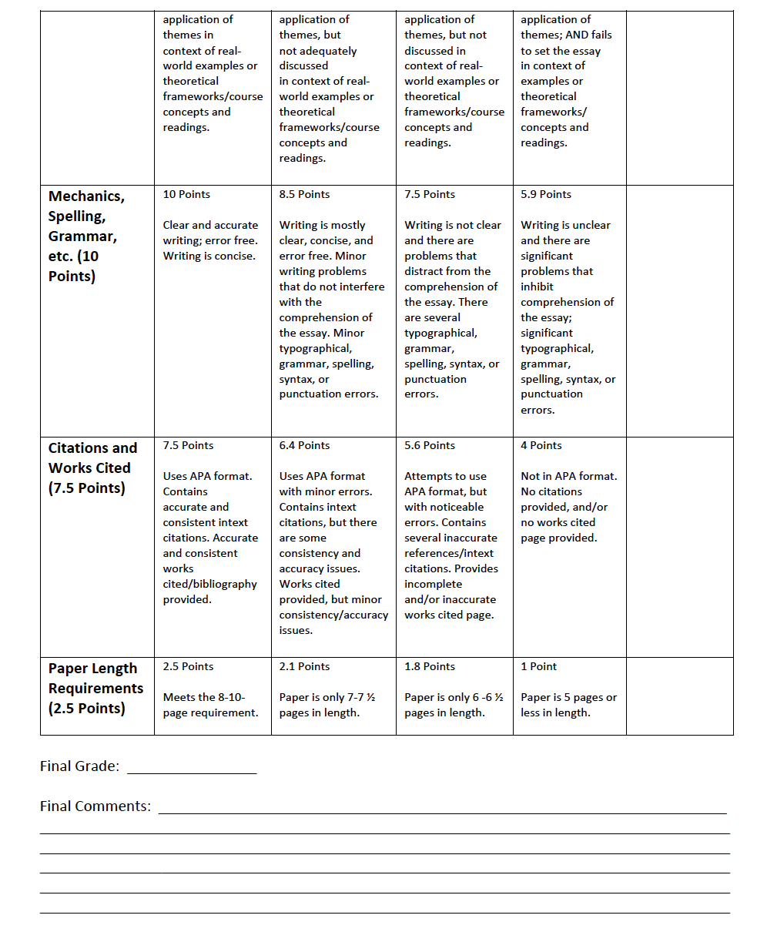
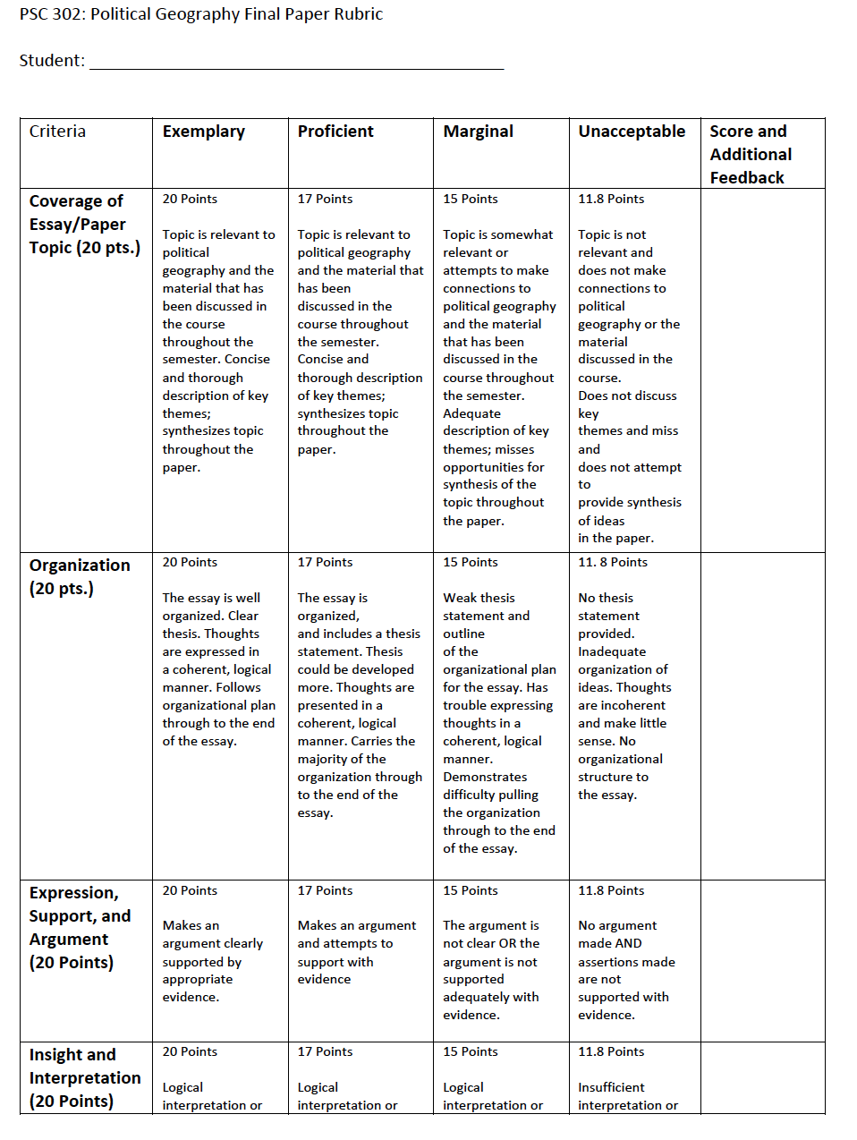
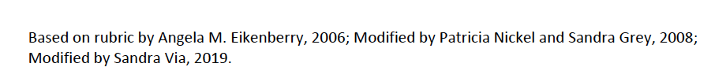
Essay Rubrics

Slide 11
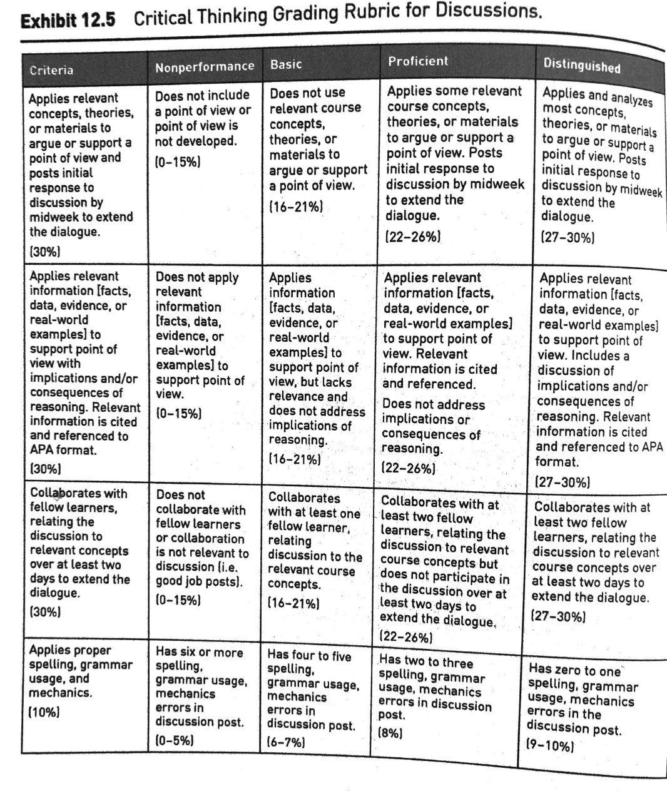
Rubric for Discussion Forums
Stavredes, T. 2011. Effective Online Teaching: Foundations and Strategies for Student Success. Jossey-Bass.

Slide 12
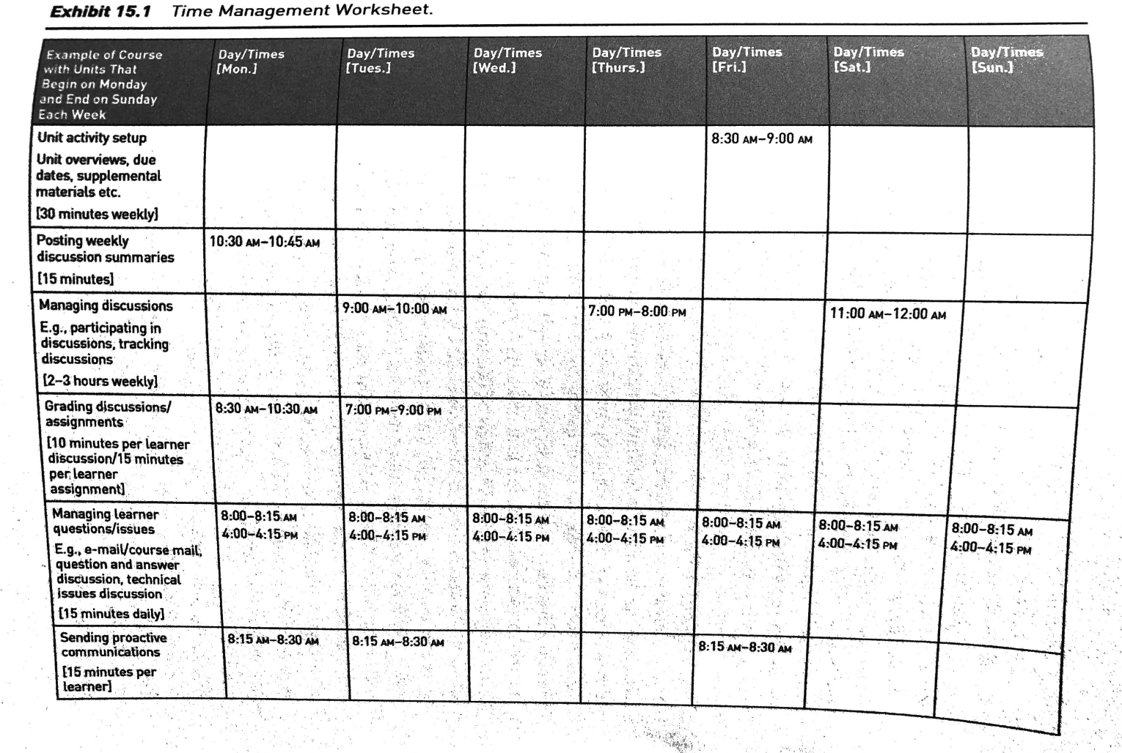
Time Management Schedule
Stavredes, T. 2011. Effective Online Teaching: Foundations and Strategies for Student Success. Jossey-Bass.

