Slide 1
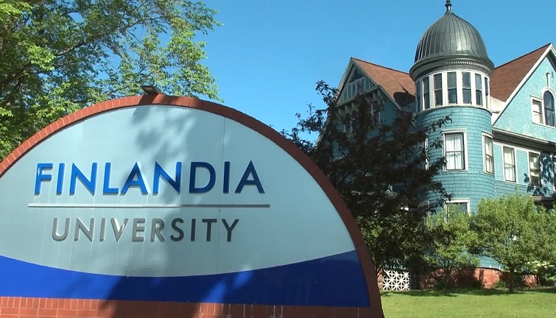
YWM Coalition: Removing Barriers to Enable Degree Completion for Low-Wealth Students – June 2, 2021
Enrollment 403 Residential students 37% Male 55% Female 45%
Pell Eligible 75% Minority Enrollment 21% Graduation rate 27%
Dr. René Johnson Director of Vocation & Servant Leadership/ Assistant Professor of Religion
Emma Dorst Director of Career Services
Notes:
Enrollment has traditionally been closer to 500 (i.e. 2015=528).
30% from our 4 county area.
Degree completion 2020: 68
Interesting: Incoming class 23% female/77% male, but the senior class in fall 2020 was 63% female/37% male.

Slide 2
2020 Indicators of Higher Education Equity in the United States
(Pell Institute for the Study of Opportunity in Higher Education)
26% of low-income/first-generation dependent students complete a 4-yr degree (compared with nearly 70% students who aren't low-income or first-generation)
9% of low-income/independent students complete a 4-yr degree
From 1970 to 2018, almost no progress in the percentage of bachelor's degrees awarded to the richest and poorest dependent students by age 24.
What are some barriers to degree completion for low income students?
Personal barriers
Costs
Work
Food insecurity
Family obligations
Technology access
College readiness
Institutional barriers
Limited options for book access
Inattention to food insecurity
Under-resourced support structures
Minimal attention to low-income,
first-generation in first year experience
Notes:
Personal Barriers & Institutional Barriers addressed by: Awards/scholarships, The Table Student Needs Pantry, TRiO, tutoring, FYE, Justice Library

Slide 3
Craig, Ryan. “The Skills Gap is Actually an Awareness Gap – And It’s Easier to Fix.” Forbes, March 17, 2017.
Markowitz, Troy. “The Barriers to Success and Upward Mobility in First Generation Students and How to Fix the Problem.” Forbes, August 8, 2017.
Opportunity Gap Achievement Gap
Awareness Gap
College awareness
Self-awareness
Employer awareness
Notes:
(Markowitz) The Opportunity Gap pertains to how "race, ethnicity, socioeconomic status, English proficiency, community wealth, familial situations and a myriad of additional factors contribute to or perpetuate lower educational aspirations, achievement, and attainment for particular groups of students."
Achievement Gap involves “any significant and persistent disparity in academic performance or educational attainment between different groups of students. It is the logical, and unfortunately, negative outcome of the systemic and unresolved Opportunity and Awareness Gaps.”
Awareness Gap; Markowitz identifies three primary manifestations of the Awareness Gap: 1) Students enter college lacking awareness of the structures, systems, and jargon of college, 2) students enter college with under-developed self-awareness, or the understanding that mature self-understanding and self-expression is a vital part of the college experience, and 3) students don’t project awareness well – they “don't do a good enough job aligning the myriad of skills they acquire from their coursework and co-curricular activities with the skills that employers seek in entry-level hires.”

Slide 4

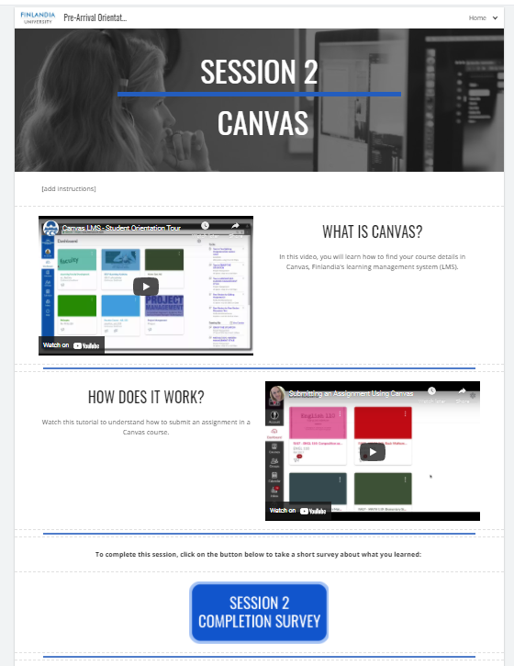
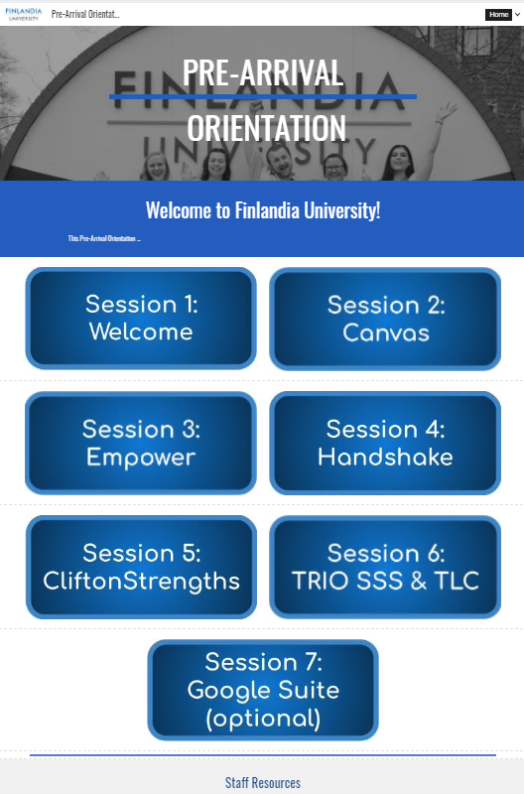
College Awareness:
“First Year Experience”
Building awareness of function and usage of institutional systems:
LMS
SIS
academic support career support
Notes:
Re-structuring of FYE for fall 2021 with the addition of the pre-arrival orientation.

Slide 5
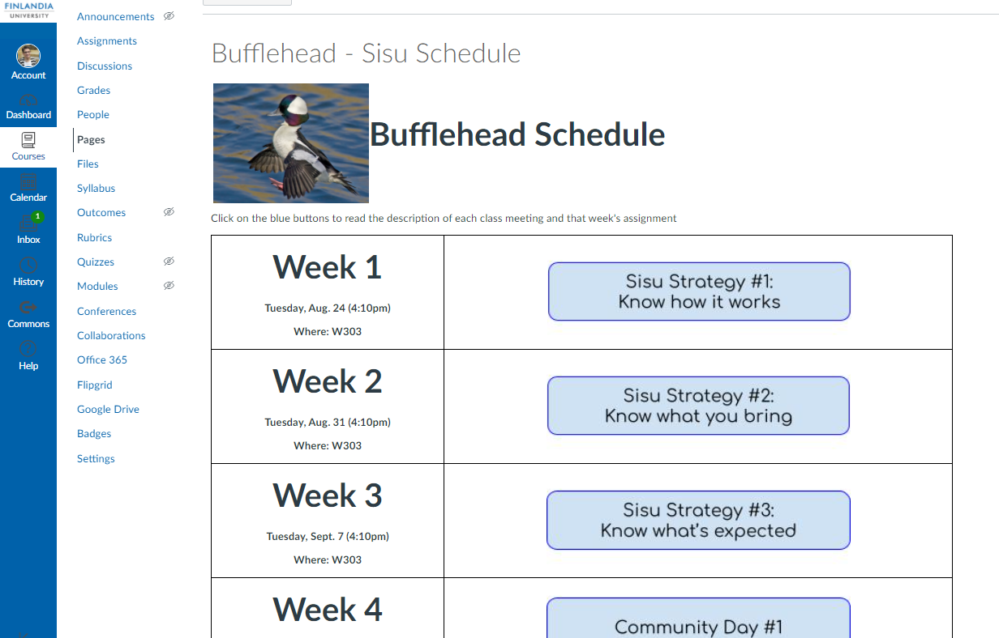
College Awareness:
“First Year Experience”
Creating awareness of academic structure, personal strengths,
& academic responsibility
Notes:
The first three sessions are designed to introduce students to academic jargon, structure, and responsibilities (i.e. communication, academic integrity…)

Slide 6

Self-awareness:
Strengths & Vocation
You have faith in your own capabilities to solve a problem or get a job done. However, what you really enjoy is facilitating a group, getting everyone on board and making sure each person has a part to play that suits them well. You work well with others and can confidently pivot when new ideas surface, whether they come from you or somebody else. You are an advocate for interdependence.
ARRANGER
ADAPTABILITY
IDEATION
INCLUDER
SELF-ASSURANCE
Fostering personal awareness of strengths and their interplay with one’s way of working, thinking, doing relationships, and impacting others

Slide 7
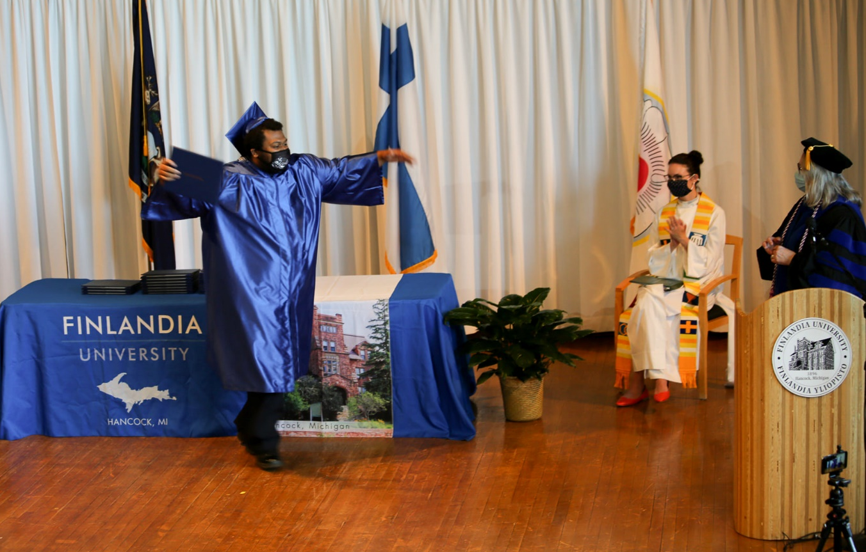
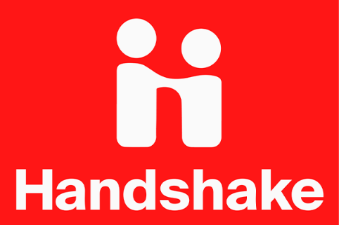
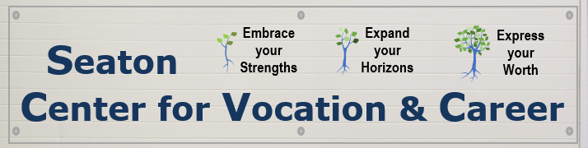
Employer Awareness:
Career courses/counseling
Creative and comprehensive self-expression that instills awareness of one’s worth in the minds of others (i.e. potential employers)
Notes:
(Craig, “The Skills Gap is Actually an Awareness Gap”) this is the inability for college graduates to make employers aware of the skills they actually have. “College graduates’ skills are not visible to employers because while they’re leaving colleges and universities with transcripts and resumes, employers aren’t able to see the skills they’ve developed through coursework and co-curricular activities.”
“Today’s progressive, student-centric institutions of higher learning can measure student learning outcomes (SLOs) -- are students actually demonstrating the outcomes that higher education accreditors require that universities state at the program and course levels? From here, it’s just a short skip to identifying skills and competencies that students demonstrate per program, course or even assignment -- demonstrating to employers that students are career-ready. Imagine a next-generation course catalog showing majors and courses, alongside the skills they should expect to attain and how those skills correspond to specific industries and jobs?”

Slide 8
Accompanying the whole
student toward a whole life

